Slide 1
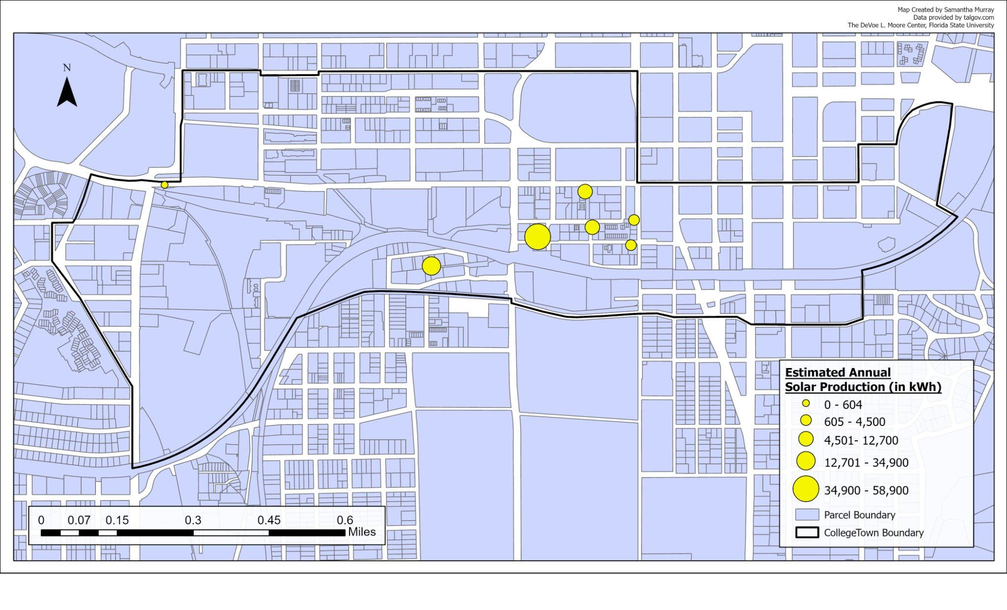
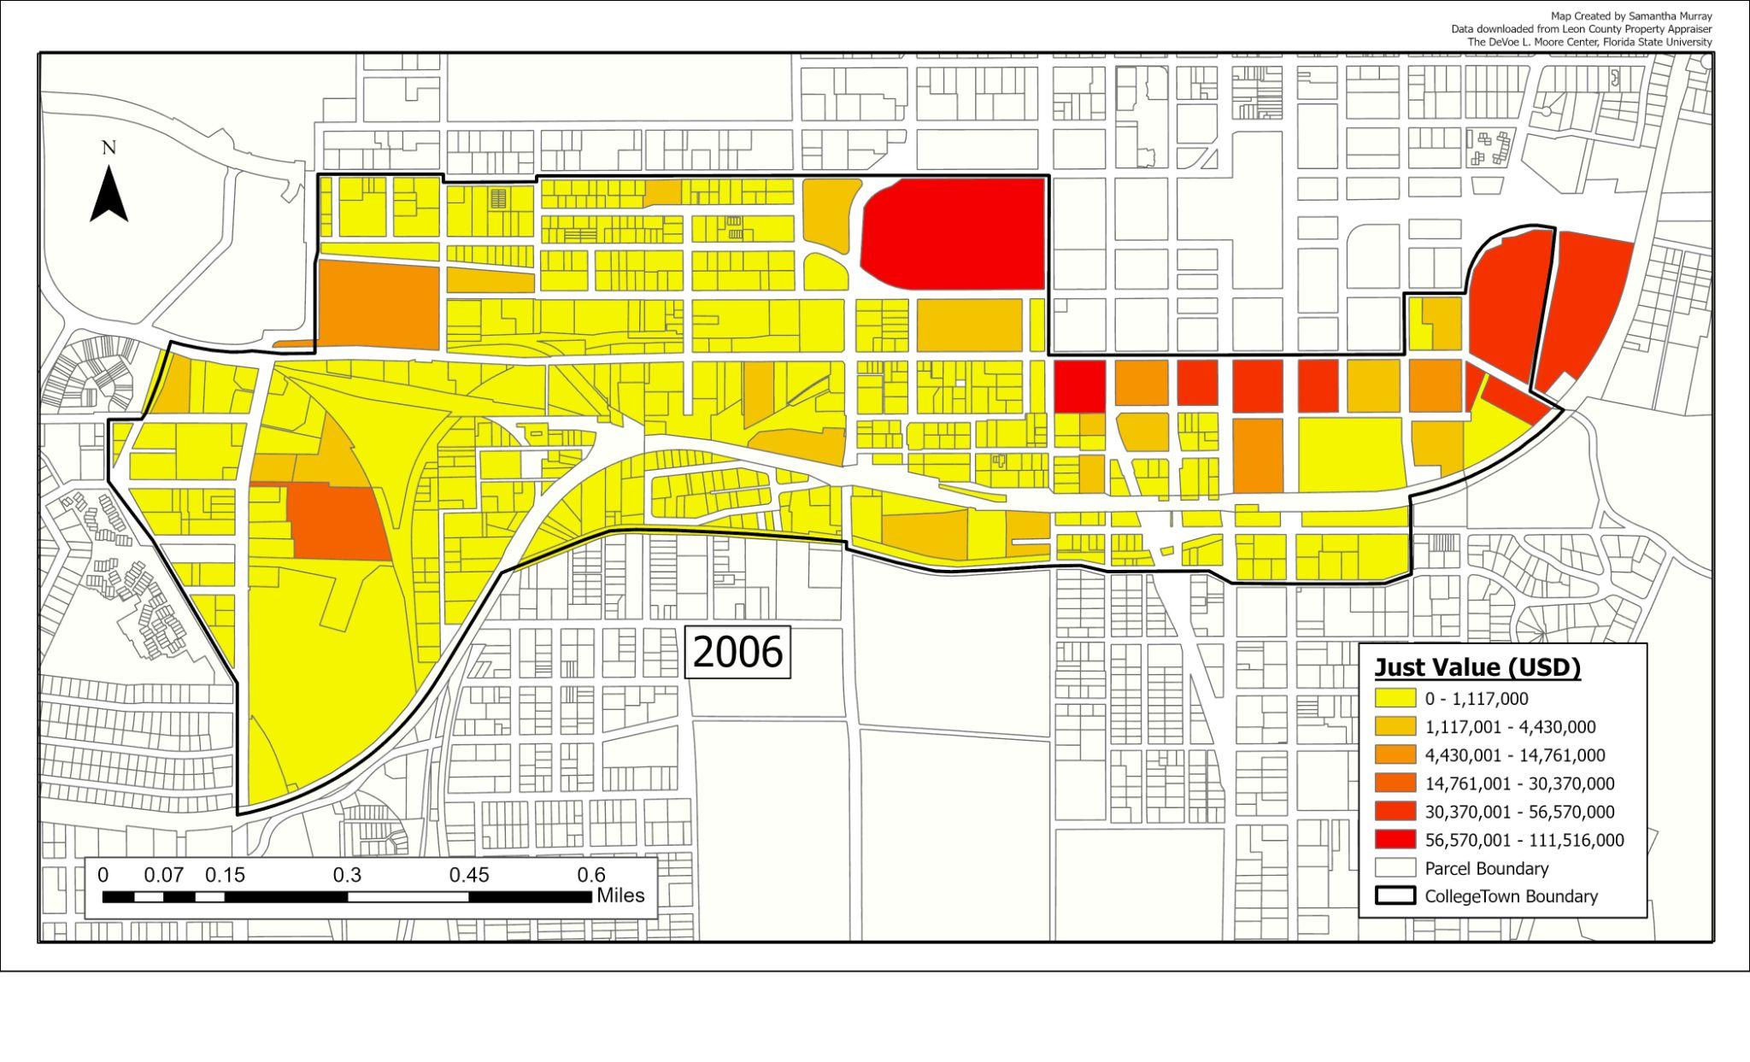
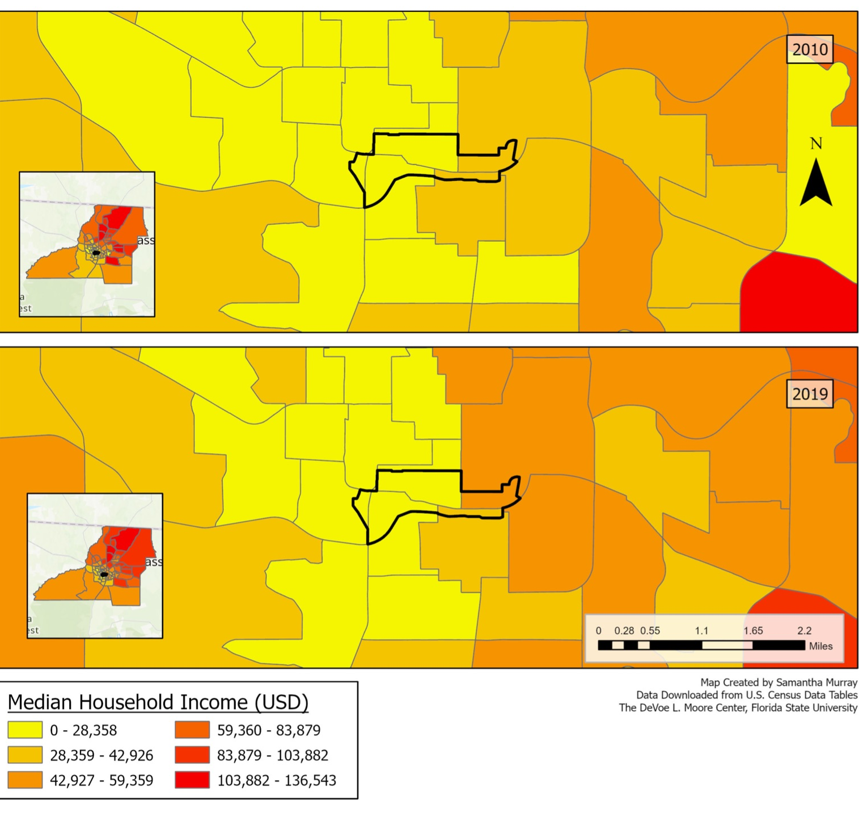
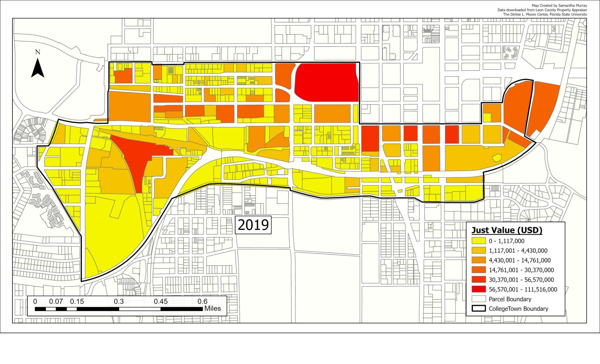
The Sustainable Development of CollegeTown
Ava Jowers, Olivia Rodrigue, Cameron Mullin
Dr. Crystal Taylor and Samantha Murray, FSU DeVoe L. Moore Center
Research Question
How sustainable is the recent CollegeTown development based on the three E’s?
Preliminary Results
CollegeTown Background
Environment (Figure 1): According to the Tallahassee government solar-net metering data, the average kWh of energy produced annually by solar panels in the CollegeTown area is 17,313 kWh.
Economic (Figure 2): Total property values have nearly doubled, growing from $489 million in 2006 to $861 million in 2019. The average property value also increased from 862 thousand in 2006 to 1.3 million in 2019.
Equity (Figure 3): Only 7% of the households in the CollegeTown area experienced income levels greater than $35,000 per household with a median household income of $8,319 in 2010. By 2019, this figure had grown to 20.5%, with median household income growing to $11,511.
Prior to 2012, the Gaines Street corridor consisted of little more than outdated warehouses and vacant lots. After a massive financial undertaking by the city of Tallahassee, promoted by a host of private investments, the CollegeTown area that the Tallahassee community knows today was developed in short order. Due to an increased awareness of issues surrounding the environment, cities are looking towards sustainable development practices to minimize environmental externalities associated with growth. Increased public awareness of environmental issues led researchers to assess the potential impacts of projects through the three E’s of sustainable development: Environment, Economy, and Equity.
Methodology: Geospatial Analysis of Environmental, Economic, & Equity Data
Environment (Figure 1): In addition to reviewing the Tallahassee Clean Energy Plan and Solar Program, researchers acquired solar panel site location data from the city of Tallahassee in order to track wattage trends.
Economic (Figure 2): Researchers used Florida Department of Revenue data from 2006 and 2019 to assess the change in property values over the years.
Equity (Figure 3): Researchers analyzed income and demographic data from the US Census.
Sustainability Policy Recommendations
Environment: Implementing more solar panels within the CollegeTown area provides a utility maximizing budget involving zero cost to implement city approved panels.
Economic: The area has seen property values nearly double since completion. From an economic point of view, this justifies the quality of the structures and time it took to complete the development.
Equity: Residents of CollegeTown have experienced low levels of income mobility throughout the development as median income household income has only risen by roughly $3,000 since the start of the development. More research should be done regarding the effect that various demographic shifts have impacted housing options within CollegeTown.
Figure 1. Solar panel energy output within CollegeTown
Data Limitations
Though not perfectly aligned, Census Tract Five encompasses the majority of CollegeTown.
Data is limited, yet growing concerning solar energy consumption pertaining to residential and commercial buildings.
As a highly transient population, college-aged students typically work part-time jobs and may not officially record their student housing as a primary residence.
Acknowledgements & References
Special Thanks: Dr. Crystal Taylor, Samantha Murray, and the DeVoe L. Moore Center.
References: “Florida Dept. of Revenue - Property Tax - Data Portal - Request Assessment Roll and GIS Data.” Florida Department of Revenue, https://floridarevenue.com/property/Pages/DataPortal_RequestAssessmentRollGISData.aspx.
“Prior HHS Poverty Guidelines and Federal Register References.” ASPE, 14 Jan. 2022, https://aspe.hhs.gov/topics/poverty-economic-mobility/poverty-guidelines/prior-hhs-poverty-guidelines-federal-register-references.
“The City of Tallahassee.” City of Tallahassee Utilities, https://www.talgov.com/you/you-products-home-solar-net-metering.aspx.
Figure 2. Property values within CollegeTown in (a) 2006 and (b) 2019
Figure 3. Median Household Incomes by census tracts within and adjacent to CollegeTown

