Slide 1
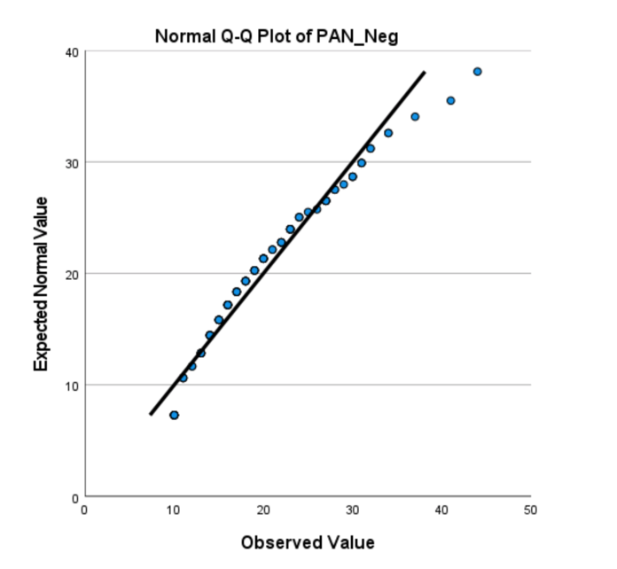
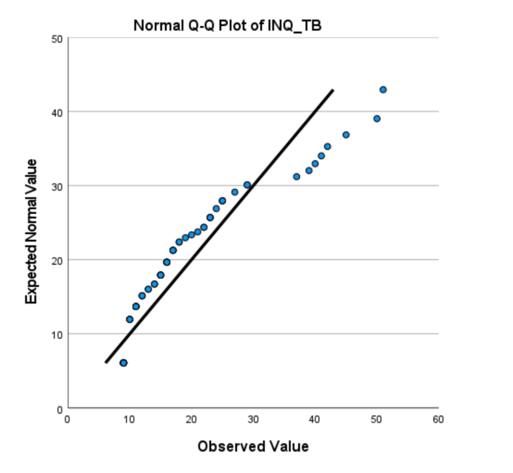
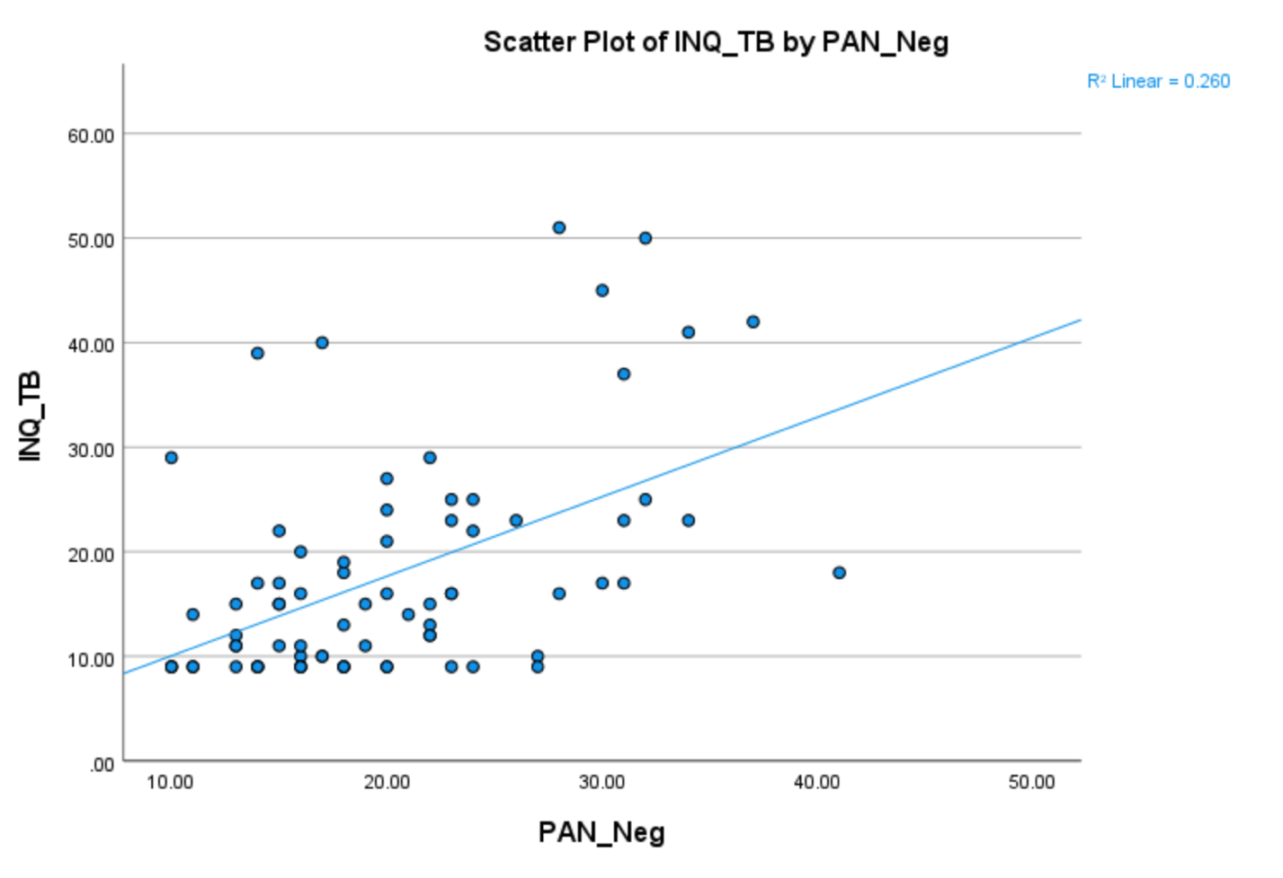
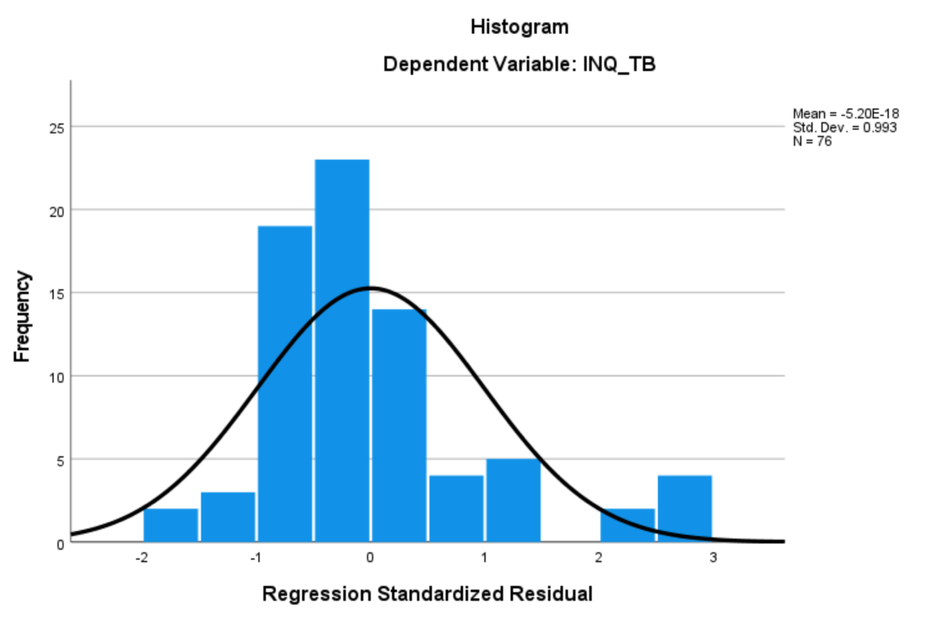
Investigating the Relationship Between Negative Emotionality and Thwarted Belongingness
Andrew J. Lodge, Sean P. Dougherty, Austin J. Gallyer, & Thomas E. Joiner
Department of Psychology, Florida State University, Tallahassee, FL
Introduction
Negative Emotionality (NE): the extent to which one has greater susceptibility to experiencing negative affect or feelings of emotional distress.
Thwarted Belongingness (TB): when one’s psychological need to form and maintain stable relationships is perceived to be unmet.
NE has been found to be related to the development of mood and anxiety disorders, whereas TB has been found to be a risk factor for suicidal ideation.
Prior research indicates that, in veterans, the association between negative emotions and thwarted belongingness is large and positive. (Rogers et. al., 2016)
Measures
Positive and Negative Affect Schedule (PANAS; Watson, Clark, & Tellegan, 1988): Evaluates proneness to negative and positive emotions. Data from the Negative Emotion subscale of the PANAS were used in this study.
Interpersonal Needs Questionnaire (INQ; Van Orden, Cukrowicz, Witt, & Joiner, 2012): Assesses the extent to which one feels like a burden to others and feels disconnected from others. Data from the Thwarted Belongingness subscale of the INQ were used in this study.
Data Analysis:
Correlation of NE and TB
Pairwise deletion was used for a simple linear regression analysis of NE and TB
Frequency analyses were conducted on sex, gender, ethnicity, race, sexual orientation, marital status, religious affiliation, and academic year in college
Hypothesis
Research Question: What is the extent of the relationship between NE and TB?
There will be a moderate, positive association between NE and TB.
Conclusions
This study revealed a significant association with a large effect size between NE and TB, which may be used to indicate risk for related psychopathology.
NE and TB have been studied within a new population of undergraduate students at Florida State University.
Future studies could establish a causal relationship between NE and TB and observe different samples.
Participants:
75 Florida State University undergraduates recruited through a psychology course study pool and incentivized by course credit.
No history of suicidal ideation, plans, or attempts.
Ages 18–22 (M = 18.78, SD = 1.11).
76.0% female, 24.0% male.
86.0% White, 8.0% Black/African American, 4.0% multiracial, 1.0% American Indian/Alaskan Native, 1.0% prefer not to answer.
98.0 % heterosexual, 2.0% bisexual.
References
Baumeister, R.F., & Leary, M.R. (1995). The need to belong: Desire for interpersonal attachments as a fundamental human motivation. Psychological Bulletin, 117(3), 497-529.
Brausch, A.M., & Decker K.M. (2014). Self-esteem and social support as moderators of depression, body image, and disordered eating for suicidal ideation in adolescents. Journal of Abnormal Child Psychology, 42, 779-789. https://dio.org/10.1007/s10802-013-9822-0
Cacioppo, J.T., & Cacioppo, S. (2014). Older adults reporting social isolation or loneliness show poorer cognitive function 4 years later. Evidence-Based Nursing, 17(2), 59-60. https://doi.org/10.1136/eb-2013-101379
Chu, C., Hom, M.A., Rogers, M.L., Ringer, F.B., Hames, J.L., Suh, S., & Joiner, T.E. (2016). Is insomnia lonely? Exploring thwarted belongingness as an explanatory link between insomnia and suicidal ideation in a sample of South Korean university students. Journal of Clinical Sleep Medicine, 12(5). http://dx.doi.org/10.5664/jcsm.5784
Crawford, J.R. & Henry, J.D. (2004). The positive and negative affect schedule (PANAS): construct validity, measurement properties and normative data in a large non-clinical sample. British Journal of Psychology, 43(3), 245-265. https://dio.org/10.1348/0144665031752934
Doan, S.N., Dich, N., & Evans, G.W. (2013). Childhood cumulative risk and later allostatic load: Mediating role of substance use. Health Psychology, 33(11), 1402-1409. https://doi.org/19.1037/a0034790
Gray, J.A., & McNaughton, N. (2000). The neuropsychology of anxiety. Oxford: Oxford University Press
Hasenfratz, L., Benish-Weisman, M., Steinbergy, T., & Knafo-Noam, A. (2015). Temperament and peer problems from early to middle childhood: Gene-environment correlations with negative emotionality and sociability. Development and Psychopathology, 27, 1089-1109. https://dio.org/10.1017/S09545794150007X
Hill, R.M., Kaplow, J.B., Oosterhoff, B., & Layne, C.M. (2019). Understanding grief reactions, thwarted belongingness, and suicide ideation in bereaved adolescents: Toward a unifying theory. Journal of Clinical Psychology, 75(4), 780-793. https://doi.org/10/1002/jclp.22731
Hill, R.M., Rey, Y., Marin, C.E., Sharp, C., Green, K.L., & Pettit, J.W. (2015). Evaluating the interpersonal needs questionnaire: Comparison of the reliability, factor structure, and predictive validity across five versions. Suicide and Life-Threatening Behavior, 45(3), 302-314. https://doi.org/10.1111/sltb.12129
Holt-Lunstad, J. (2018). The potential public health relevance of isolation and loneliness: Prevalence, epidemiology, and risk factors. Public Policy and Aging Report, 27(4), 127-130. https://dio.org/10.1093/ppar/prx030
Joiner, T.E. (2005). Why people die by suicide. Cambridge: Harvard University Press
Larsen, R.J., & Ketelaar, T. (1991). Personality and susceptibility to positive and negative emotional states. Journal of Personality and Social Psychology, 61(1), 132-140. https://10.1037/0022-3514.61.1.132
Ma, J., Batterham, P.J., Calear, A.L., & Sunderland, M. (2019). The development and validation of the thwarted belongingness scale (TBS) for interpersonal suicide risk. Journal of Psychopathology and Behavioral Assessment, 41, 456-469. https://doi.org/10.1007/s10862-019-09721-6
Martin, C.E., Pukay-Martin, N.D., Blain, R.C., Dutton-Cox, C., & Chard, K.M. (2020). Suicidal ideation in a veterans affairs residential Posttraumatic Stress Disorder treatment setting: The roles of thwarted belongingness and perceived burdensomeness. Journal of Traumatic Stress. https://doi.org/10.1002/jts.22540
Mincic, A.M. (2015). Neuroanatomical correlates of negative emotionality-related traits: A systematic review and meta-analysis. Neuropsychologia, 77, 97-118. https://doi.org/10.1016/j.neuropsychologia.2015.08.007
Monteith, L.M., Menefee, D.S., & Bahraini, N.H. (2017). Perceived burdensomeness, thwarted belongingness, and fearlessness about death: Associations with suicidal ideation among female veterans exposed to military sexual trauma. Journal of Clinical Psychology, 00(0),.1-15. https://doi.org/10.1002/jclp.22462
Rogers, M.L., Kelliher-Rabon, J., Hagan, C.R., Hirsch, J.K., & Joiner, T.E. (2016). Negative emotions in veterans relate to suicide risk through feelings of perceived burdensomeness and thwarted belongingness. Journal of Affective Disorders, 208, 15-21. http://dx.doi.org/10.1016/j.jad.2016.09.038
Van Orden, K.A., Cukrowicz, K.C., Witte, T.K., & Joiner, T.E. (2012). Thwarted belongingness and perceived burdensomeness: Construct validity and psychometric properties of the interpersonal needs questionnaire. Psychological Assessment, 24(1), 197-215. https://dio.org/10.1037/a0025358
Van Orden, K.A., Witte, T.K., Cukrowicz, K.C., Braithwaite, S.R., Selby, E.A., & Joiner, T.E. (2010). The interpersonal theory of suicide. Psychological Review, 117(2), 576-600. https://doi.org/10.1037/a0018697
Watson, D., Clark L.A., & Tellegen, A. (1988). Development and validation of brief measures of positive and negative affect: The PANAS scales. Journal of Personality and Social Psychology, 54(6), 1063-1070. https://dio.org/10.1037/0022-3514.54.6.1063
Results
There were 104 responses for the PANAS negative emotion subscale (PANAS-NE), with scores ranging from 10 to 44 (M = 19.84, SD = 7.27; skew = 0.87, SE = 0.24; kurtosis = 0.59, SE = 0.47).
There were 75 responses for the INQ thwarted belongingness subscale (INQ-TB), with scores ranging from 9 to 51 (M = 17.87, SD = 10.52; skew = 1.56, SE = 0.28; kurtosis = 1.92, SE = 0.55).
In accordance with the hypothesis, NE and TB were strongly, positively correlated, r(74) = 0.50, p < .001.
Negative emotionality scores were associated with thwarted belongingness scores (b = 0.76, β = 0.50, t(74) = 4.97, p value out to 3 decimals, 95% CI [0.45, 1.06]).
Negative emotionality explained a significant proportion of variance in thwarted belongingness scores (R² = 0.25, adjusted R² = 0.24, SEM = 9.15, p < .001).

