Slide 1
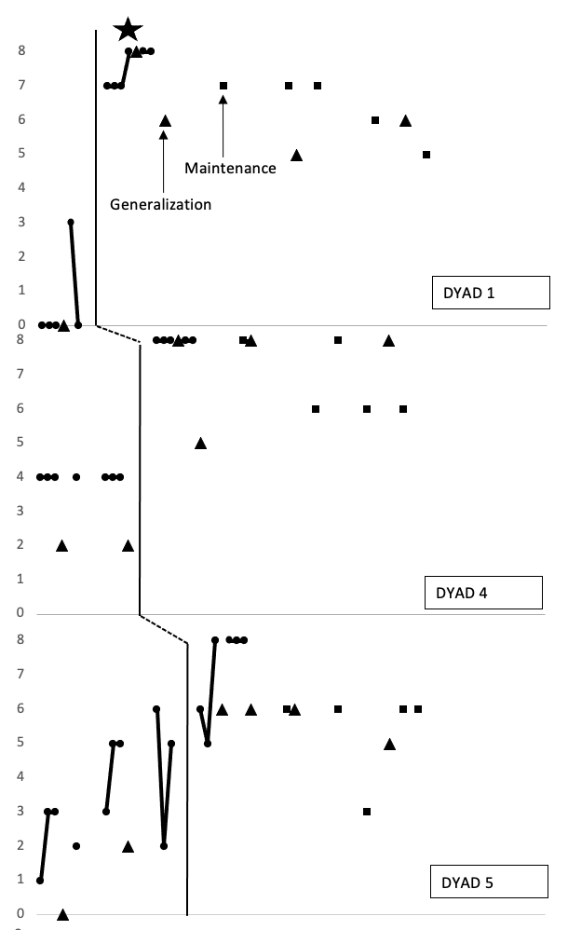
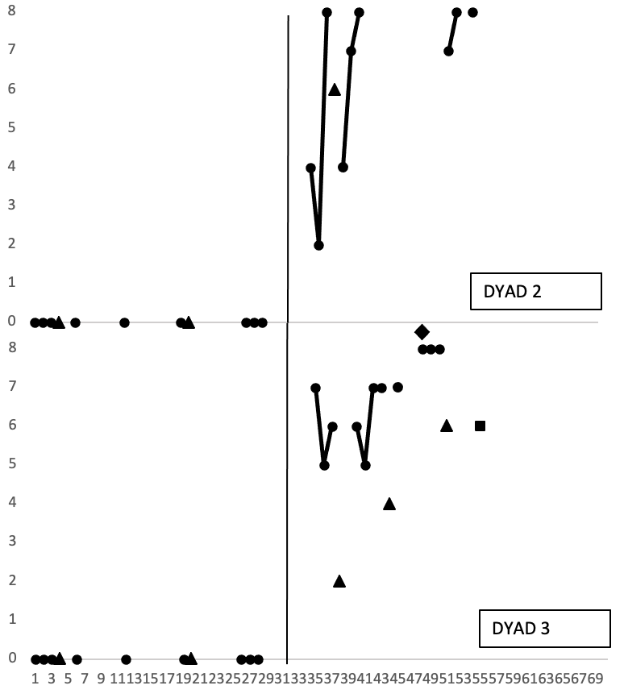
Peer-Mediated Modified Schema Based Instruction Targeting Mathematical Problem Solving for Students with Extensive Support Needs
Mentor: Deidre Gilley, MS
PhD Student - Florida State University
dgp17c@my.fsu.edu
Bianca Hamm
bah20c@my.fsu.edu
Emily Dillon
eed20@my.fsu.edu
Lily England
lge21@my.fsu.edu
Amanda Ravins
anr20x@my.fsu.edu
Purpose
Participants & Setting
Results
Peer-mediated instruction has positive impacts across a range of academics (i.e., language arts, mathematics, science, and social studies) for students with disabilities, regardless of their disability (Okilwa and Shelby, 2010).
Peer-mediated instruction supports growth and development of both the mentee and the mentor.
Alegre-Ansuategui et al. (2017) later supported this finding within their meta-analysis of peer mediating instruction and academic achievement in mathematics.
Modified schema-based instruction has been shown to be effective within the literature as an intervention package to increase mathematical skills among students with ESN across a range of math contents and contexts.
Ley Davis (2016) used peer-mediated MSBI with middle-school aged students targeting additive mat problems. Results indicated a functional relation.
Setting: separate classroom, one-on-one
Peer Mentees
 | Grade | Gender | Race | Disability
Eve | Senior | Female | Asian American | Intellectual Disability
Parker | Senior | Male | White | Autism Spectrum Disorder
Janelle | Freshman | Female | Black | Intellectual Disability
Patrick | Freshman | Male | White | Intellectual Disability and Autism Spectrum Disorder
Ezra | Freshman | Male | Multiracial | Intellectual Disability
Research Questions
Peer Mentors
 | Grade | Gender | Race | Experience
Abby | Senior | Female | White | Multi-Year Mentor
Ashley | Junior | Female | White | Multi-Year Mentor
Nick | Senior | Male | White | Multi-Year Mentor
Evan | Senior | Male | White | Multi-Year Mentor
RQ 1: Did MSBI work?​
What is the effect of peer-delivered modified-schema based instruction on the frequency of correct, independent steps of the task analysis for solving multiplication word problems completed by high school students with ESN? ​
RQ 2: Can they use mathematical reasoning?​
How do high school students with ESN justify their mathematical reasoning do during turn and talk when provided with a system of least prompts after peer-mediated modified-schema based instruction?​
RQ 3: How is MSBI perceived? ​
What are the perceptions of key stakeholders (e.g., tutors and tutees) on peer-delivered math instruction?
Graph represents the data of each peer mentor dyad on DV1, the number of critical steps out of 8 completed independently correct.
Procedures
Baseline
Given word problem, task analysis, schema, virtual manipulatives
No system of least prompts, error correction, or peer support
Limitations / Future Research
Lesson 1
Vocabulary (e.g., equal, factors, multiply, multiplication)
Conceptual overview of multiplication
COVID-19 Related Attendance
Narrow Generalization
Structured Turn and Talk
Teacher Implemented
Method
Lesson 2
Review vocabulary
Practice multiplication with manipulatives (i.e., cubes and virtual)
Design: Mixed methods single case research (MMSCR)​
Conditions: ​
Baseline​
Intervention​
Generalization​ (approximately every 3 probes)
Maintenance (goal of at least 3)
Independent Variable: Peer-Mediated Modified Schema Based Instruction (MSBI) ​
Dependent Variables:​
Number of critical steps
completed independently correct ​
(2) Number of word problems correct ​
(3) Ability to use mathematical reasoning
References
Lesson 3
Review vocabulary, concepts
Guided practice solving problems with virtual worksheet
Introduce self-monitoring and self-graphing
Alegre Ansuátegui, F. J., Moliner Miravet, L., Lorenzo Valentín, G., & Maroto, A. (2018). Peer tutoring and academic achievement in mathematics: a meta-analysis. EURASIA: Journal of Mathematics, Science and Technology Education, 14(1), 337-354. DOI: 10.12973/ejmste/79805.
Davis, L. L. (2016). Effects of peer-mediated instruction on mathematical problem solving for students with moderate/severe intellectual disability (Doctoral dissertation, The University of North Carolina at Charlotte).
Okilwa, N. S., & Shelby, L. (2010). The effects of peer tutoring on academic performance of students with disabilities in grades 6 through 12: A synthesis of the literature. Remedial and Special Education, 31, 450-463.
Intervention
Began with reviewing goal
Prompting hierarchy: verbal, specific verbal, model
Maintenance
Given word problem, task analysis, schema, virtual manipulatives
No system of least prompts, error correction, or peer support
Generalization
Given word problem, task analysis, virtual manipulatives
Fade schema
No system of least prompts, error correction, or peer support

