Slide 1
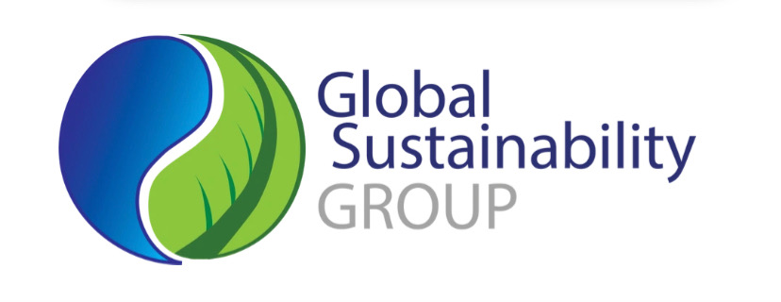
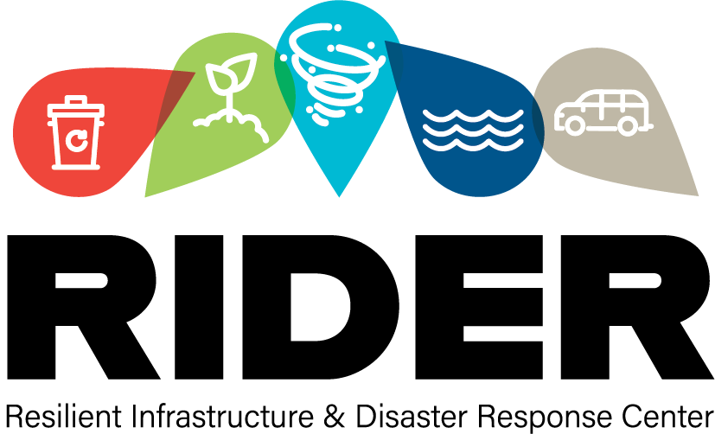
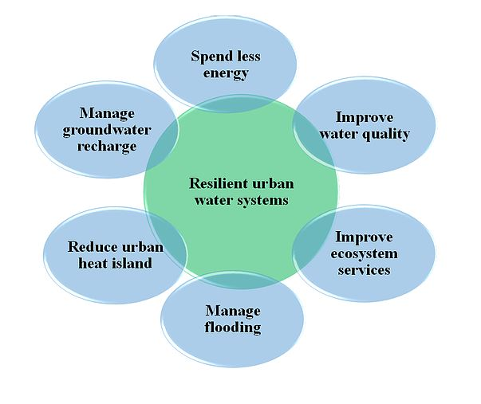
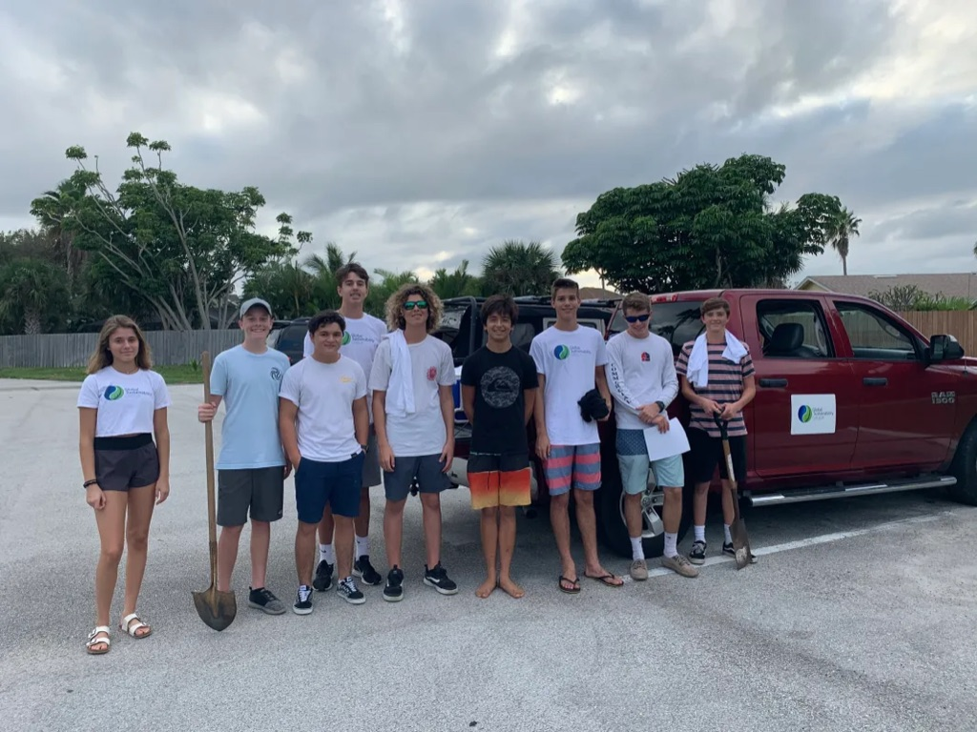
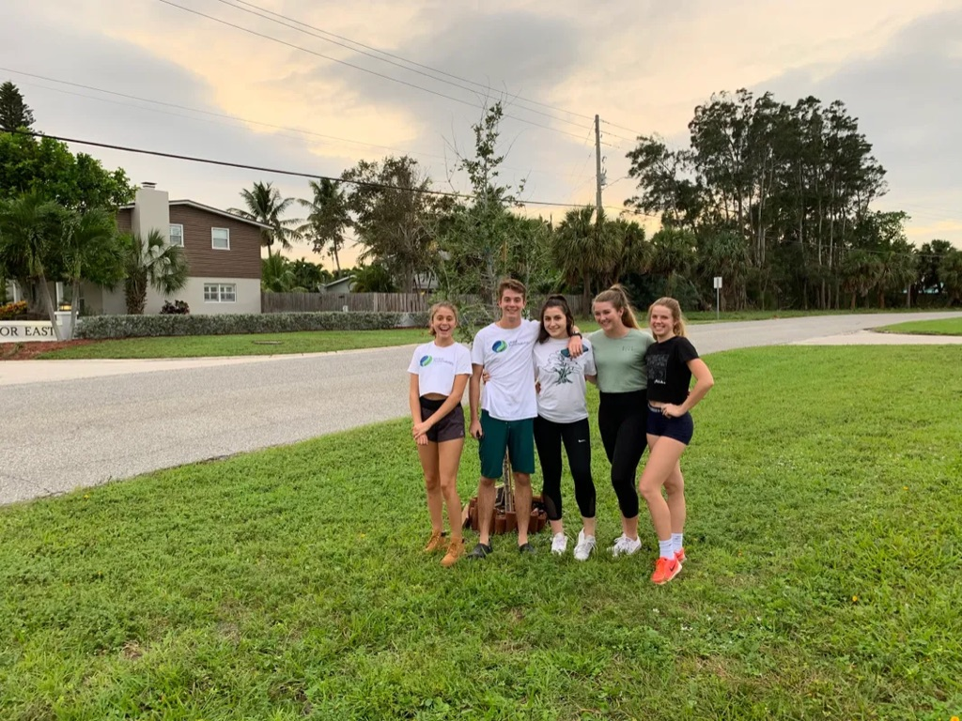
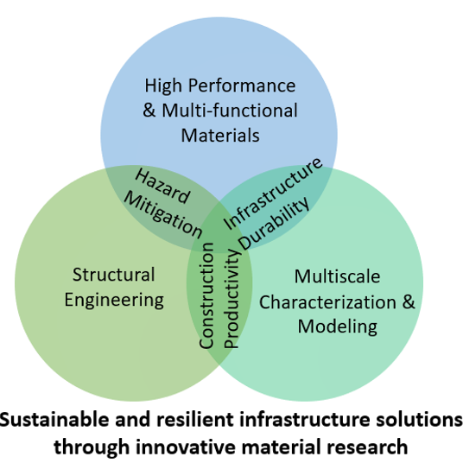
Communicating STEM – Resilient Infrastructure and Disaster Response UROP Student: Luke Marzano – Research Mentor: Will Hill Florida Agriculture and Mechanical University – Florida State University College of Engineering
Introduction
Results
The Resilient Infrastructure and Disaster Response (RIDER) Center, a part of the FAMU-FSU College of Engineering, leads many different research projects, one of which sets out to solve the challenge of communicating science, technology, engineering and math (STEM) to the many diverse stakeholders involved in RIDER’s activities. One way to educate stakeholders about the activities of RIDER and STEM that has been shown to be impactful is community service. Community service is engaging, hands-on and offers the potential for direct conversations between stakeholders and members of RIDER. This allows stakeholders a first-hand look at all of the activities of RIDER with opportunities to receive an answer to any questions that they may have. Sustainability-focused community service even helps improve the disaster response to a wide variety of disasters, both natural and man-made. Through community service that focuses on the sustainability and health of the Earth and its diverse ecosystems, these ecosystems will be better able to build up their natural defense in the event of any disaster. An example of this type of community service could be removing invasive species that compete with native species and push them out of the ecosystem when the native species was vital in the ecosystem’s natural disaster response, such as the Coast Live Oak which has natural fire resistant properties. By offering these type of community service events, RIDER is able to directly interact with their many stakeholders which will increase the communication of STEM and RIDER activities, but also offer an opportunity for the ecosystems around our community to become healthier and more resistant to disaster.
No events have happened yet so the effectiveness of communicating STEM to stakeholders of RIDER cannot yet be analyzed.
Five events, one for each of the four laboratories and one initiative, are currently being planned and are expected to be on weekends before the Undergraduate Research Symposium on April 7, 2022.
All events will be accompanied by blog and social media posts on globalsustainabilitygroup.com, the RIDER Center website and GSG social media (Facebook and Instagram).
Discussion
Having the RIDER Center partner with GSG is a great way to get volunteers out into the community to confront real issues while also educating them about the research conducted by the RIDER Center.
Most volunteers are students which helps to foster interest for future RIDER Center projects and potentially generate some funding. Unfortunately, most volunteers being students means these events have a limited impact for other RIDER stakeholders such as corporations, FAMU-FSU College of Engineering and the government, who provide the majority of the funding for RIDER Center projects. Although no events have happened yet at the time of this writing, similar literature supports the idea that combining community service and learning improves social understanding of issues, attitude and willingness to make a difference in the community (Eyler, Giles & Braxton, 1997).
Methods
The goal of this study is to communicate the STEM research being conducted at the RIDER Center to the stakeholders involved with the RIDER Center. GSG seeks to contribute to this goal through unique events related to each of the four labs and one initiative, accompanied by informative social media posts to facilitate the further spread of information. Events will be analyzed based on previous analyses of other university community engagement projects. Below is each event for each RIDER Center Laboratory:
Resilient Materials and Structures (ReMS) – The planting of native trees to demonstrate how they serve as a wind break that can protect structures.
Water Sustainability and Coastal Hazard (WaSCH) – A cleanup of a local waterway such as Alligator Point Beach.
Advanced Operations Research and Resilience Applications (LAORA) – An informative lecture about the many projects within this laboratory while doing a major roadway cleanup.
Sustainable Infrastructure Management (SIM) – A cleanup around popular destinations in Tallahassee, such as Collegetown, with the focus of recycling the trash collected.
Methane Reduction Initiative (MERI) – An educational lecture about methane emissions from landfills.
Acknowledgments
I would like to sincerely thank my research mentor Will Hill for his passion and enthusiasm throughout this project. From the plentiful ideas he had for this project to the excellent communication of his vision, the leadership he displayed has monumentally inspired me.
I would also like to thank my research teammates Gaby Sanchez, Isaiah Scott, Jonathan Cushman and Lily Johnson for their support of my project despite having projects of their own to complete.
References
Vogelgesang, L. J. & Astin, A. W. (2000). Comparing the effects of community service and service-learning. Michigan Journal of Community Service Learning, 7, 25-34.
Eyler, J., Giles, D. E. & Braxton, J. (1997). The impacts of service-learning on college students. Michigan Journal of Community Service Learning, 4, 5-15.
McCarthy, A. M. & Tucker, M. L. (2002). Encouraging community service through service learning. Journal of Management Education, 26(6), 629- 647.

