Slide 1
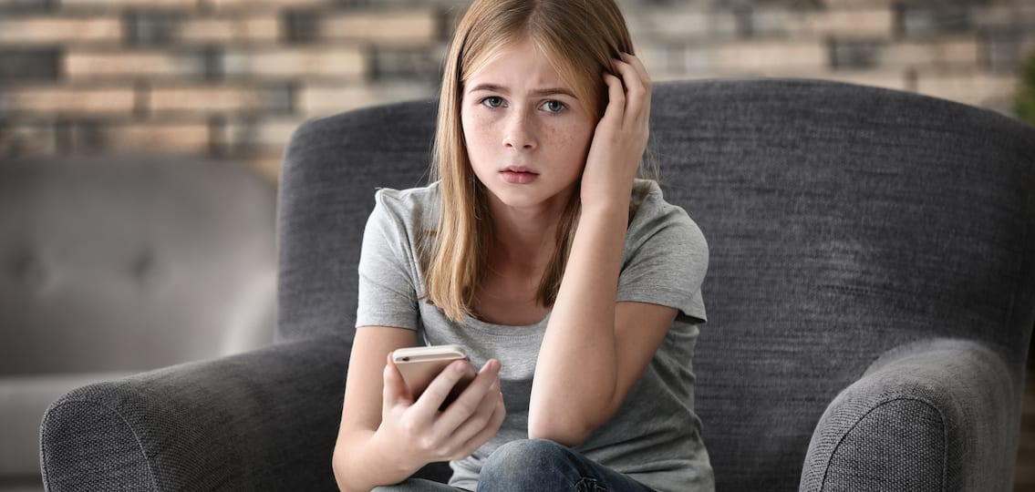
Emotions and Social Media Use: Youth Experiences of Different Online Phenomena
Eva Rucinski, Maddie Massmann, Martina Rojas, Olivia Martin, Sofia Bernal Dr. Vanessa Dennen
Florida State University, College of Education
ABSTRACT
METHODS
Social media has become more prominent in the 21st century and has facilitated easier modes of communication. However, with the emergence of social media, many individuals have started associating social media in both a negative and positive light. This study investigates possible correlations between social media and feelings of negative and positive emotions while also conducting a meta-analysis to investigate trends that are related to this field of study. The objective of this research was to investigate why individuals experience these varieties of emotions and provide more knowledge to this current field of literature. Additionally, it is also a way to provide more knowledge than what is known about current studies. Participants involved in this study were asked to complete a Qualtrics survey that offered in depth questions about emotions experienced while doing certain tasks on social media. Afterwards, participants were asked two long answer questions about one time they experienced both positive and negative emotions while on social media
We designed a survey composed of short response and scale questions through Qualtrics and distributed it through Florida State’s study sign up system.
Participants were young adults aged 18-22.
The survey presented in depth questions which prompted students to expose their social media usage on a number of platforms.
The survey also addressed frequency of app usage, and forms of interaction n social media such as comments, likes, and shares.
We chose the survey method in an attempt to understand if there is an existing correlation between social media and negative or positive emotions.
The data collected was qualitative
RESULTS
Since the nature of this study is still ongoing, results have yet to be determined. However, through a literature review we can deduce preliminary results.
Globally, there is a collective understanding that social media can cause negative and positive emotions.
Based on the literature review, we saw specific causes of negative emotions such as cancel culture, cyberbullying, and body shaming.
This research dives more into the emotions aspect of social media such as guilt and embarrassment as it relates to the overall use of social media.
We predict that there will be a correlation between the use of social media and the experience of negative emotions.
INTRODUCTION & BACKGROUND
Introduction
Our area of study was how social media affects the emotional well-being of its users. We specifically questioned why some users felt shame or embarrassment when they spent time on their phone and targeted why these feelings are evoked in the first place. This topic is significant in the current field of research because it may provide more knowledge as to why many social media users experience feelings of shame and what factors influence the creation of these negative emotions.
References
“Young adults ages 18-29 remain the group with the highest social media usage; 90% report using social media on a regular basis,” (Bennett et al., 2020).
“During adolescence peer relationships and friend networks are of key importance…Social networks have increased developmental significance for young people accounting for cumulative popularity of social networking sites among this population,” (Best et al., 2015).
“Mobile phones have rapidly become ubiquitous in the last decade. Nearly 90% of Americans owned a mobile phone in 2012. At the end of 2016, 95% owned a mobile phone and 77% owned a smartphone,” (Caron & Mays, 2021).
Purpose
This study may provide more insight on how to educate others on what is potentially contributing to these feelings of shame and how to combat it. It can potentially provide knowledge on how to reduce these feelings of shame as technology advances, but also acknowledge that there is a recurring problem that many users experience on the internet.
Insert Filler Graph Here
DISCUSSION
Through the continuation of our study, we hope to draw conclusions on the correlation between social media and the positive and negative emotions that surface when using platforms such as Tiktok, Snapchat, Instagram, and other popular platforms.
With these findings, we expect to better understand the harmful natures of social media such as cyberbullying, social comparison, hate experienced online, and body shaming.
The results may also allow us to gain a newfound understanding on the positives aspects of social media. Positive comments, followers, and likes can create a comfortable environment online, which can foster a community of connected supporters.
We hope to raise awareness and take proactive action against the negatives that surface. Future research can be conducted on how to prevent negative psychological effects of harmful social media use.

