Slide 1
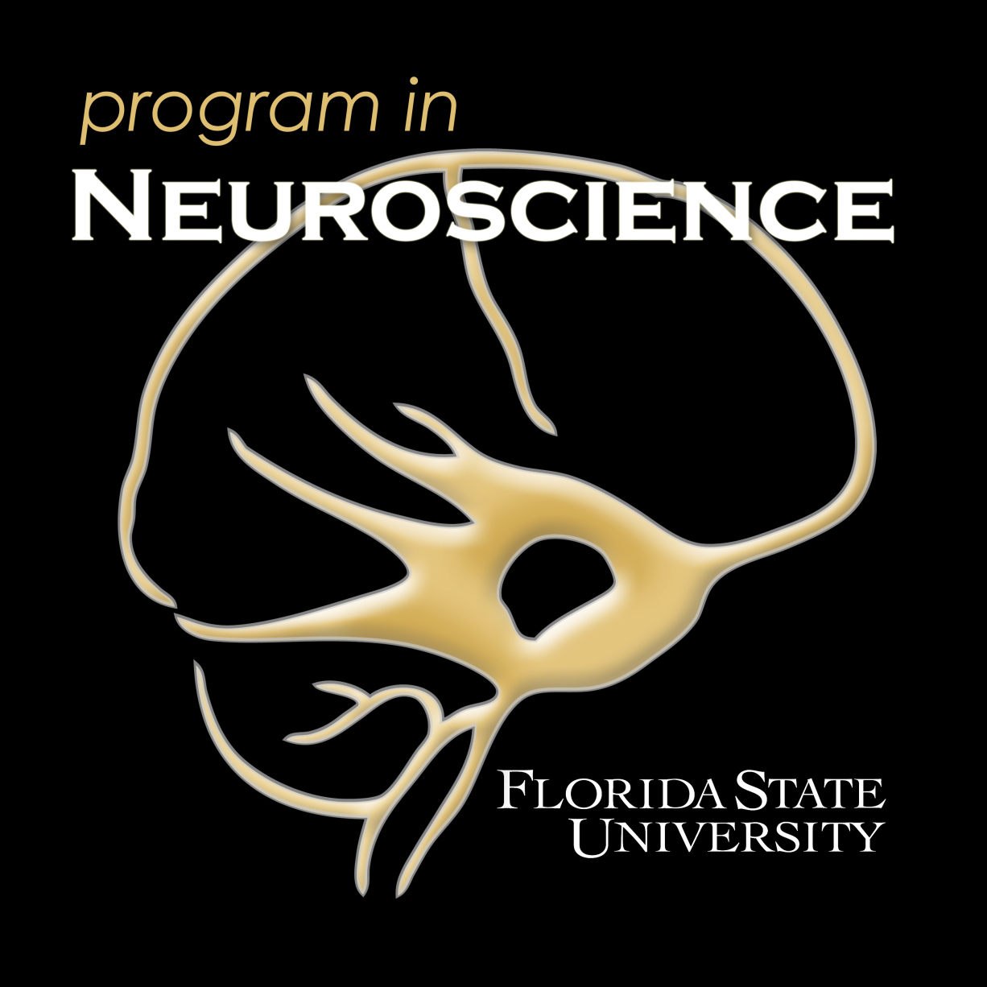
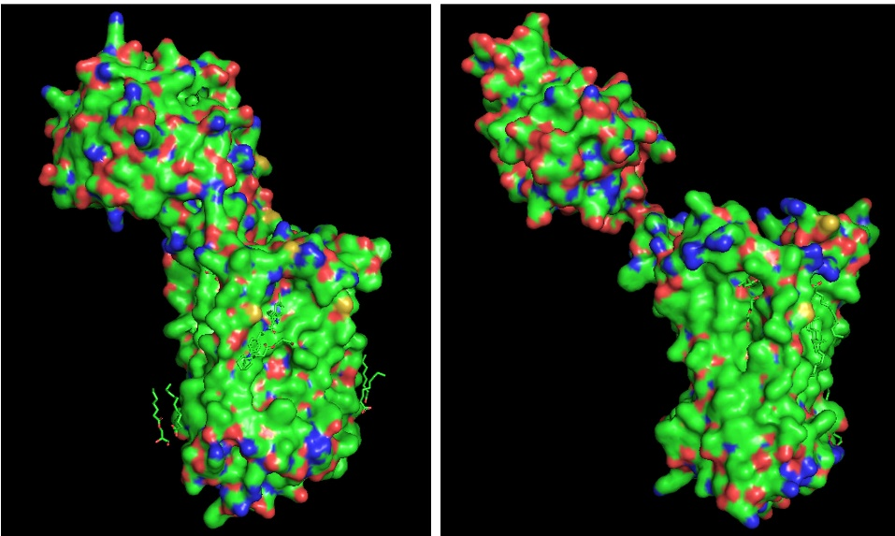
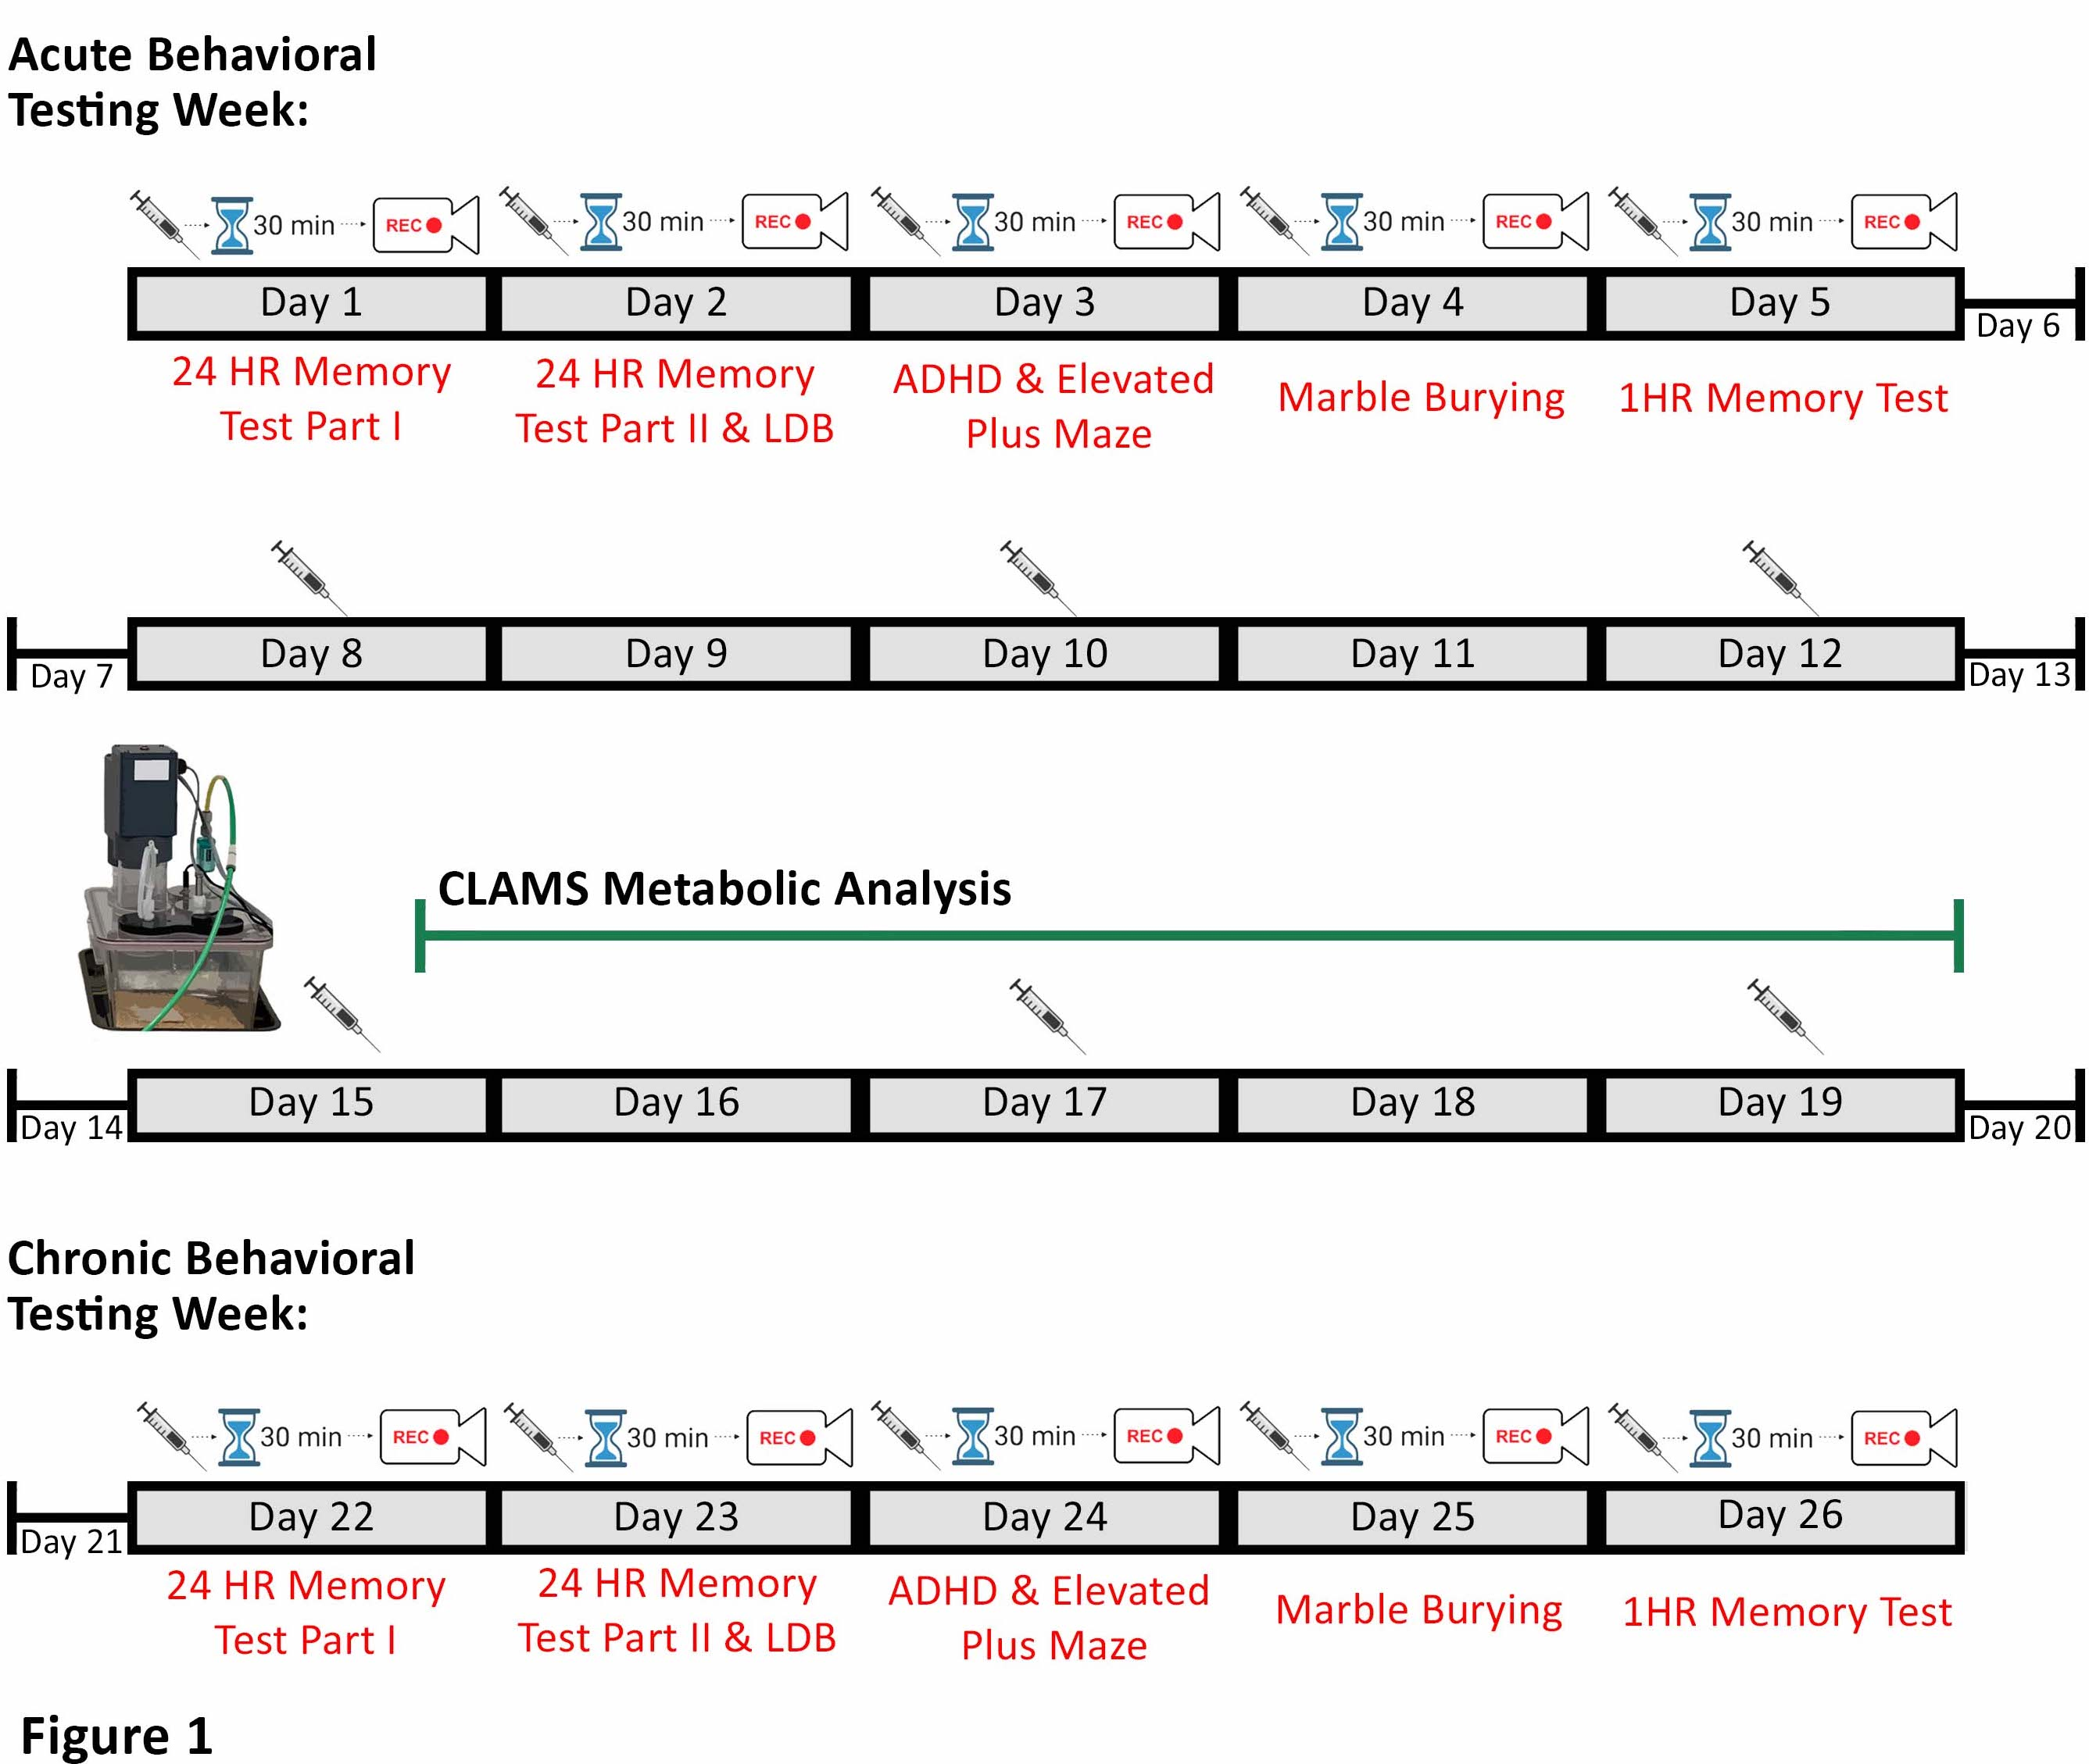
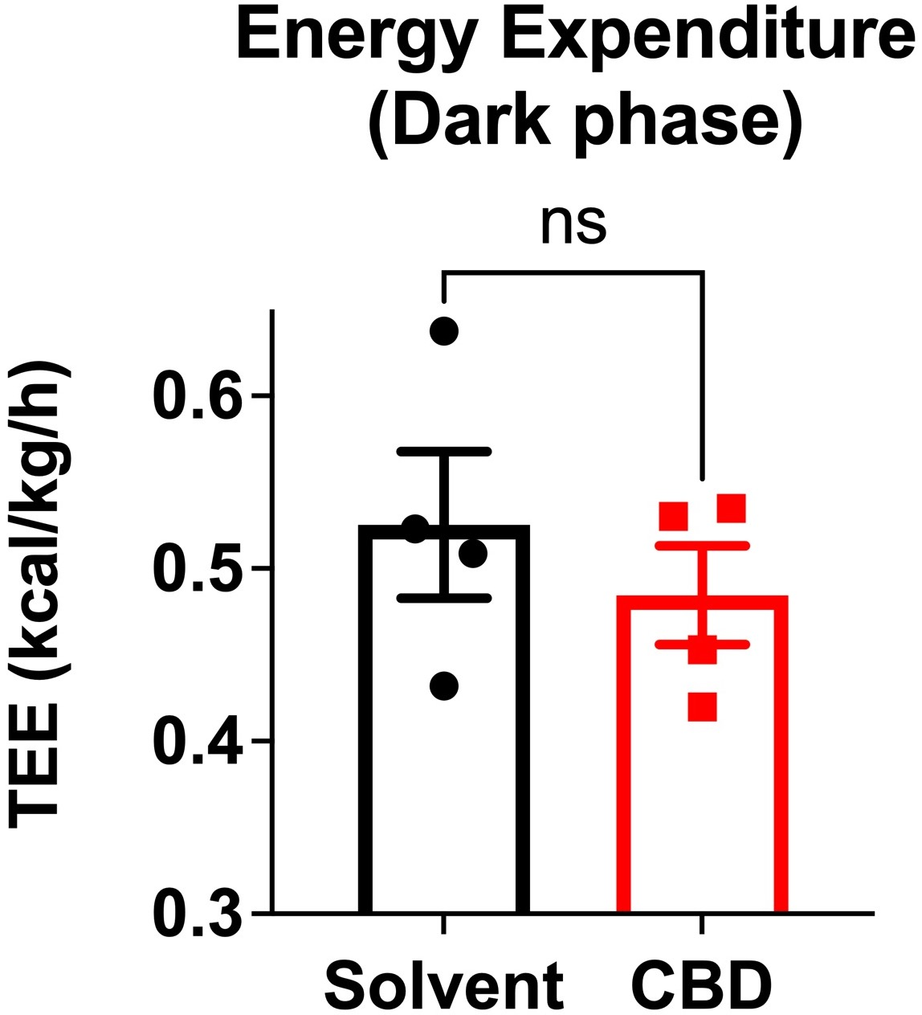
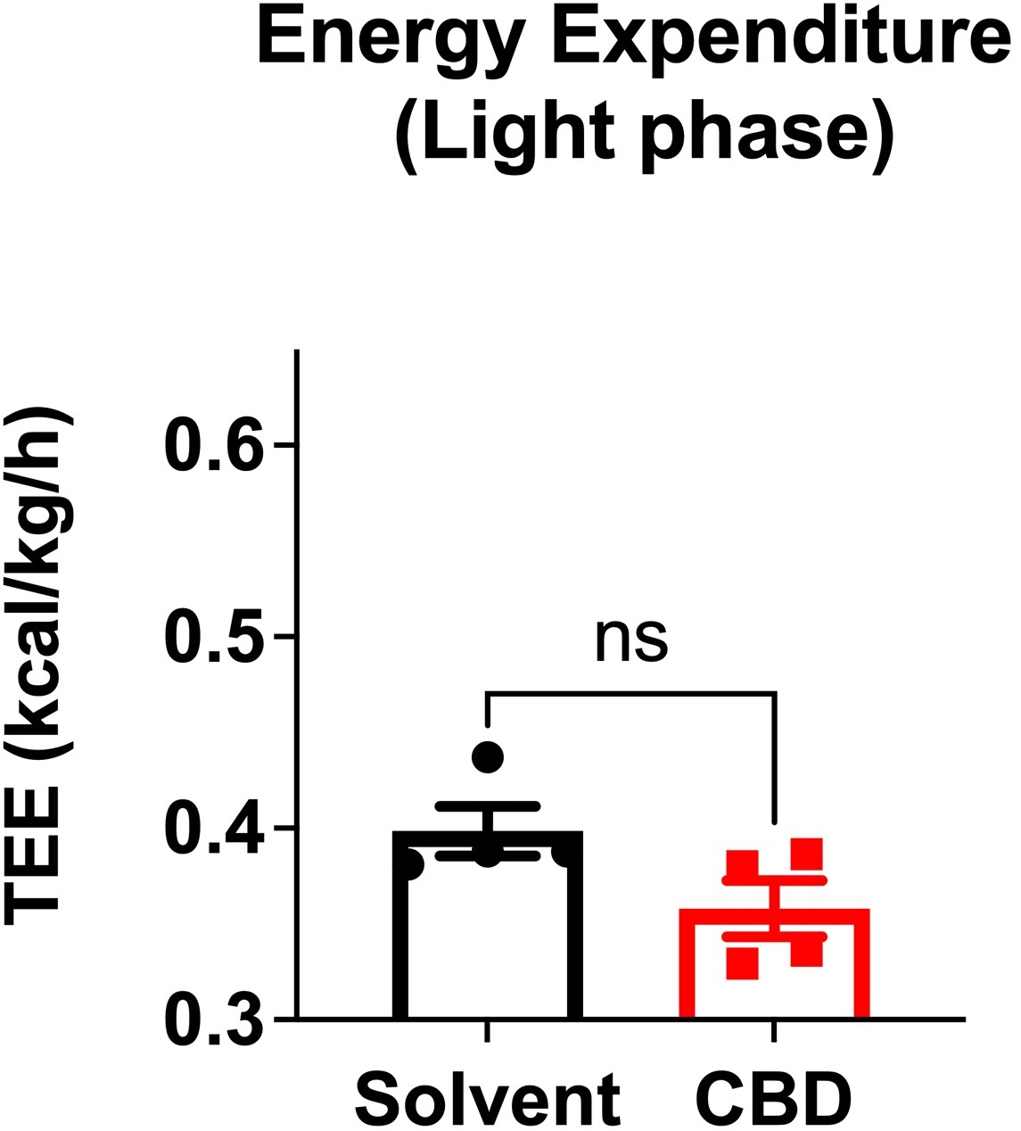
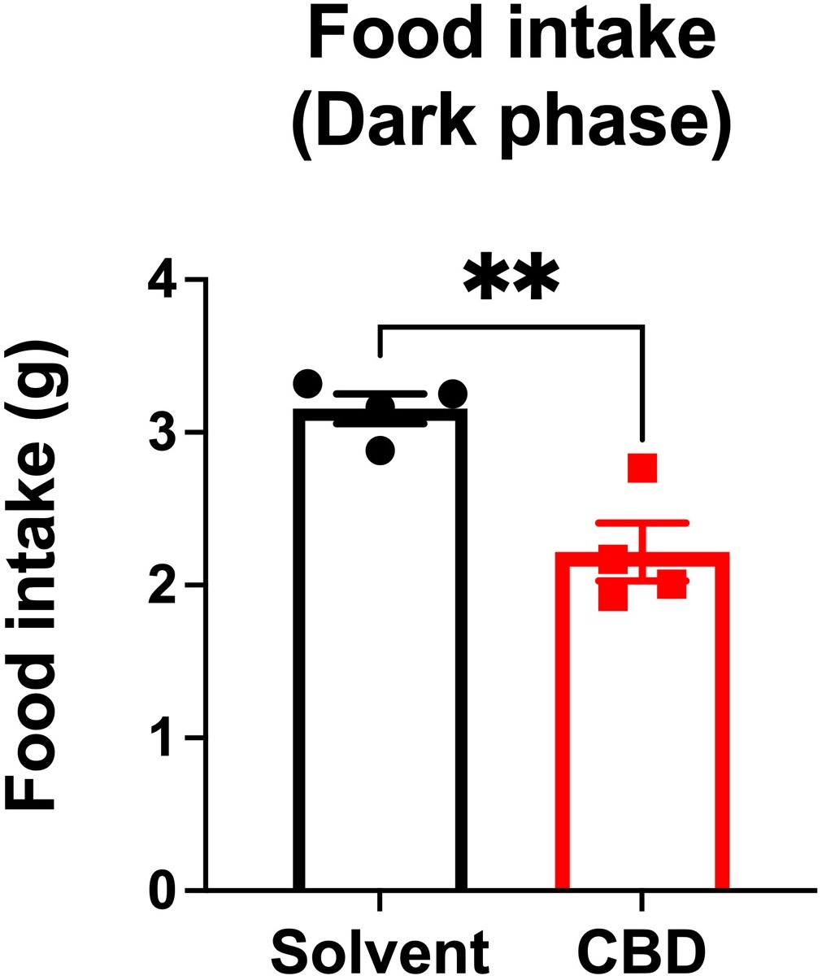
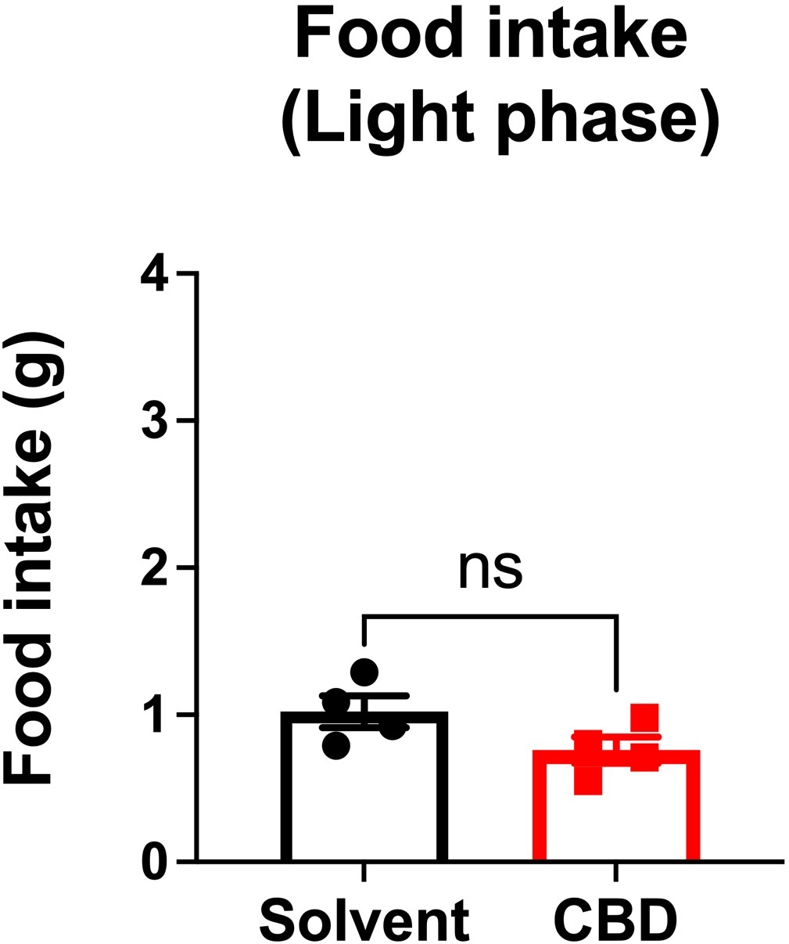
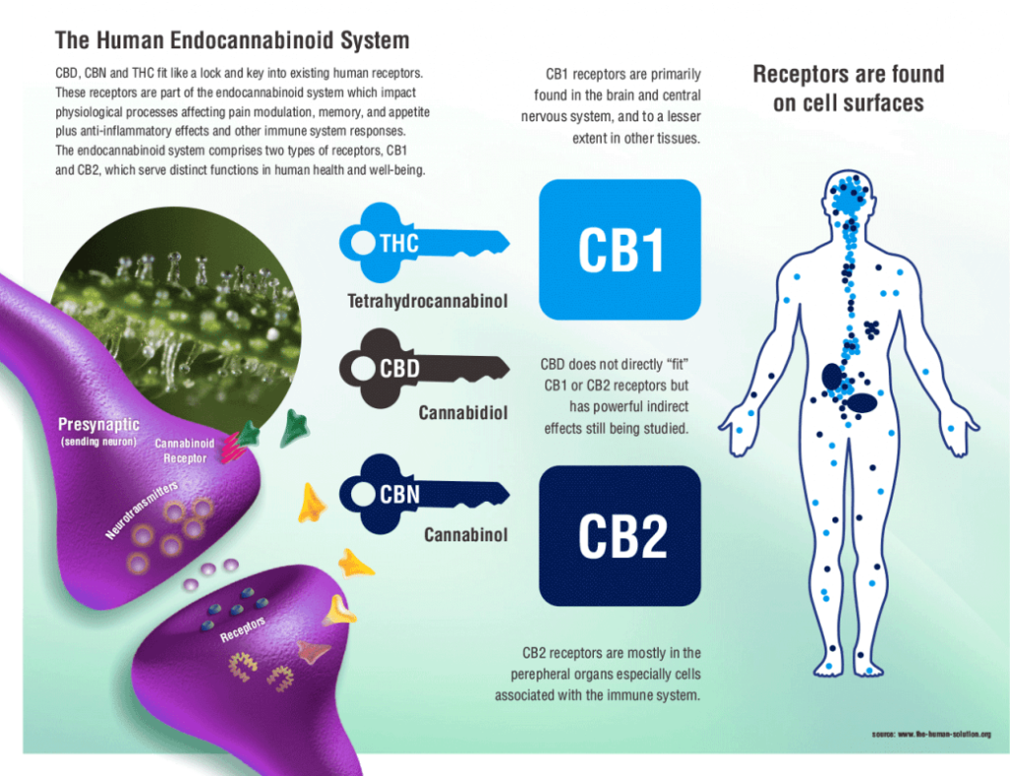
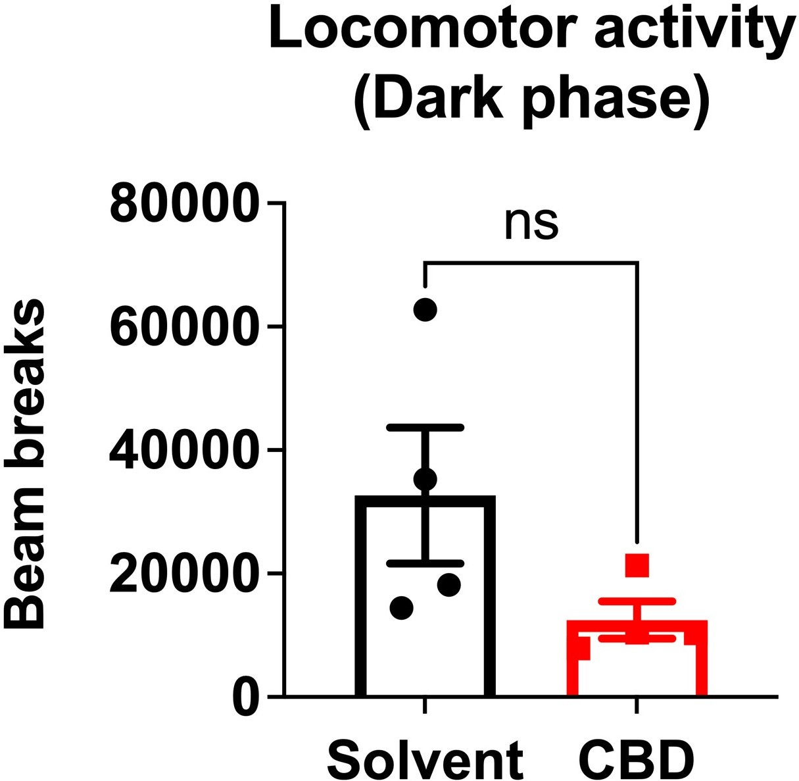
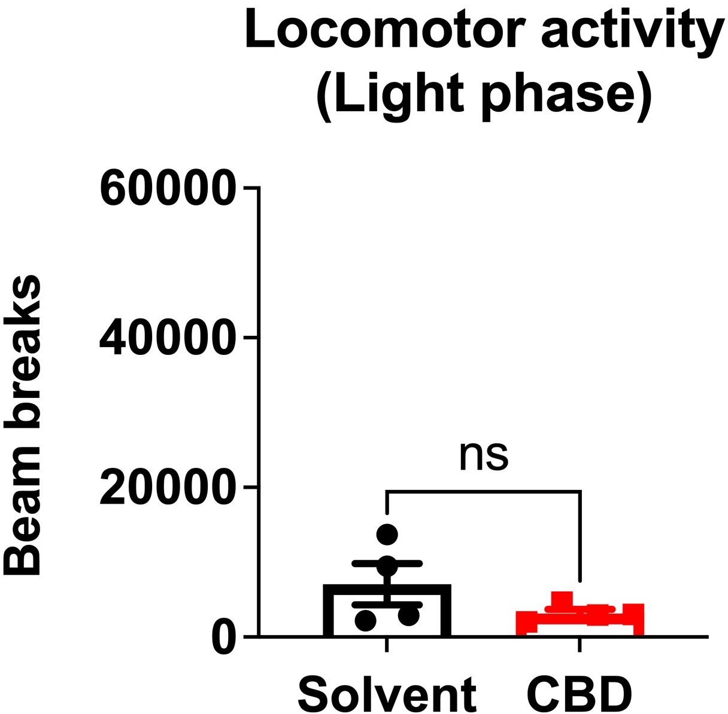
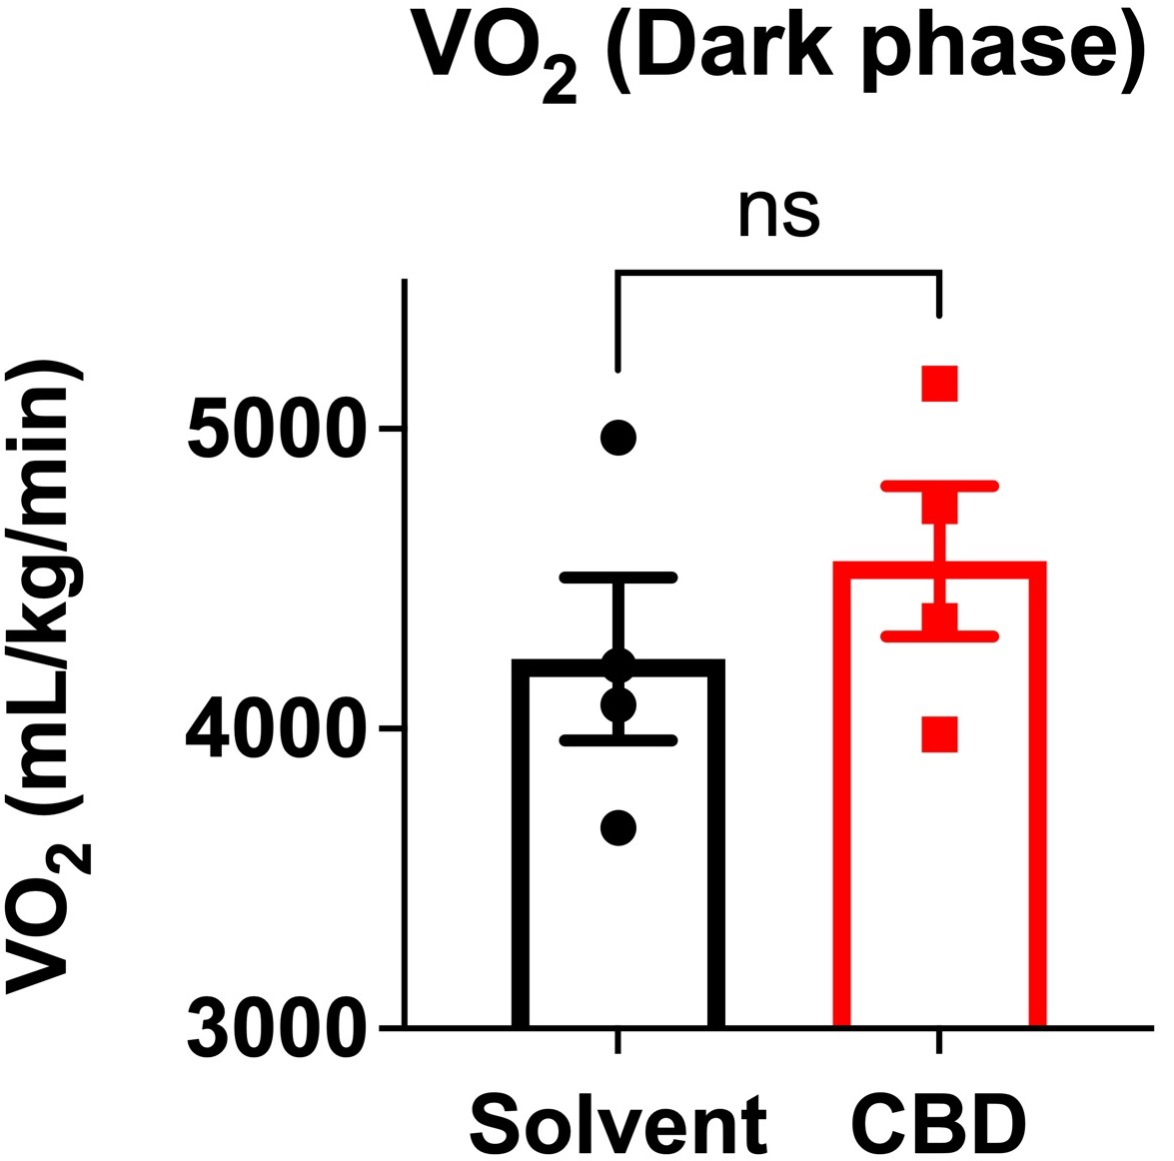
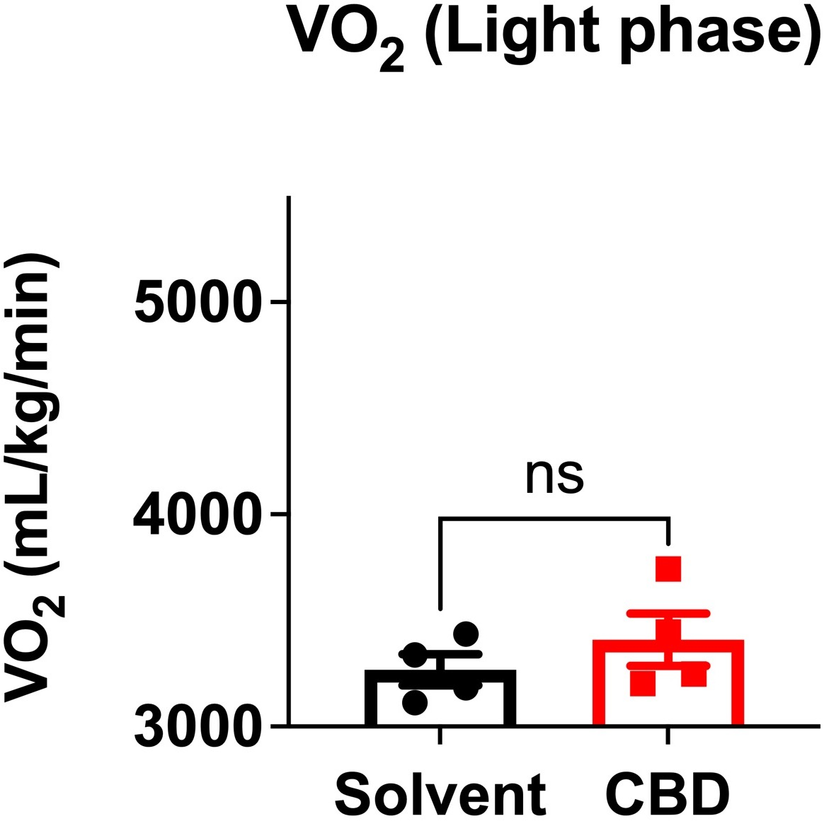
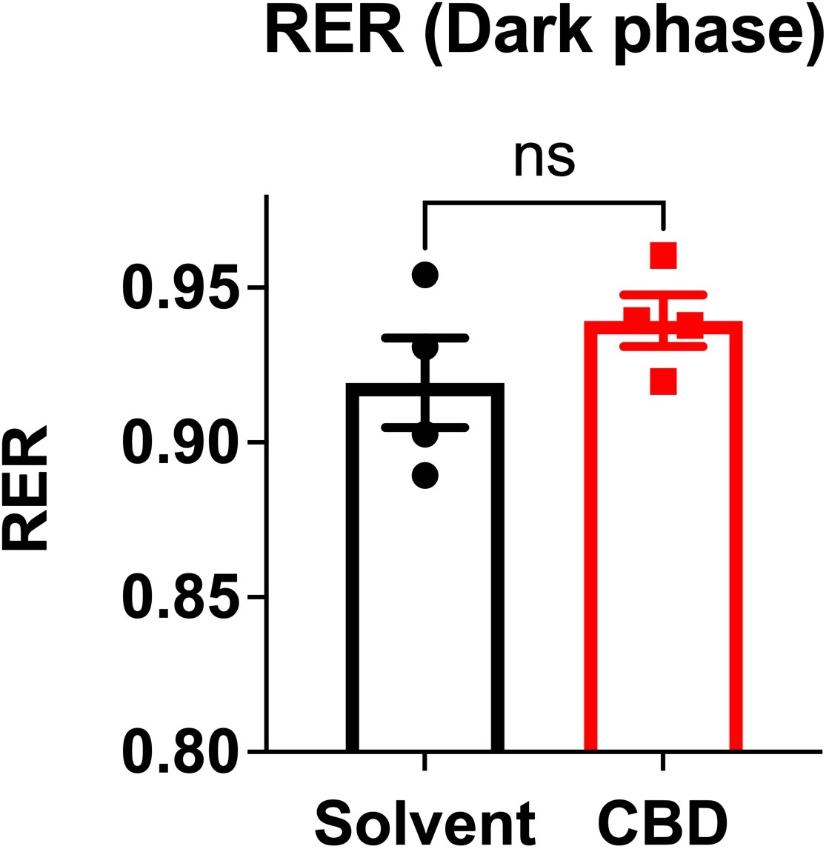
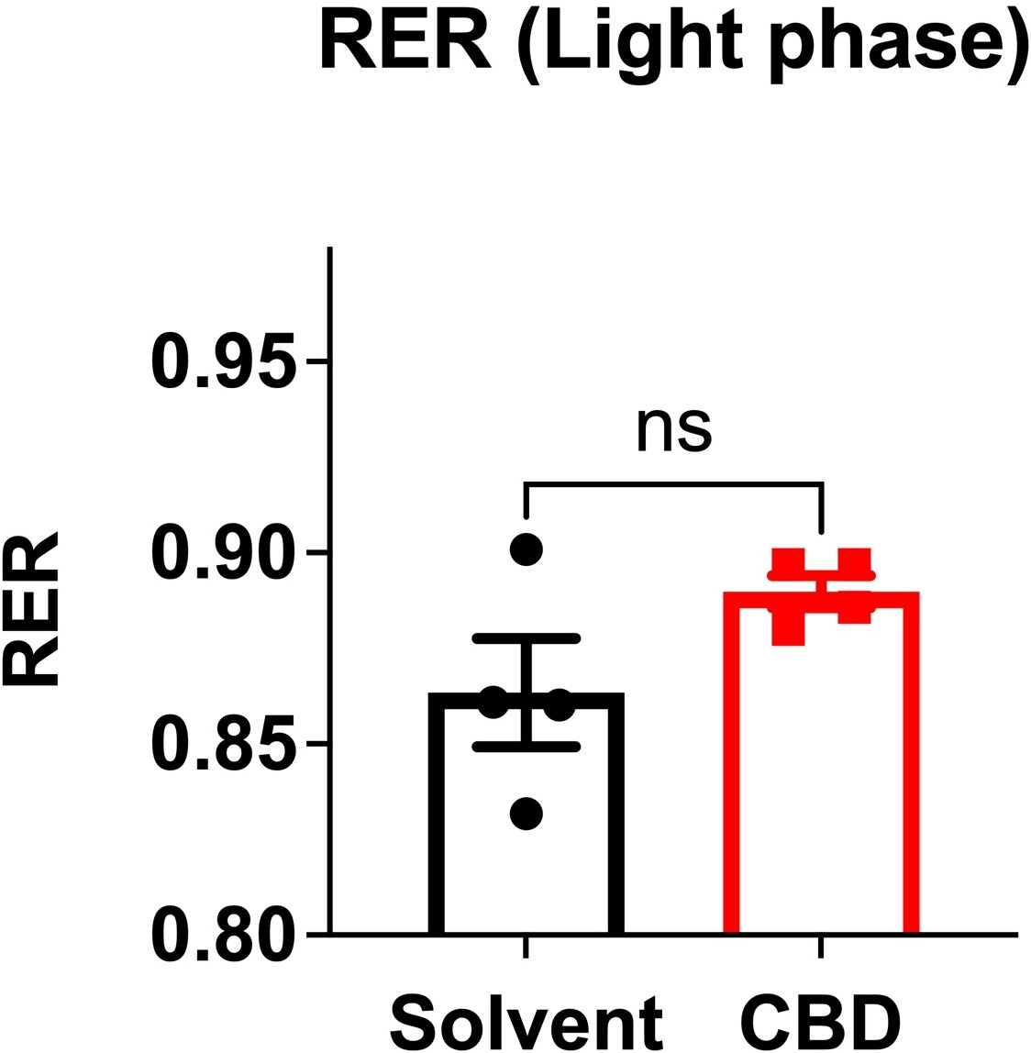
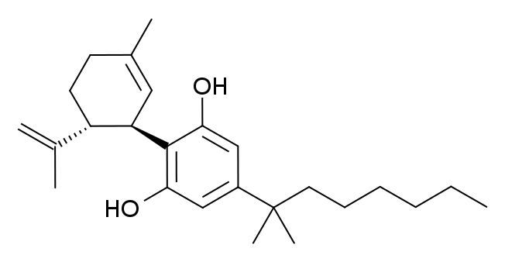
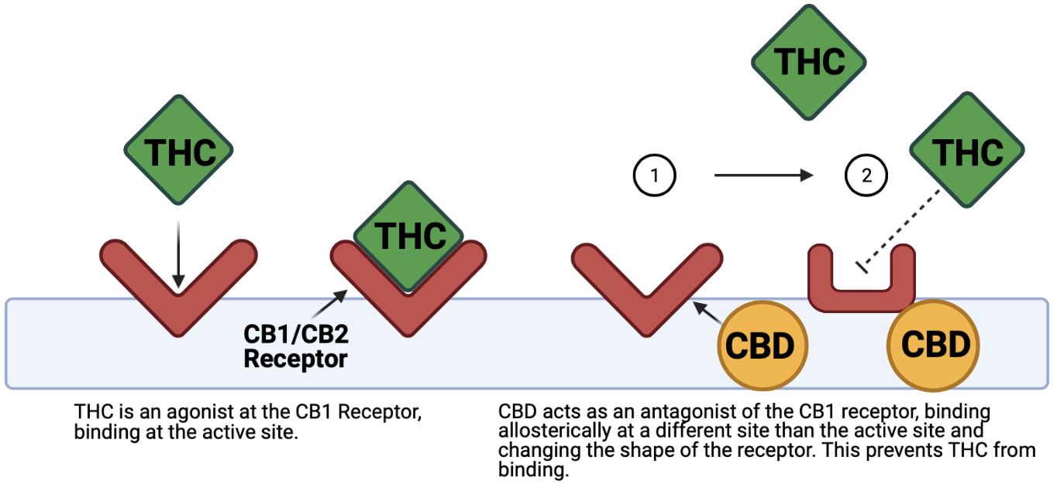
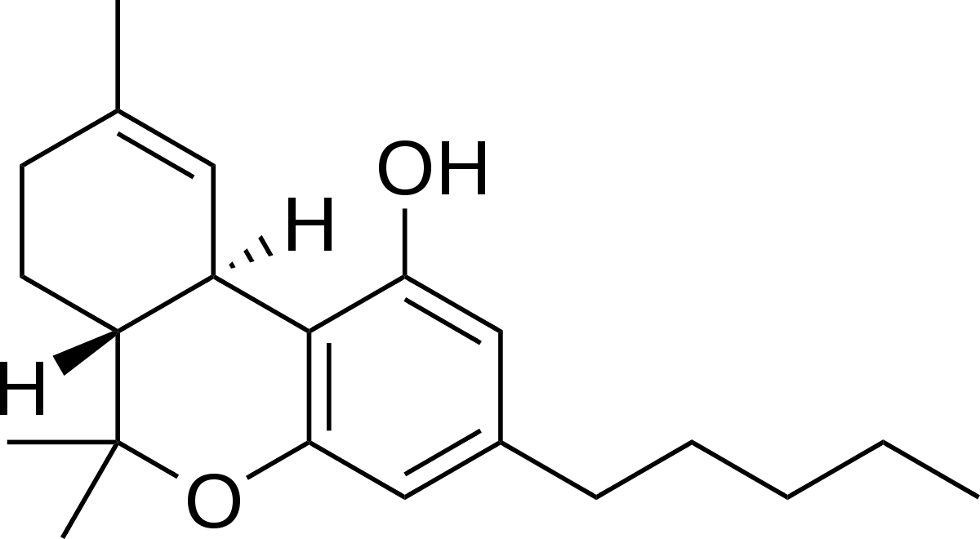
p=0.2127
Can CBD be used to treat metabolic disorders
while maintaining its anxiolytic effects?
N. Maykut¹, D. Landi-Conde^{1,2}, R. Ochoa^{1,2}, A Cox¹, C. Cedeno¹, T. Dolezel¹, E. Franck¹, C. May¹, A. Narvaez¹, C. Silver¹, and D.A. Fadool^{1,2,3}
The Florida State University, ¹Department of Biological Science, Tallahassee, FL-32306;
The Florida State University, ²Program in Neuroscience, and ³Institute of Molecular Biophysics, Tallahassee, FL-32306
m
Introduction
Methods
2. Chronic IP administration of CBD does not significantly alter energy expenditure.
5. Chronic IP administration of CBD decreases food intake.
As the medicalization of marijuana occurs across the United States, phytocannabinoids—a class of cannabinoids that are synthesized and extracted from plants—have become a popular form of treatment for conditions such as anxiety, depression, and many more through the endocannabinoid system. These phytocannabinoids can be extracted from the plant Cannabis sativa, with the most well-known compound being ∆9-tetrahydrocannabinol (THC). However, THC has psychoactive effects that may include hallucinations and delusions¹. Due to these undesired effects, cannabidiol (CBD)—another molecule that is also synthesized from Cannabis sativa—has become increasingly popular². CBD functions as a low-affinity antagonist, blocker of receptor activity, of the CB1 receptor and several other receptors². While researching the effects of CBD on behavior, our lab observed that CBD may also have a statistically significant impact on metabolic data such as body weight and food intake. This observation has inspired
the current project aimed to determine the effects of CBD on various
p=0.4559
p=0.0045
p=0.0851
p=0.1105
metabolic variables in mice and its possible treatment for the metabolic disorders that follow.
Metabolic Syndrome (MetS) refers to a group of five abnormal metabolic conditions that include hypertension, central obesity, insulin resistance, and high amounts of triglycerides or low amounts of HDL cholesterol in circulation. These factors are shown to increase one’s risk of developing cardiovascular disease or diabetes³. We are currently seeing an increase in the number of cases of metabolism-related disorders including diabetes⁴. This rise has signaled a need for new therapies to treat metabolic
3. Chronic IP administration of CBD does not significantly alter total ambulatory activity.
Future Considerations
The dosage of CBD used in this project was 10 mg/kg body weight of the mice. We plan to test three cohorts of mice (n=16) at two different dosages (10 mg/kg and 20 mg/kg) to determine the effects that dosage may have on these variables.
The preliminary results only consisted of female mice (n=4). We plan to test males and females in each cohort (n=8 each) and separate data by sex to look for any significant differences.
The use of the CLAMS allows for real-time data tracking—we will be able to examine the effects of CBD on a time scale. We are interested in determining how chronic administration of CBD truly exerts its effects. Is there a strong acute effect directly after administration? Are the effects of chronic administration additive over time?
The mice were treated with an intraperitoneal (IP) injection of 10 mg CBD/kg body weight for a period of four weeks. CBD injections were prepared using Purisys LLC synthetic cannabidiol (CBD). All mice used in this study were housed in vivaria with a reverse 12/12-hour light/dark cycle (lights off at 8:00 A.M. and on at 8:00 P.M.)
The metabolic data will be obtained using the Columbus Instruments Comprehensive Lab Animal Monitoring System (CLAMS). In conjunction with Oxymax computer software, CLAMS uses indirect calorimetry to provide real time data tracking of metabolic variables of interest. Mice are individually housed and acclimated to the metabolic chambers for two days prior to data collection.
Experiments were approved under protocol number #202000036 by the Florida State University Institutional Animal Care and Use Committee (IACUC). Experiments were performed on approximately 3-month-old male and female C57BL6/J mice (WT and Kv1.3−/−).
p=0.1276
syndrome however the best mechanism for treatment is still being uncovered. Studies have shown that there is a strong correlation between obesity and risk of diabetes, with many of these studies citing weight loss as the most effective treatment or prevention strategy⁴. Rimonabant, a previously prescribed weight loss drug, was shown to be effective in encouraging weight loss and restoring insulin sensitivity. Although Rimonabant is no longer prescribed due to its adverse side effects, we can extrapolate valuable information from its mechanism of action. Rimonabant, like CBD, acts as an antagonist of the CB1 receptor— binds to the receptor and blocks its activation by other molecules⁵. With this in mind, we are interested in seeing if CBD—a reported antagonist of the CB1 receptor—can induce weight loss like that of Rimonabant⁵. In contrast to Rimonabant, CBD functions as a low affinity antagonist and shows low activity in many efficacy assays⁶. Therefore, CBD may be able to produce the desired effects while also limiting the possibility of adverse side effects. We are interested in determining if, through its effects at the CB1 receptor, CBD may be an adequate treatment for metabolic disorders—inducing weight loss—while also limiting any adverse side effects—specifically anxiety.
p=0.2127
References
1. Lu, H. C. & MacKie, K. An introduction to the endogenous cannabinoid system. Biological Psychiatry vol. 79 516–525 (2016).
2. Zou, S. & Kumar, U. Cannabinoid receptors and the endocannabinoid system: Signaling and function in the central nervous system. International Journal of Molecular Sciences vol. 19 (2018).
3. Alger, B. E. Getting High on the Endocannabinoid System. Cerebrum (2013).
4. Blessing, E. M., Steenkamp, M. M., Manzanares, J. & Marmar, C. R. Cannabidiol as a Potential Treatment for Anxiety Disorders. Neurotherapeutics vol. 12 825–836 (2015).
5. Rochlani, Y., Pothineni, N. V., Kovelamudi, S. & Mehta, J. L. Metabolic syndrome: Pathophysiology, management, and modulation by natural compounds. Therapeutic Advances in Cardiovascular Disease vol. 11 215–225 (2017).
6. Pepper, I., Vinik, A., Lattanzio, F., McPheat, W. & Dobrian, A. Countering the modern metabolic disease rampage with ancestral endocannabinoid system alignment. Frontiers in Endocrinology 10, (2019).
7. Thomas, A. et al. Cannabidiol displays unexpectedly high potency as an antagonist of CB 1 and CB 2 receptor agonists in vitro. British Journal of Pharmacology 150, 613–623 (2007).
8. Zlebnik, N. E. & Cheer, J. F. Beyond the CB1 Receptor: Is Cannabidiol the Answer for Disorders of Motivation? Annual Review of Neuroscience 39, 1–17 (2016).
1. Chronic IP administration of CBD does not significantly alter oxygen consumption.
4. Chronic IP administration of CBD does not significantly alter respiratory exchange ratio (RER).
The structure of CBD
p=0.4124
p=0.2752
p=0.1243
The structure of THC
p=0.3580
Funding
This work was funded by the Florida Consortium for Medical Marijuana (MMJ) Clinical Outcomes Research. The authors declare no conflict of interest.
Created with BioRender.com
Notes:
Acute graphs at the top of each section

