Slide 1
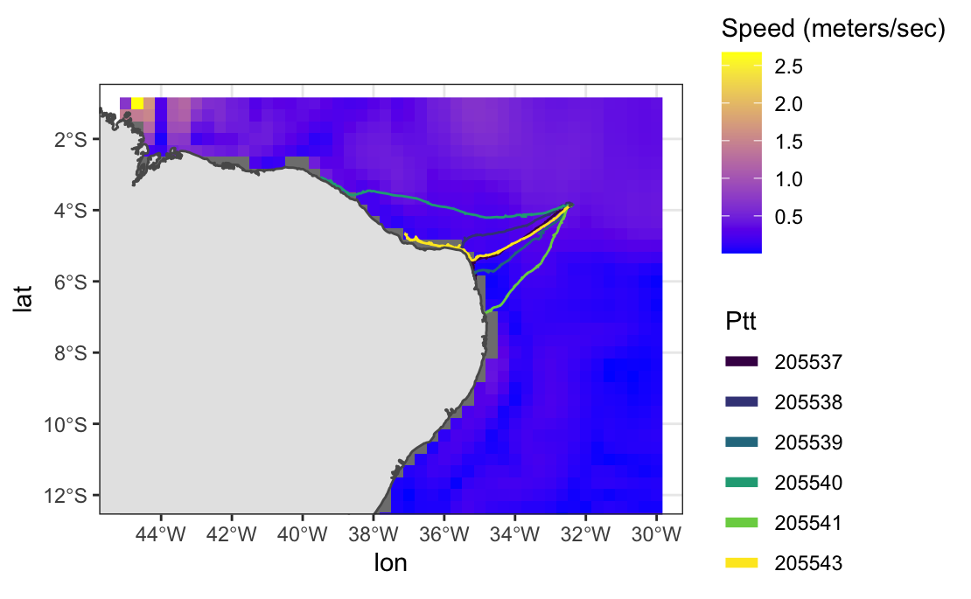
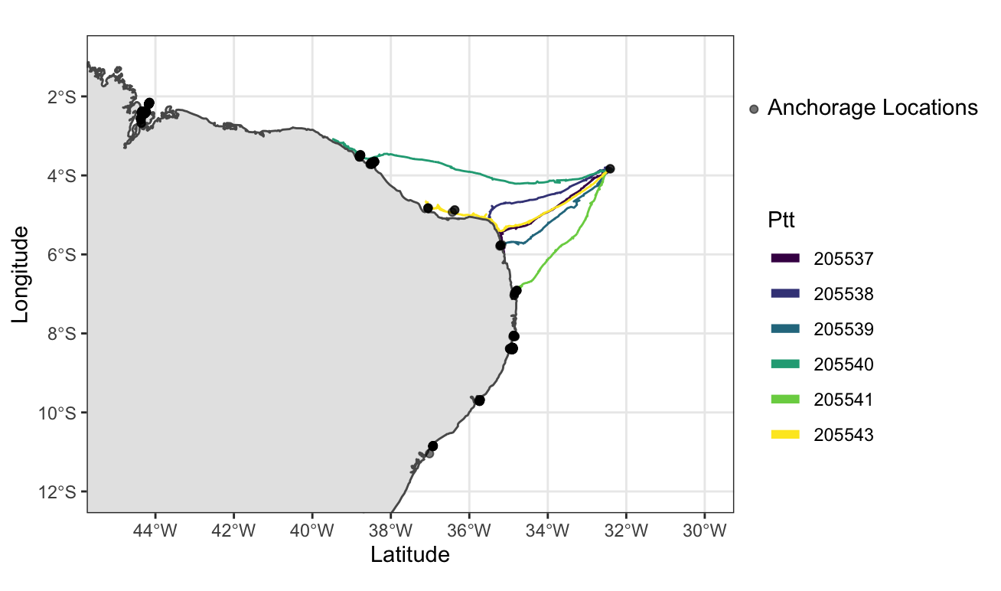
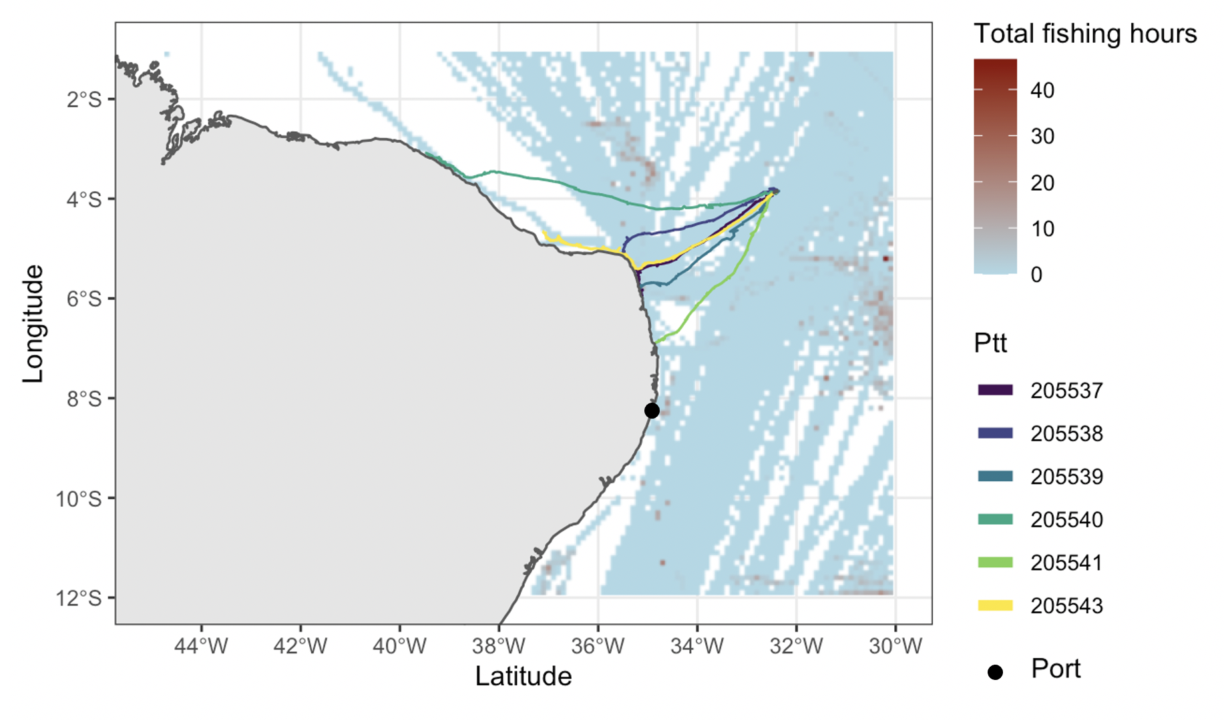
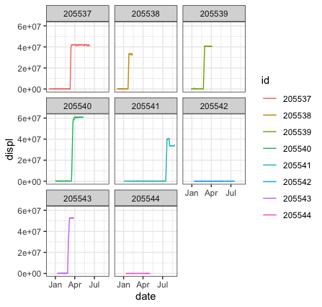
Assessing the functional connectivity of adult male green turtles
(Chelonia mydas) between an island rookery and coastal foraging grounds
Margaret Rivas, Mariana MPB Fuentes, Joshua Cullen
Florida State University, Tallahassee, FL.
Introduction
Understanding the drivers of marine animal movement is crucial in the effort to mitigate adverse impacts of anthropogenic activities and changing environments on landscape connectivity¹.
Long-distance movement patterns are affected by a number of internal (e.g., navigation, homing) and external factors (e.g., ocean currents, human development) that influence the location of migratory corridors for a given species.
Seascape permeability is an underexplored topic as barriers in least cost paths do not appear as evident as those in terrestrial environments.
There is a lack of information on the spatial ecology of adult male sea turtles since they are encountered and tagged much less frequently than nesting females and juveniles.
Results
Brazil
Objectives
Understand how natural and anthropogenic factors affect functional connectivity of green turtles (Chelonia mydas) between an island rookery and coastal foraging ground.
Compare seascape permeability to empirical turtle tracks to determine whether they use paths with the lowest estimated seascape resistance or use alternative corridors.
Figure 4. The presence of frequently utilized anchorage locations (where at least 20 unique vessels remained stationary at some point since 2012) are shown with respect to the migratory corridors of 6 post-breeding adult male green turtles.
Methods
8 post-breeding adult male green turtles were satellite-tagged from 2020-2021 at Fernando de Noronha, Brazil (N=24168 observations).
Location error from Argos and Fastloc GPS locations were accounted for using a continuous-time correlated random walk (CTCRW) as part of a state-space model (SSM) in the R package “foieGras” ².
Net-squared displacement (NSD) was calculated to identify the migration periods for each turtle³. This is a measure of the squared distance from the first observation to every other point on track.
Out of the 8 tagged turtles, only 6 are included in the subsequent analysis as these displayed migratory behavior while the other 2 remained resident at Fernando de Noronha.
Environmental variables included advective current velocity at the ocean surface, which was obtained from the NOAA Ocean Surface Current Analyses Real-time (OSCAR) database⁴.
Commercial fishing effort (as determined from Brazil’s Vessel Monitoring System) was obtained from Global Fishing Watch and aggregated for all of 2020⁵.
Consistent anchorage points (presence of at least 20 stationary vessels at some point since 2012) were gathered from Global Fishing Watch⁵ and used to account for human activity and boat mobilization.
Figure 2. Migratory corridors are shown for 6 post-breeding adult male green turtles with respect to ocean current velocity at the sea surface during January 2020.
Future Directions
Inclusion of additional variables, such as Earth’s geomagnetic field and carrier-vessel trajectories.
The development of a model to estimate habitat selection during the migratory period.
Using results of the habitat selection model as input to estimate permeability of the seascape.
Determine how closely the observed empirical turtle tracks overlap with predicted migratory corridors from the model and try to understand reasons for any deviations.
Figure 1. Net-squared displacement (NSD) was plotted over time to visually determine the start/end dates of migratory periods for 8 post-breeding adult male green turtles.
References
Alfaro-Shigueto, J., Mangel, J. C., Darquea, J., Donoso, M., Baquero, A., Doherty, P. D., & Godley, B. J. (2018). Untangling the impacts of nets in the southeastern Pacific: Rapid assessment of marine turtle bycatch to set conservation priorities in small-scale fisheries. Fisheries Research, 206, 185-192. doi:10.1016/j.fishres.2018.04.013
Jonsen, I.D., Patterson, T.A., Costa, D.P. et al. (2020). A continuous-time state-space model for rapid quality control of argos locations from animal-borne tags. Mov Ecol 8, 31. https://doi.org/10.1186/s40462-020-00217-7
Papworth, S.K., Bunnefeld, N., Slocombe, K. and Milner-Gulland, E.J. (2012), Movement ecology of human resource users: using net squared displacement, biased random bridges and resource utilization functions to quantify hunter and gatherer behaviour. Methods in Ecology and Evolution, 3: 584-594. https://doi.org/10.1111/j.2041-210X.2012.00189.x
NOAA National Centers for Environmental Prediction (NCEP).2011. NOAA/NCEP Global Forecast System (GFS) Atmospheric Model. https://www.ncei.noaa.gov/products/weather-climate-models/global-forecast
Global Fishing Watch. 2020. www.globalfishingwatch.org
Industrial and Port Complex of Suape
Figure 3. The number of total fishing hours of commercial fishing vessels in 2020 is compared to the migratory corridors of 6 post-breeding adult male green turtles.
Acknowledgements
We would like to thank the National Science Foundation for assistance with funding. We would like to thanks our collaborators Will White (OSU) and Lisa Komoroske (UMass). Field support was provided by Fundacao Pro-Tamar and Armando Santos. The permits obtained for the project were ACUC (1803) and SISBIO (9389-9).

