Slide 1
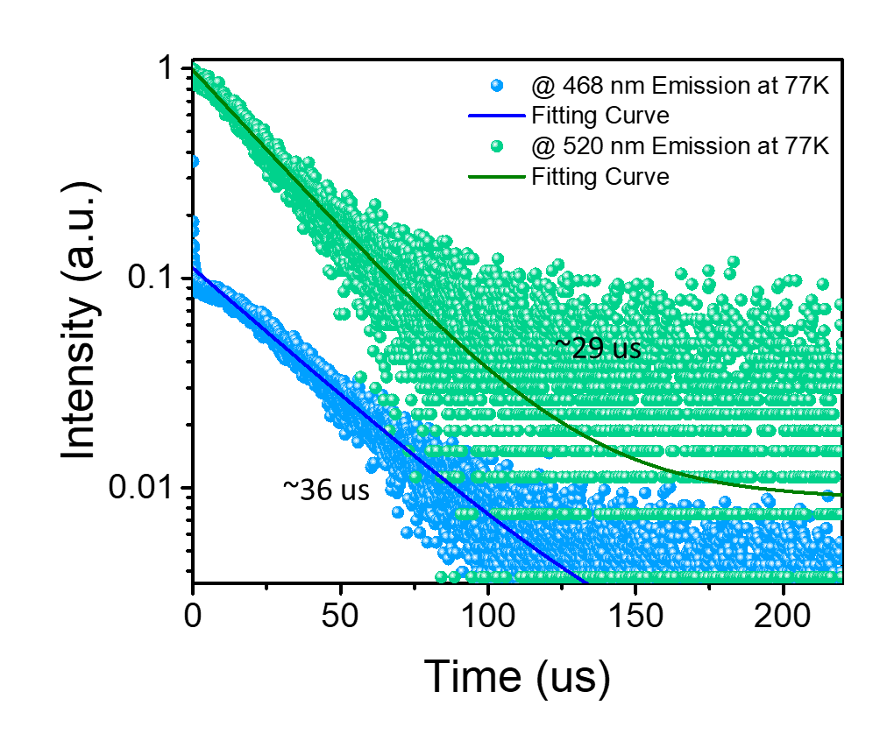
Development of Unique One-Dimensional Organic Metal Halide Hybrids
Derek Luong, Sujin Lee, and Dr. Biwu Ma
Florida State University, Department of Chemistry and Biochemistry
Abstract
Objective
Discussion
The family of low-dimensional organic metal halide hybrids at the molecular level has attracted great attention as a new type of light-emitting material due to its structural versatility and exceptional optical properties. The structural versatility of this class of materials provides ample space to explore new crystal structures exhibiting diverse properties. Here, a rare new 1D edge-shared pyramidal lead bromide hybrid, (C₁₃H₁₉N₄)PbBr₃, is synthesized via an antisolvent diffusion approach. The majority of 1D lead halide hybrids are composed of [PbX₆] octahedrons, yet a limited number of hybrids based on five-coordinated [PbX₅] units were reported. With this unique 1D hybrid which is developed by rational synthetic approaches, we explored its distinct properties, using Single-Crystal X-ray Diffraction (SCXRD), X-ray Diffraction (XRD), Photoluminescence steady-state studies, etc.
The goal is to develop new single-crystalline 1D lead bromide hybrids as an extension of the previously reported 0D HMTA₂PbBr₄ with the same starting materials to get different dimensional structures and properties.
By adjusting the ratios between HMTA and PbBr₂, we have been able to synthesize a rare new 1D edge-shared pyramidal lead bromide hybrid, HMTAPbBr₃. HMTAPbBr₃ shows the broadband greenish emission only at 77K with a long decay lifetime due to its flexible and highly distorted structure. Our work not only gives a new single crystalline material but also suggests a rational synthetic approach to manipulate its structure and optical properties.
Results
References
Lin, H.; Zhou, C.; Tian, Y.; Siegrist, T.; Ma, B. Low-Dimensional Organometal Halide Perovskites. ACS Energy Letters 2017, 3 (1), 54–62.
Lin, H.; Zhou, C.; Chaaban, M.; Xu, L.; Zhou, Y.; Neu, J.; Worku, M.; Berkwits, E.; He, Q.; Lee, S.; Lin, X.; Siegrist, T.; Du, M.; Ma, B. Bulk Assembly of Zero-Dimensional Organic Lead Bromide Hybrid with Efficient Blue Emission. ACS Materials Letters 2019, 1, 594-598.
Hu, T.; Smith, M. D.; Dohner, E. R.; Sher, M.-J.; Wu, X.; Trinh, M. T.; Fisher, A.; Corbett, J.; Zhu, X.-Y.; Karunadasa, H. I.; Lindenberg, A. M. Mechanism for Broadband White-Light Emission from Two-Dimensional (110) Hybrid Perovskites. The Journal of Physical Chemistry Letters 2016, 7 (12), 2258–2263.
Figure 1. Image of HMTAPbBr₃ single-crystals under (top) ambient light, (bottom left) under UV irradiation (365 nm) at RT, and (bottom right) at 77K.
Figure 2. Single-crystal structure of 1D HMTAPbBr₃.
Procedure
HMTAPbBr₃ was synthesized via antisolvent diffusion by dissolving HMTA and PbBr₂ at a 1:1 molar ratio into 6mL of DMF. Next, 1 mL of the precursor solution was then placed into 2 mL of DCM and was left to set overnight. The obtained colorless needle-like crystals were washed with DCM and dried under reduced pressure.
Figure 3. Powder X-ray diffraction (PXRD) patterns of the HMTAPbBr₃.
Figure 4. Thermogravimetric analysis (TGA) of HMTAPbBr₃.
Materials
Antisolvent Diffusion Method
N-benzyl Hexamethylenetetramine (HMTA) Bromide
Acknowledgments
I would like to express my gratitude to Dr. Ma and the Ma group for allowing me to participate in their lab for the past 2 semesters. A special thanks to Sujin Lee for mentoring me throughout my time in the lab.
PbBr₂
DMF / DCM
Figure 5. Excitation and emission spectra of HMTAPbBr₃ at 77K.
Figure 6. The photoluminescence decays of HMTAPbBr₃ (measured at 468 nm and 520 nm) at 77K.

