Slide 1
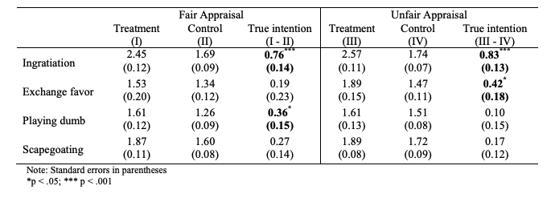
Perceived Fairness in Performance Appraisal and Political Behaviors:
A List Experiment of Employees’ Reaction to Performance Appraisal
Aaron Gow, Joohi Kim, Dongfang Gaozhao
Florida State University Askew School of Public Administration and Policy
Introduction
Performance appraisals are tools used by management to assess the quality and production of employees. As evaluators, managers assess the performance of their employees for the purpose of determining pay increases, promotions, transfers, termination, and other employment-related decisions(Ashbough & Moussavi, 1995). Especially in the public sector, anecdotal observations and survey findings indicate that the extrinsic component embedded in performance appraisal may cause a crowding out effect on employee motivation, resulting in perceived stress, demotivation, or even burnout(Kellough & Nigro, 2002; Pearce & Perry, 1983). These shortcomings lead into the main hypothesis about the research
Methods
List Experiment: One Control Group and One experiment group
220 FSU Students participated
Each Group had a separate group that has a fair or unfair appraisal
Presented with four questions
Question for ingratiation(trying to be likeable), exchanging of favors, playing dumb and scapegoating
A sensitive or political action is only presented to the experimental group as an option
Counted total items chosen in each of the four groups to create authenticity
The mean difference between the experimental and control was taken
Discussion/Conclusion
Only the second and third hypothesis was supported by the data
Both fair and unfair appraisal groups were favorable to participate in ingratiation
Neither groups were inclined to participate in scapegoating
Not only unfair appraisals led to political activities
Although it is a positive sign that a couple of the hypothesis were supported by the experiment and data. More questions apply when it comes to applying these results to actual public employees. The entire procedure would change because every company has a different way of evaluating their employees. These can range from basing their performance on set tasks that the employee and employer are aware of. It can be interpreted that a student’s mindset would be different from public employees based on growth and the environment that they are around. This experiment can be replicated in a different manner with a larger pool to determine that public employees react in a negative manner based on their appraisal.
Preliminary Results
Hypothesis
Employees with a perception of unfair performance appraisal are more likely to engage in ingratiation.
Employees with a perception of unfair performance appraisal are more likely to engage in exchanges of favors.
Employees with a perception of fair performance appraisal are more likely to play dumb
Employees with a perception of fair performance appraisal are more likely to engage in scapegoating
References
Kellough, J. E., & Nigro, L. G. (2002). Pay for performance in Georgia state government
employee perspectives on Georgia gain after 5 years. Review of Public Personnel Administration, 22, 146-166.
Moussavi, F., & Ashbaugh, D. L. (1995). Perceptual effects of participative, goal-orientated performance appraisal: a field study in public agencies. Journal of Public Administration Research and Theory, 5 (3), 331–344.
Pearce, J. L., & Perry, J. L. (1983). Federal merit pay: A longitudinal analysis. Public Administration Review, 43, 315-325.

