Slide 1
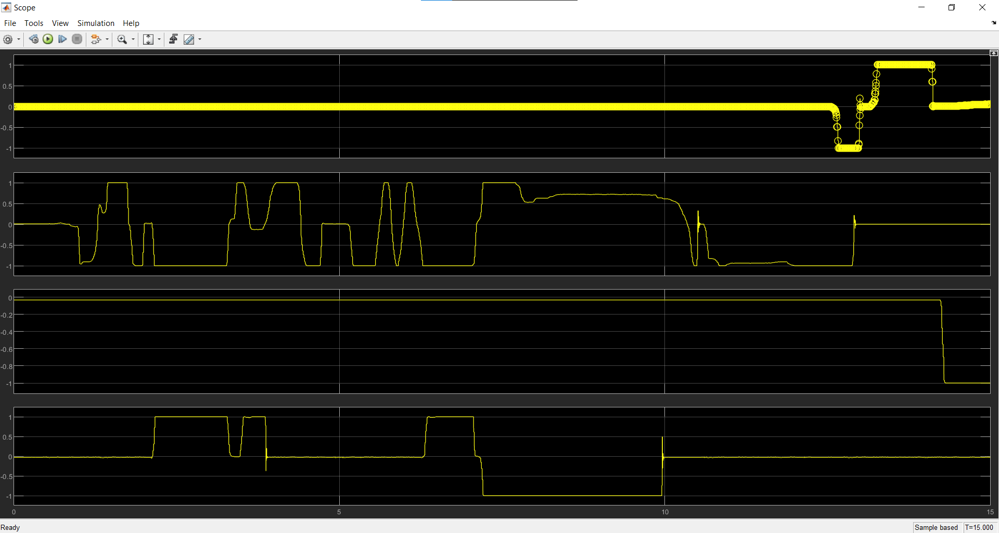
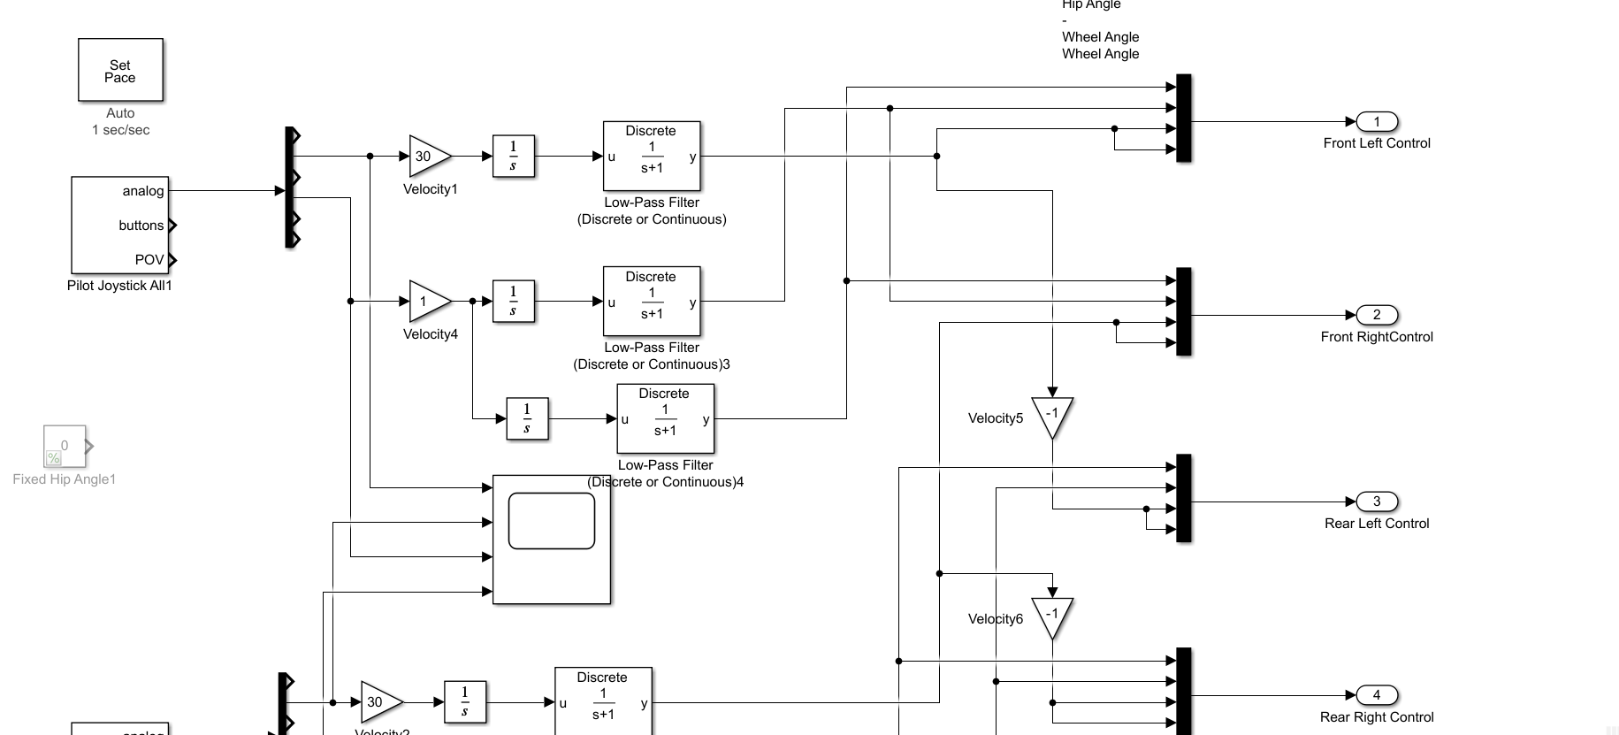
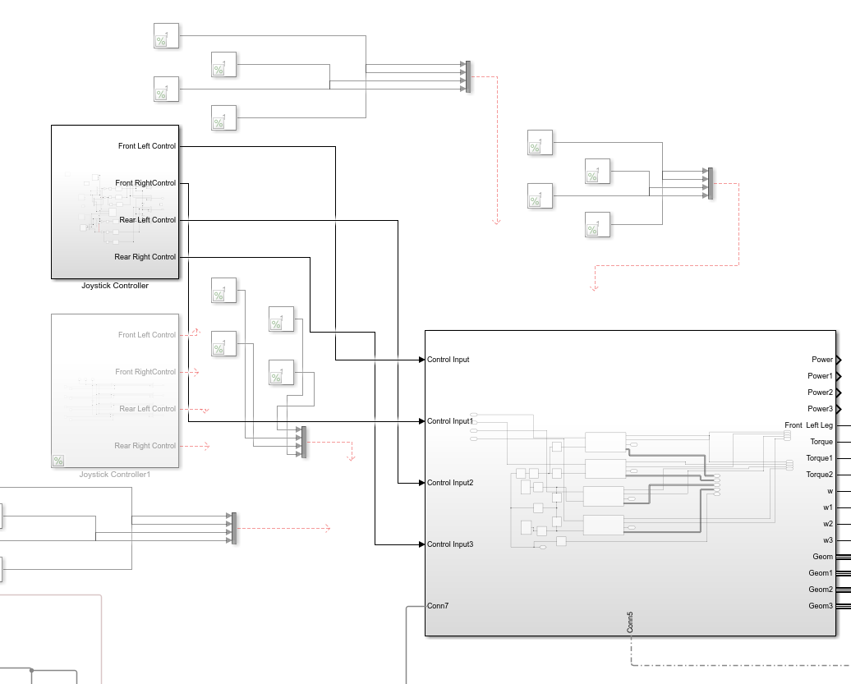
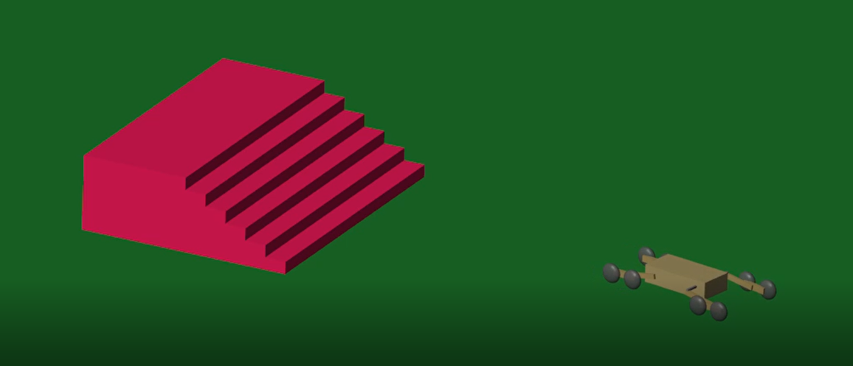
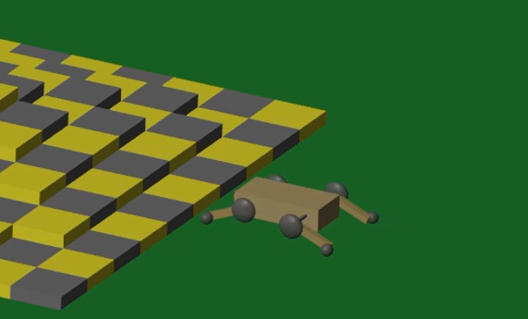
Simulating Unmanned Ground Vehicles Traversing Rough Terrain Jose Brouwer and Dr. Christian Hubicki College of Computer Science, FAMU-FSU College of Engineering, Florida State University
Abstract
Methods
Input From Gamepad Being Received
Traversing certain types of terrain with unmanned Ground Vehicles (UGV) can be an arduous task. Some are not suited to cover certain terrains whatsoever. The project seeks to further develop and simplify the controls of UGVs designed to navigate these rough/inaccessible terrains. Utilizing code and simulations produced by graduate students in the Optimal Robotics Lab, these simulations were optimized to be more user friendly and accessible. These optimizations involved the tweaking and redesign of certain features to reduce the interface complexity. So far, incompatibility issues have prevented major progress from being made towards the goal of optimizing these simulations. Once these issues are solved, progress is expected to be more abundant.
- Use of MATLAB official resources and tutorial to learn programming in MATLAB and the efficient use of the Simulink simulation environment.
- Use of previously developed code and Simulink environments by graduate students and Optimal Robotics Lab members to produce more efficient and user-friendly devices.
Simulink Simulation Programming
Debugging Simulink Program
Alpha Model V1 in Simulink
Results
Discussion
Results on the improvement of controls and handling are still pending with the goal of making the devices more accessible and user-friendly.
The progress made on these simulations demonstrates possible features to implement into future iterations of Unmanned Ground Vehicles allowing them to become more versatile and easier to control.
Introduction
In recent history, we have seen a surge of UGVs being used for a variety of purposes. Delivery, reconnaissance, rescue, even bomb defusal are all tasks UGVs have undertaken. The introduction of these machines sought to reduce human exposure to dangerous and/or inaccessible areas such as radioactive terrain. By sending in an UGV to accomplish the desired task you remove the possibility of exposing others to a dangerous environment. Another example is the defusal of bombs. Utilizing a remote-controlled robot to manage the defusing of explosives allows for the handling of a situation without risking additional lives. These machines are helping save lives daily. This is the foundation for this project. Our endeavors seek to further develop and simplify the controls of robots designed to traverse these rough/inaccessible terrains.
Paddle Model V1 in Simulink
References
Clark, J., Hubicki, C., Austin, M., Mane, A., Stratum, B. V., & White, J. (2019, December 19). L3Harris High Mobility UGV Study.
Acknowledgements
I would like to thank Dr. Christian Hubicki for allowing me to join his lab and research. Thank you for helping me overcome the variety of obstacles I encountered through this project and exposing me to new horizons. I would also like to thank the Undergraduate Research Opportunity Program for proving me with the opportunity to be part of research and informing me on the many intricacies of research.

