Slide 1
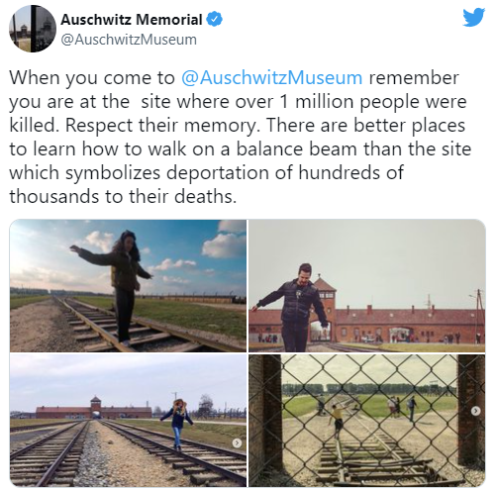
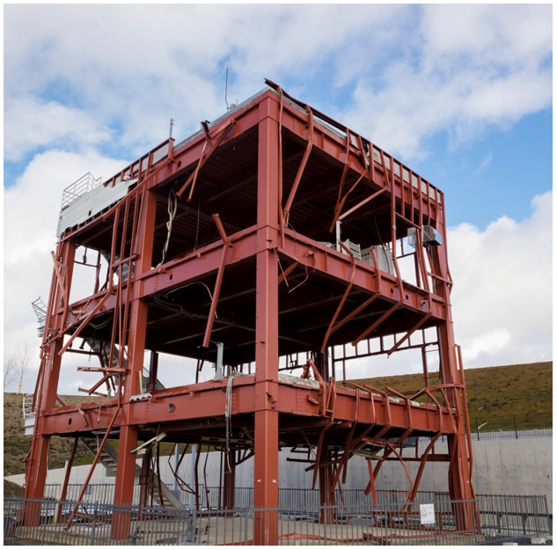
The Ethics of Dark Tourism
Joshua Liebman
Florida State University
Department of Religion
Research Mentor: Dr. Kristina Buhrman
Abstract
Methodology
Conclusions
Tourism has been and continues to be a major economic factor for communities.
Through research on historical memorials and disasters, the question of visitor movement and motivation emerged. A fledgling concept, Dark Tourism, has been proposed to explain the reasoning behind tourist movement to sites famous because of tragedy and disaster.
Tourism to sites such as the Catacombs of Paris and Auschwitz is notorious for the “dark” motivations of their visitors. To understand whether Dark Tourism is ethical, this investigation will cross-examine literature on Dark Tourism. Data collected and the conclusion from this research will not only help with optimization of tourist sites, but also to allow the audience to answer a subjective question, is Dark Tourism ethical?
Through the course of this investigation, a collection of literature on Dark Tourism was consulted, comparing various analyses, spanning from 1996 to 2019.
These ranged from the original work whose authors coined the term “Dark Tourism”, to social media articles about visitor conduct at Auschwitz.
Although a relatively new field, a number of works were found with varying viewpoints.
These works were analyzed, yielding arguments for and against Dark Tourism’s ethicality.
Refer to the “Conclusions” section for the ethicality involved in Dark Tourism presented.
This theory was applied to various primary and secondary sources, including social media.
An overwhelming amount of literature on Dark Tourism points towards its positive use as an educational tool. Other sources found that not all visitors to for example, Arlington Cemetery D.C., go because of an obsession with death, instead, some visitors likely go because it is a beautiful park with calming scenery.
However, many examples can be found where proper reverence is not respected in their interpretations by tourists. Think of Auschwitz and the recent cases of people taking selfies and making a mockery of what the site is meant for: education.
The biggest ethical issue lies with the commodification of tragic experiences, especially those of the affected community. Centralia, PA, whose residents live in what the media calls a “toxic ghost town” feel this injustice everyday, with visitors coming to see their town as if they were animals in a zoo.
Yet, these sites present educational elements encouraging tourists to be “aware” of the world. Although the dark motives for visiting are real and evident, perhaps cultural sites like these present a great value in keeping Dark Tourism?
Applications
A post from the Auschwitz Museum social media team asking visitors to refrain from disrespectful acts.
References
The motivations of those who visit the many disaster memorials and monuments can be wildly different.
It is understood that Dark Tourism deals with the philosophical interrogation of death and disaster. Put simply, visitors who are interested in these sites manifest their intentions to understand the experience through the lens of the victims.
Throughout history, humans have always had a fascination for death and disaster. Gladiator games brought in huge swaths of people, popular attendance of public executions, the list goes on and on.
Tourists might come to understand the power of a tsunami – enough to bend even rebar and steel – but those affected come to the same memorial to grieve for their loved ones and commemorate the memory of their city.
Holocaust sites are prime examples. Some go to these as heritage, and others go for Dark Tourism reasons.
Media plays a huge role in shaping Dark Tourism. For instance, the Netflix show “Dark Tourist” received pushback from Japan due to the show’s portrayal of Fukushima as a dangerous place, although that danger is a part of the “dark” appeal of the site. Their portrayal contributed to Fukushima evacuees being discriminated against, and the loss of a market for Fukushima products.
Dimitrovski, Darko & Luković, Maja & Senić, Vladimir. (2019). Motives, obsession with death and behavioral intentions in dark tourism.
DeKok, David (October 2009). Fire Underground: The Ongoing Tragedy of the Centralia Mine Fire. ISBN 9780762758241.
Farmaki, Anna. (2013). Dark tourism revisited: A supply/demand conceptualization. International Journal of Culture Tourism and Hospitality Research.
Lennon, J. John, and Malcolm Foley. Dark Tourism. Cengage Learning, 2010.
Malcolm Foley & J. John Lennon (1996) JFK and dark tourism: A fascination with assassination, International Journal of Heritage Studies.
Acknowledgements
I’d like to thank Dr. Kristina Buhrman, whose research originally inspired this project.
I’d like to thank Alicia Batailles and UROP for the opportunity to present this information today.
Lastly, I’d like to thank my instructors, Emma Bernstine and Kaitlyn O’Connor, whose tireless work enabled us to be here today.
The “Bosai Building”, once a disaster management center for the town of Minamisanriku, it is now a shrine to the 830 deaths and many more displaced from the 3.11 Earthquake.

