Slide 1
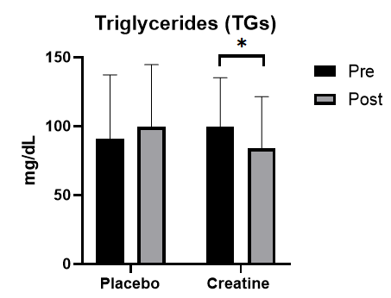
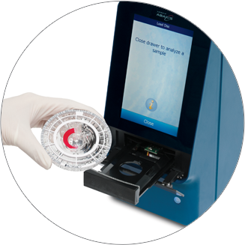
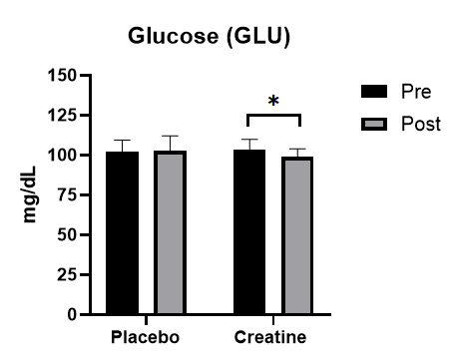
The Effects of 4-Week Creatine Supplementation on Lipid Profiles in Older Adults
Kyle Kraeher, and Dr. Holly Clarke,
Florida State University’s Department of Nutrition, Food, and Exercise Science College of Human Sciences
Abstract
Methods
Aging can lead to the deterioration of a variety of physiological systems. Older adults are at a higher risk of both hyperglycemia and dyslipidemia, both of which can be further augmented by a poor diet and inactivity. There is some evidence suggesting that creatine may potentially serve as a therapeutic aid, eliciting positive effects upon blood glucose and lipid levels. Therefore, creatine has been termed a potential nutraceutical, capable of exerting promising effects upon common pathologies the US population face today. The purpose of this research was to determine the effects of four weeks of creatine supplementation on lipids and blood glucose in healthy, older adults. Twelve adults consumed creatine monohydrate (CM) and placebo for 4 weeks. Pre- and post supplementation, participants underwent a fasted venous blood draw. Plasma levels of cholesterol (CHOL), high density lipoprotein (HDL), triglycerides (TG), non-HDL cholesterol (nHDLc), low density lipoprotein (LDL), very LDL (vLDL), and blood glucose (GLU) were then analyzed using a Piccolo Xpress clinical chemistry analyzer. Results were analyzed by 2x2 Repeated Measures ANOVA, with significance accepted as p < 0.05. vLDL decreased in both groups on average – 2.46 mg/dL showing significant improvement in TG and GLU however there were no significant changes following CM in LDL, HDL, nHDLc, or CHOL. Due to the strong relationship between triglycerides and glucose with CVD, the ability of creatine to reduce these suggests that creatine may have the possibility to serve as an adjuvant therapy for the control of TGs and glucose.
Twelve adults consumed creatine monohydrate (CM) and placebo (maltodextrin) for 4 weeks.
Pre- and post-supplementation, participants underwent a fasted venous blood draw.
Plasma levels of cholesterol (CHOL), high density lipoprotein (HDL), triglycerides (TG), non-HDL cholesterol (nHDLc), low density lipoprotein (LDL), very LDL (vLDL), and blood glucose (GLU) were then analyzed using a Piccolo Xpress clinical chemistry analyzer.
Introduction
Results
Approximately 10.5% of adults in the United States (US) suffer from hyperglycemia
33.5% of adults older than 20 suffering from dyslipidemia
Both hyperglycemia and dyslipidemia can be highly correlated to increased risk of heart disease, fatty liver disease, and diabetes one and two
The efficient management of uncontrolled sugar and/or lipids levels is vital
not every citizen in the US can afford pharmaceutical treatments, and not every citizen has insurance, diabetes medication with no health insurance can cost up to 500 dollars a month.
Evidence suggests that creatine can serve as a therapeutic strategy to help with these common diseases.
Creatine, an easily accessible supplement has been shown to have antioxidant, anti-inflammatory, and lipid/blood glucose maintenance properties
Aimed to assess the effects of four-week creatine supplementation on lipids and blood glucose in older adults.
Noticeable improvements in TG (Pre: 99.81± 35.35 mg/dL, Post: 3.82 ± 37.65 mg/dL, p < .05) and GLU (Pre: 103.64 ± 6.28 mg/dL, Post: 99 ± 4.9 mg/dL, p < .05).
There was a significant main effect of time in that vLDL decreased in both groups on average – 2.46 mg/dL.
There were no significant differences in the levels of LDL, HDL, nHDLC, or CHOL
* = significant change pre- to post-, p < .05
Conclusion
Main detail to take away from this experiment is that the supplementation of CM improved TG levels
Future research is needed to further support findings of CM effect on the body concerning antioxidant, anti-inflammatory, and lipid/blood glucose maintenance properties.
Participant Descriptive Characteristics (n=12)
Variables | Value (+/- SD)
Age (years) | 59 ± 2.7
Height (cm) | 171.7 ± 8.2
Weight (kg) | 75.6 ± 17.9
BMI (kg/m²) | 25.7 ± 5.9
References
Clarke, H., Kim, D.-H., Meza, C. A., Ormsbee, M. J., & Hickner, R. C. (2020). The Evolving Applications of Creatine Supplementation: Could Creatine Improve Vascular Health? Nutrients, 12(9). http://dx.doi.org/10.3390/nu12092834
Chia, C.W., Egan, J.M., Ferrucci, L. (2018). Age Related Changes in Glucose Metabolism, Hyperglycemia, and Cardiovascular Risk. American Heart Association, 123(7), 886-904 https://doi.org/10.1161/CIRCRESAHA.118.312806
Liu, H., Li, J. (2014). Aging and dyslipidemia: A review of potential mechanisms. Elsevier, 19, 43-52. https://www.clinicalkey.com/#!/content/playContent/1-s2.0-S1568163714001287?returnurl=null&referrer=null

