Slide 1



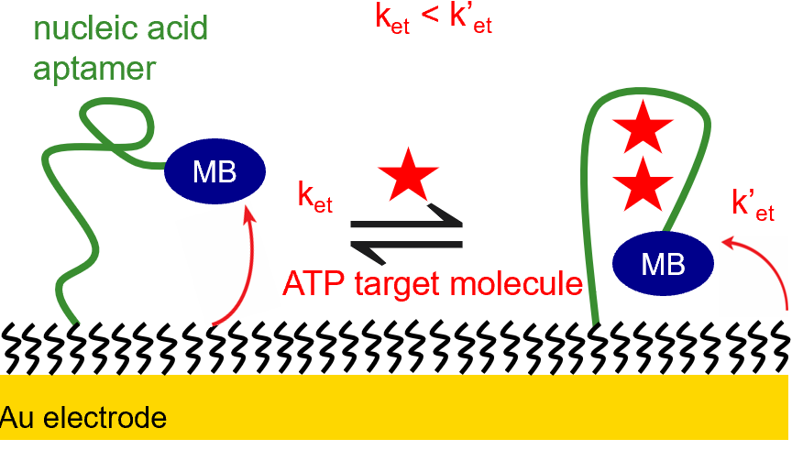
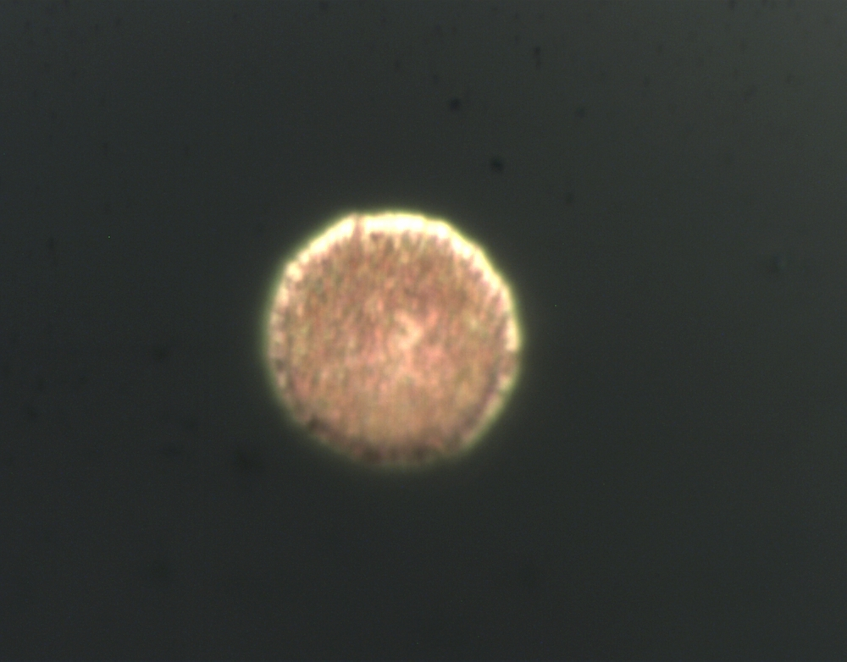
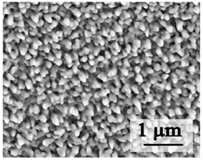
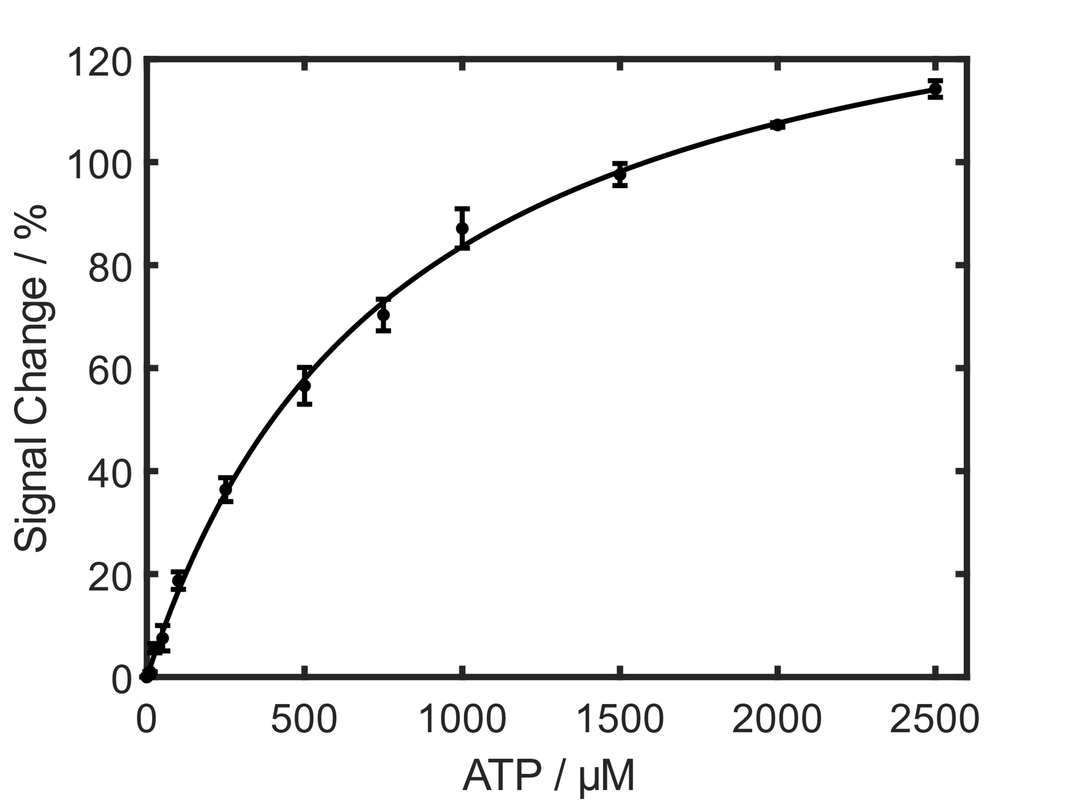
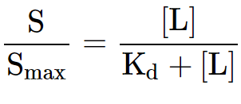
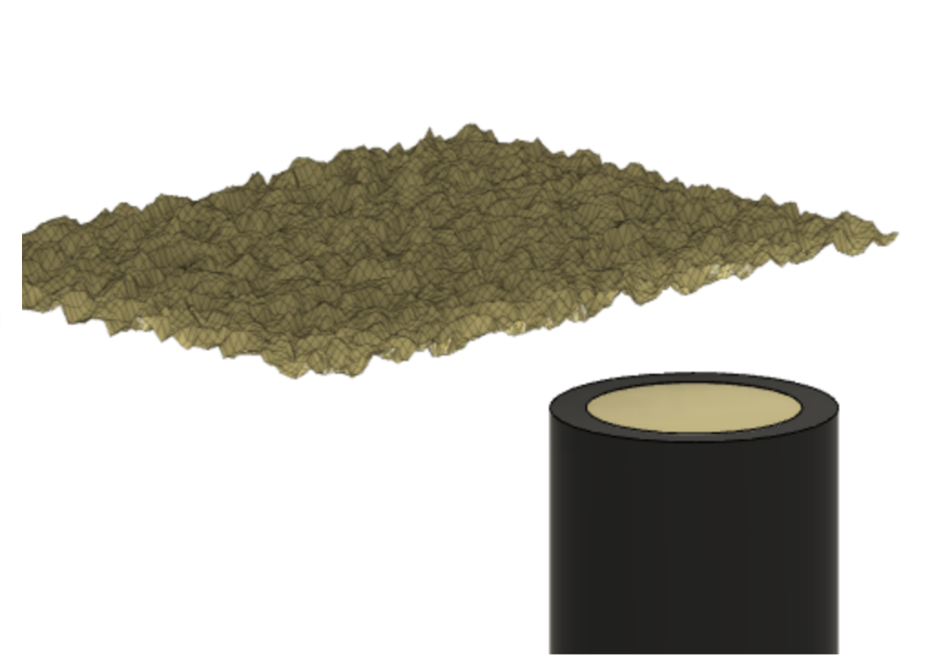
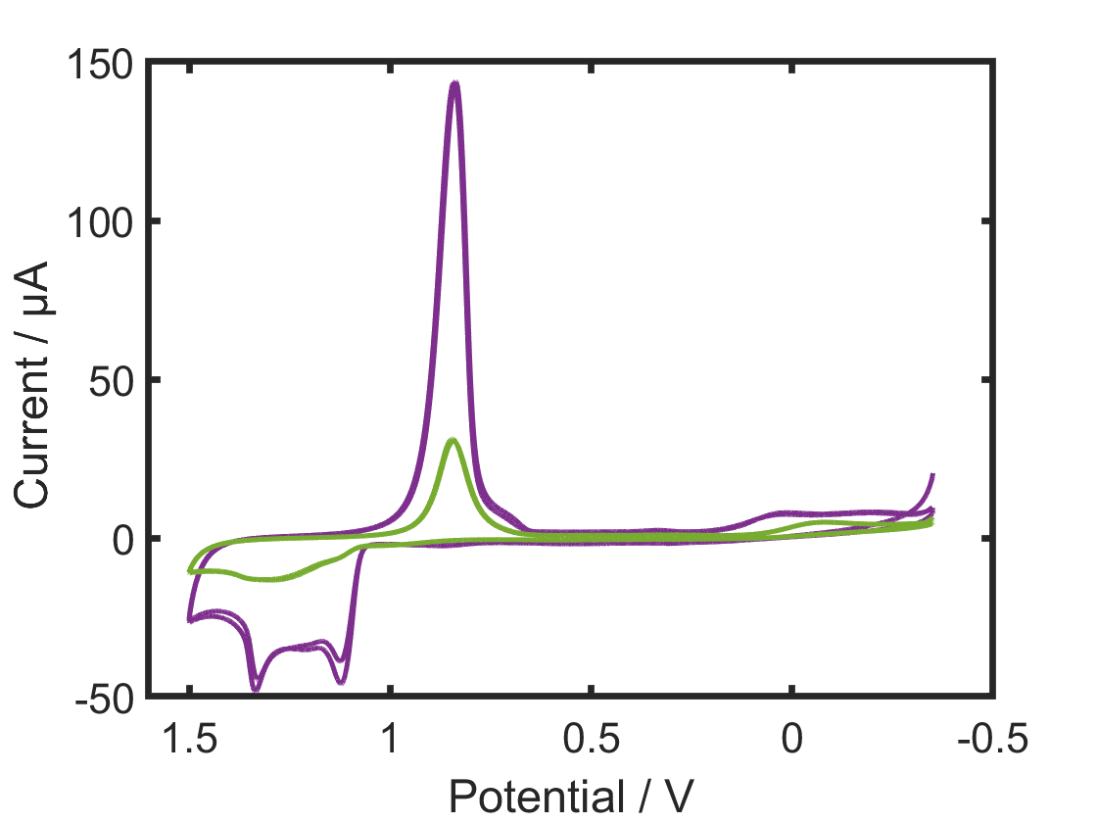
L
azenby
Controlling surface morphology of electrodeposited gold for the preparation of electrochemical aptasensors
L
_
ab
@
Danté N. Comer, Olivia Stuehr, Amanda Ritz, Robert A. Lazenby
Department of Chemistry & Biochemistry
Electrochemical, Aptamer-Based Sensing
Nanostructured Macroscale EAB Sensors
Nanostructured Microscale EAB Sensors
What is an electrochemical, aptamer-based sensor?
Electrochemical, aptamer-based (EAB) sensors are electrochemical biosensors that utilize structure-switching aptamer probes attached to electrodes to detect analytes.
Schematic of target analyte detection
Constant potential electrodeposition of Au nanostructures to control morphology.
Surface area enhancement via constant potential electrodeposition.
Applying a potential of -0.2 V to gold electrodes for 120 s (B) and 600 s (C) in a solution of 10 mM HAuCl₄/0.5 M H₂SO₄ gave rise to unique surface characteristics. (A) depicts an unmodified electrode. (D) depicts the i-t curve, which results from the nucleation and growth processes of Au nanostructures on the electrode surface.
Charge associated with growth of nanostructures
ECSA vs Deposition time
Optical image of 120 s deposited ME
K_{et} < K’_{et}
4.5
4
K’_{et}
3.5
ECSA / cm²
3
K_{et}
2.5
ECSA / cm²
2
1.5
Au electrode surface
1
25 µM
Why EAB Sensing?
Reagentless
Reversible analytical detection
Highly specific
Gives rapid results in real time
Components of an EAB sensor
Charge / C
0.5
30
60
120
240
Deposition Time / s
6-mercaptohexanol
(backfilling molecule)
Nucleic acid oligomer
Leucomethylene blue
(redox-active molecule)
Aptamer-only vs Aptamer-target complex EAB sensor immobilization
Electrode center
The Aptamer-target immobilization² method led to a lower aptamer packing density, and decreased signal changes observed on the microscale. This decrease in signal change contradicts the trend reported in the literature².
Sensor Interrogation Methods:
1 µm
1 µm
Square wave voltammograms (SWVs) for detecting ATP
Langmuir isotherm calibration curve for quantifying sensor performance
Langmuir isotherm parameters
C
EAB sensor titration of ATP with traditional aptamer-only incubation.
EAB sensor titration of ATP with fabricated with aptamer-target complex
Apparent binding affinity K_{d} between target analyte and aptamer
K_{d} = 1000 µM
K_{d} = 192 µM
K_{d}=1000 µM
LOD=7.48 µM
Electrode edge
Current / µA
S, S_{max} = peak current
[L] = target concentration
Current / µA
A
1 µm
B
1 µm
D
Deposition Time / s
Introduction
EAB sensor performance dependent on electrodeposition conditions for both target analytes tested..
Effects of electrodeposition on EAB sensor performance
Langmuir isotherm calibration curves for detection of target analyte
Enhancing the ECSA increased the aptamer packing density and ATP signal change for microscale sensors.
Project Goal: Use electrodeposition of gold nanostructures to control the morphology of sensors and investigate its impact on the binding affinity, aptamer packing density, and signal change of EAB sensors on the micro- and macroscale.
Aptamer Probe Packing Density
Surface area vs Deposition time
Langmuir isotherm fit on ATP calibration curves
120
18
14
0 s
120 s
600 s
0 s K_{d} = 833 µM
120 s K_{d} = 1099 µM
600 s K_{d} = 1664 µM
16
12
30 s
60 s
120 s
100
14
10
Modification of planar Au electrode
CV in 0.05 M H₂SO₄ to characterize (ECSA)
12
8
EAB sensor descriptors:
Aptamer packing density / molecules/cm²
80
10
6
ECSA
ATP
4
Aptamer packing density / molecules/cm²
8
2
Integrate charge (Q) from Au oxide reduction peak
0
60
6
0
50
100
150
200
250
Aptamer packing density
Binding affinity (K_{d}) between aptamer and target analyte
Target analyte signal change
Signal Change / %
4
Deposition time / s
planar
nanostructured
40
2
Geometric
20
0
0 50 100 150 200 250
ECSA (cm²) = (Q) /(400 µC∙cm⁻²) ¹
0
Deposition time / s
0
500
1000
1500
2000
2500
Conclusions and Future Work
Electrodeposited Au nanostructures on microelectrodes enhances S/N.
ATP Concentration / µM
unmodified
nanostructured
0 s
120 s
600 s
250
0 s K_{d} = 22.32 µM
120 s K_{d} = 33.78 µM
600 s K_{d} = 68.49 µM
^{Conclusions:}
Target-assisted decreases sensing performance on the microscale.
Enhancing the ECSA decreases sensing performance on the macroscale and increases performance on the microscale.
^{Future work:}
Microscale: Test operational stability of microelectrode EAB sensors and acquire more data for the detection of target molecules that vary in size.
Macroscale: Fabricate sensors for large molecule targets such as thrombin to verify sensing trends.
200
Dopamine
150
Signal Change / %
100
References
50
^{Text}
0
Acknowledgements
References
¹Trasatti, S.; Petrii, O. A. Pure Appl. Chem. 1991, 63 (5), 711−734.
²Liu, Y.; Canoura, J.; Alkhamis, O.; Xiao, Y. ACS Appl. Mater. Interfaces 2021, 13 (8), 9491–9499.
0
200
400
600
Lab website:
Dopamine Concentration / µM
https://www2.chem.fsu.edu/~lazenby/
FSU Startup Funds

