Slide 1
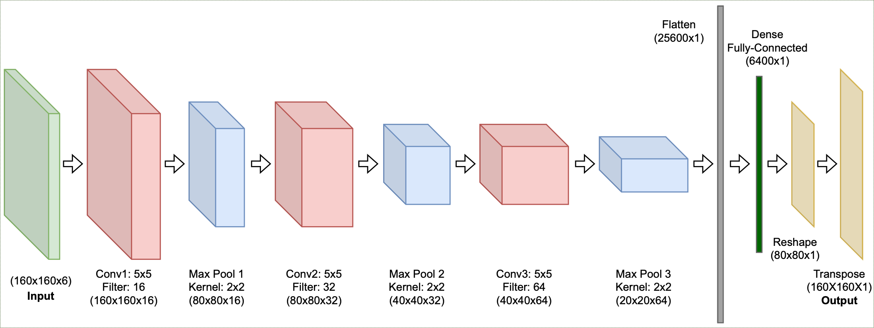
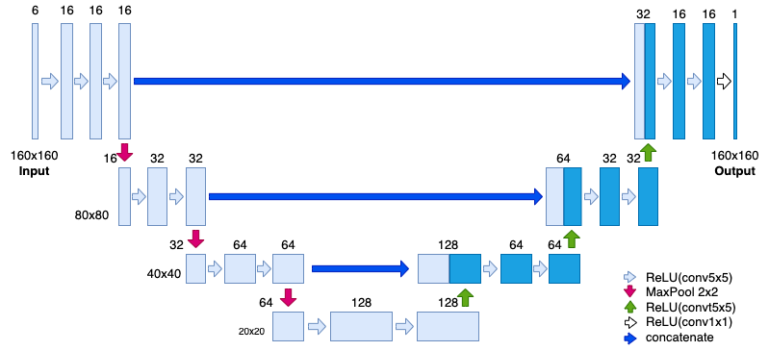
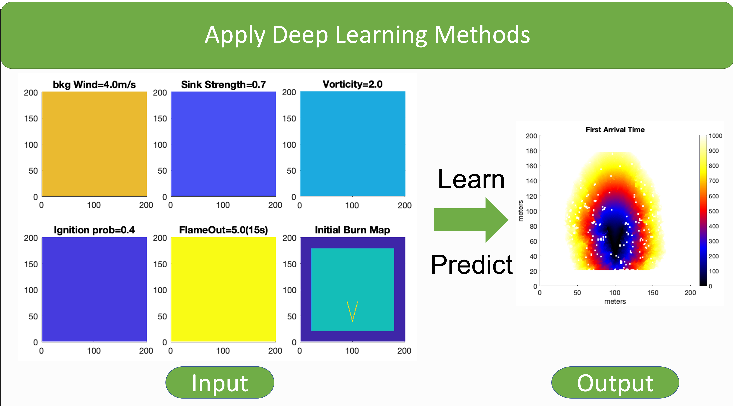
Generating A Fire Spread Model
Katelyn Fischer
Introduction
Methods
In 2021, Bryan Quaife and Kevin Speer introduction a computational model for fire Vortex-Sink interactions. The impact on how fire spreads was based on a number of factors: Wind speed, sink strength, vorticity, ignition probability, flame out time, and state type. Xin Tong is now creating a neural network to map how the fire would grow and spread over time. We are training this model by applying datasets generated by the computational model.
Left: General Convolutional Model Middle: UNET Model Right: Generated Computational Fire Model
The neural network models were coded in Python in Google Collaboratory. The testing and training sets were created in MATLAB and then ran through the neural network.
Conclusion
My results concluded that the UNet model is much better at generating the fire spread model than the general convolutional model.
The UNET model is clearer and is more accurate to the generated “True” model.
Abstract
This project uses two different neural network models to calculate how fire grows and spreads. A computational model is then applied to the neural network to create the fire spread model. The two types of neural network models that are used are a general convolutional model and a UNet model. These models were compared to each other based on their accuracy. The accuracy is measured by the level of error each model generates. It is also based on the accuracy of the calculated fire model versus the neural network generated fire model. Testing multiple models allows us to choose which model would work best for the project and provide the most accurate data on how fire spreads.
Results
Acknowledgments
I would like to thank my research mentor Dr. Xin Tong who was so patient with me throughout this entire process. She taught me everything I know about neural networking and matrices. I would also like to thank the UROP Program for enabling me to do research.
The results generated above were created from the neural network. The initial burn map shows the fire shape, in this case a junction30. The Truth model was generated from the computational fire model. The CNN and UNet models were generated from the neural network.
References
Quaife, Bryan, and Kevin Speer. (2021). “A Simple Model for Wildland Fire Vortex–Sink Interactions.”

