Slide 1


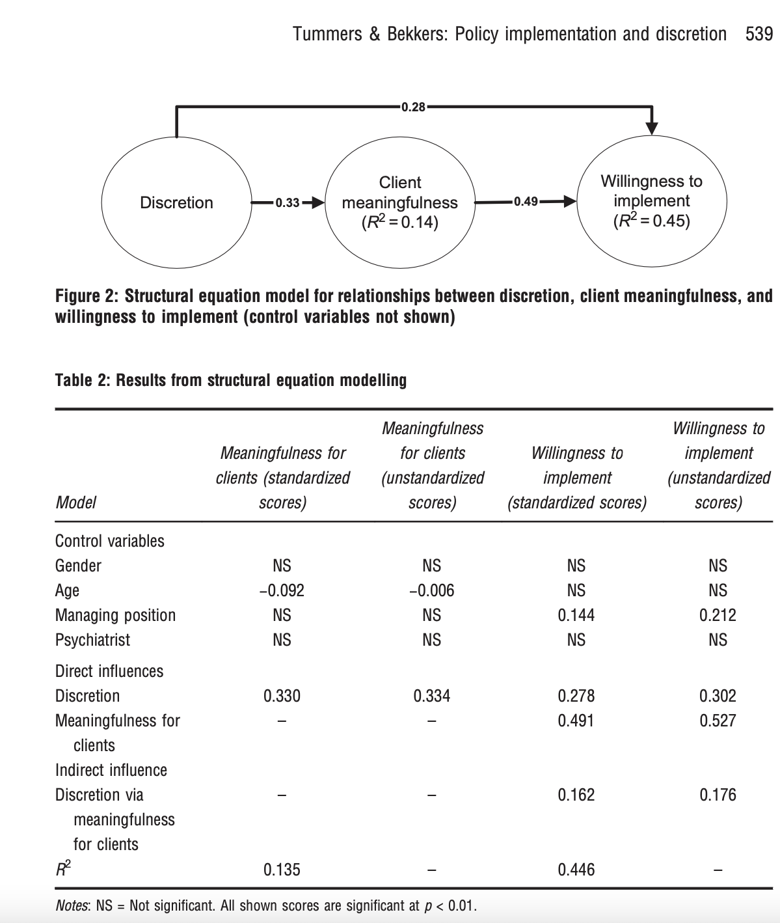
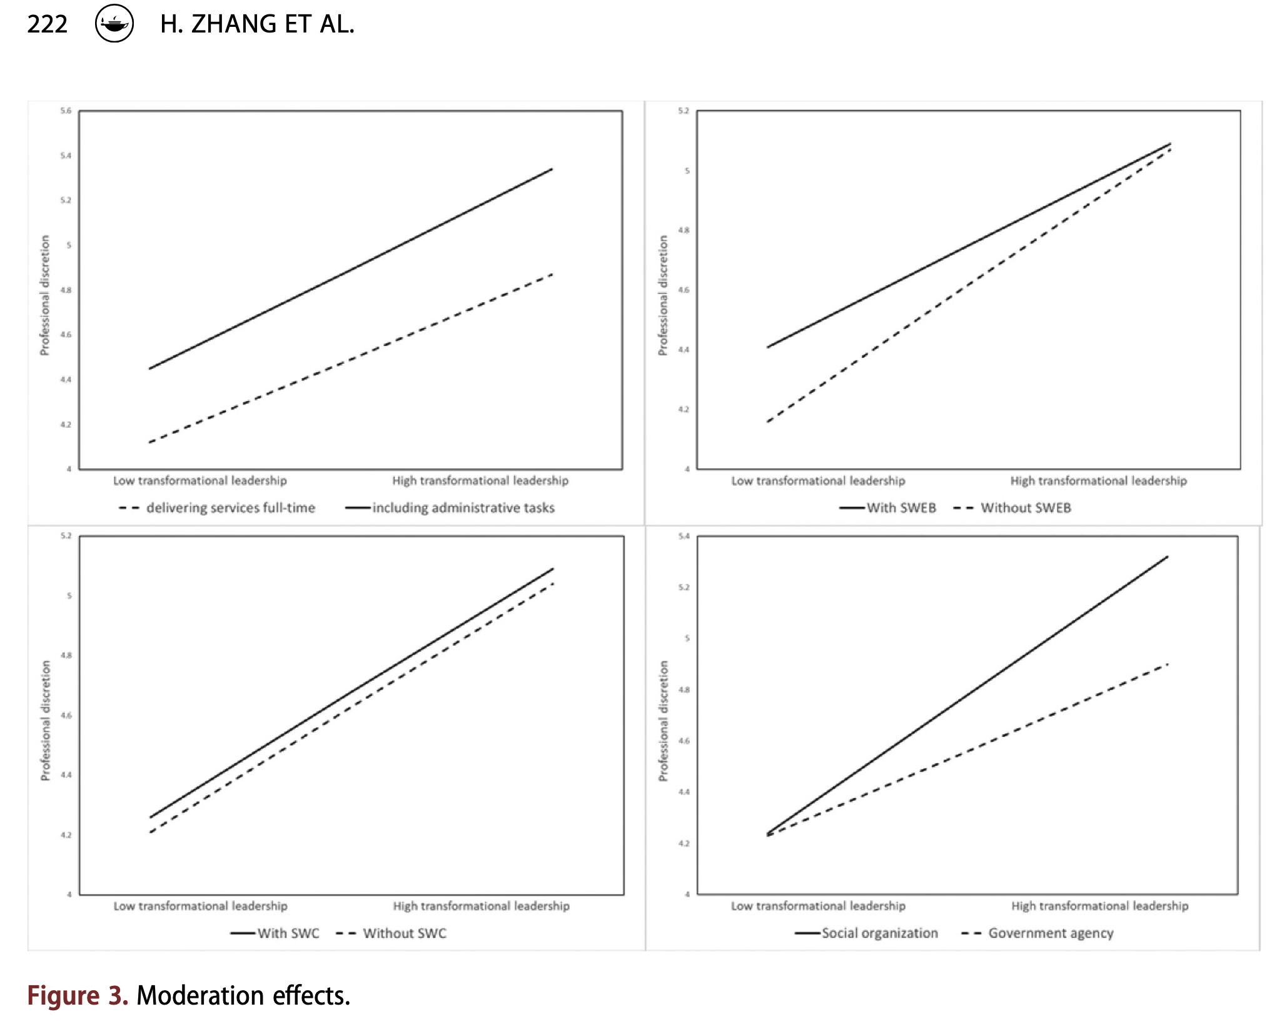
Literature Review on Administrative Discretion
Author: Mia Medney Mentor: Jing He
Florida State University, Tallahassee, FL
Introduction
Results
Conclusion
The objective of this project is to understand what administrative discretion was, how it works and whether discretion is good for street-level bureaucrats. Street-level bureaucrats are public employees who deal directly with clients and have discretion in their jobs. Administrative discretion refers to the flexibility street-level bureaucrats have to exercise judgement and their autonomy in decision making within their field of work. Discretion is present throughout all lines of work but especially though the government. It is important to understand the value of discretion as controlled discretion would violate the second amendment: freedom of speech. Yet it is just as important to understand the potential for an abuse of discretionary power. A primary problem with discretion that may arise are street-level bureaucrats’ willingness to implement and thus their impact on client meaningfulness (see figure 1). Client meaningfulness is the perception of street-level bureaucrats implementing policy that has values for their clients. Meanwhile, a professionals’ willingness to implement policies for discretion is the positive behavioral intention towards implementing policies by street-level bureaucrats. Connecting sociology with social science we can see a strong correlation between social capital, client meaningfulness and the professionals’ willingness to implement policies. Social capital is based in the ideology of it’s not what you know, but who you know. There are no previous studies that have done a literary, systematic review of administrative discretion like this presentation.
Figure 1: Concept map defining administrative discretion created by my mentor (Concept map of Discretion, He 2022.)
The trends founds throughout this literary review is that the more discretionary power a street-level bureaucrats holds the more likely they will be willing to implement policies and in turn be more passionate about their work and then increasing client meaningfulness. This study can easily be continued through analyzing more articles. We hope to have funding in the future to conduct our own research using a survey of students and professors at Florida State University. And then distribute the same survey to the general public of Tallahassee to compare the different degrees of power. This would compare not only one’s knowledge of administrative discretion but how much they are able to understand the importance of discretion based on their levels of education. Another possibility to continue this study is to measure the difference in discretion in different countries such as China and the United States and how power is distributed in these different societies. Personally, I would like to continue this research through delving into the medical field and the autonomy professionals have in their lines of work. Then comparing Physician Assistant’s with Medical Doctors and Psy.D. doctors and how their discretionary power may differ.
Figure 2: example of data from a journal article analyzing medical professional’s discretionary power within their field and how useful it is in the United States. Data for discretion can be collected through field studies and most commonly by surveys (such as this one). Keep in mind while looking at this graph that medical professionals tend to have more discretion than most street-level bureaucrats.
I
Methods
References
Conduct a systematic review of academic journal articles from the Public Management Review of Taylor & Francis Online. The articles could also be found on JSTOR.
        First: read through the article highlighting and annotating
    Second: form an annotated bibliography
    Third: use excel to list hypothesis, theories, independent and dependent variables of the individual studies the various papers have conducted.
Figure 3: Graphs illustrating the trends with professional administrative discretion and their effects. Professional discretion often has a greater impact than street-level such as construction workers.
Carpenter, Daniel P. Krause, George A. Reputation and Public Administration. Public Administration Review., 72(1), 26–32. November 15, 2011. Https://Doi.Org/10.1111/J.1540-6210.2011.02506.X
Kelly, Marisa. Theories of Justice and Street-Level Discretion¹. Journal Of Public Administration Research and Theory J-PART., 4(2). April 1, 1994. Https://Doi.Org/10.1093/Oxfordjournals.Jpart.A037201
Riccucci, Norma M. Street-Level Bureaucrats and Intrastate Variation in the Implementation of Temporary Assistance for Needy Families Policies, Journal of Public Administration Research and Theory, Volume 15, Issue 1, Pages 89–111. January 1, 2005. https://doi.org/10.1093/jopart/mui005
Yesilkagit, Kutsal. Christensen, Jørgen G. Institutional Design and Formal Autonomy: Political versus Historical and Cultural Explanations, Journal of Public Administration Research and Theory, Volume 20, Issue 1, January 2010, Pages 53–74. April 1, 2009. https://doi.org/10.1093/jopart/mup002
Hassan,MohammedSalah, Raja Noriza Raja Ariffin, Norma Mansor, and Hussam Al Halbusi. 2021. An Examination of Street-Level Bureaucrats’ Discretion and the Moderating Role of Supervisory Support: Evidence from the Field. AdministrativeSciences11: 65. https://doi.org/10.3390/ admsci11030065
Huan Zhang, Ling Yang, Robert Walker & Yean Wang (2022) How to influence the professional discretion of street-level bureaucrats: transformational leadership, organizational learning, and professionalization strategies in the delivery of social assistance, Public Management Review, 24:2, 208-232, DOI: 10.1080/14719037.2020.1805919
Lars Tummers & Victor Bekkers (2014) Policy Implementation, Street-level Bureaucracy, and the Importance of Discretion, Public Management Review, 16:4, 527-547, DOI: 10.1080/14719037.2013.841978
Rafael Alcadipani, Sandro Cabral, Alan Fernandes & Gabriela Lotta (2020) Street-level bureaucrats under COVID-19: Police officers’ responses in constrained settings, Administrative Theory & Praxis, 42:3, 394-403, DOI: 10.1080/10841806.2020.1771906
Sowa, Jessica E., and Sally Coleman Selden. “Administrative Discretion and Active Representation: An Expansion of the Theory of Representative Bureaucracy.” Public Administration Review, vol. 63, no. 6, [American Society for Public Administration, Wiley], 2003, pp. 700–10, http://www.jstor.org/stable/3542465.
Keiser, Lael R., and Joe Soss. “With Good Cause: Bureaucratic Discretion and the Politics of Child Support Enforcement.” American Journal of Political Science, vol. 42, no. 4, [Midwest Political Science Association, Wiley], 1998, pp. 1133–56, https://doi.org/10.2307/2991852.

