Slide 1
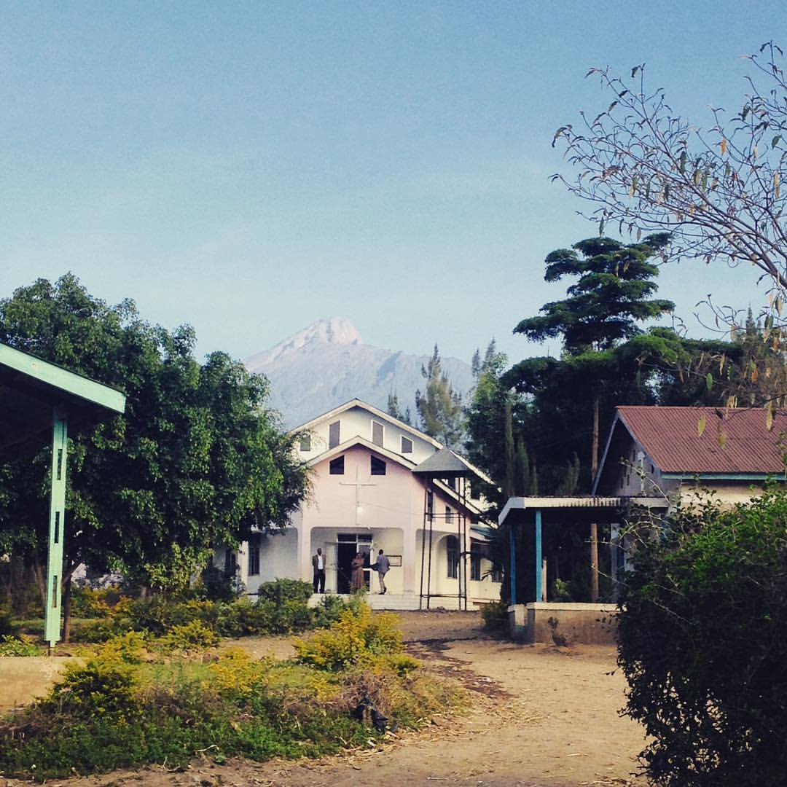
Evolving Christian Womanhood and Social Change in Mt. Meru, Tanzania
Sophie Winer
Research Mentor: Dr. Beth Ann Williams
r
Background
Modern Structural Issues
The 19th century introduction of colonizers and missionaries to East Africa deepened and solidified the patriarchal norms that pervaded public and private life. Prior to the Western arrival, scholars have argued “neither the domestic nor the public sphere was gendered as primarily male or female” (Hodgson, 1999).
“You know it’s a patriarchal society. Girls are socialized to not open our mouths in front of men…You cannot even open your mouth to challenge things that are directly related to your sexual life or your own life.” Agnitha Kutazaa
Interview with Beth Ann Williams
The overwhelming consensus among interviewed women is that the desires, livelihoods, and needs of the men take precedence over women and children. In many cases, Meru women are not allowed to own property. They face very poor employment opportunities, and struggle to get educated (though there has been more equality in the educational realm in recent years). Women expressed feeling a much stronger connection to their family than men, and many women were abandoned by their husbands.
Introduction
Our research explores the role of the prevalence of the Lutheran church in the community as an influential and evolving place of support and social impact. I explore the conflict between support provided by the church even as it advanced persisting patriarchal norms.
Alleviation Provided Through the Church
Socialization in church and personal relationships with God are crucial to female social and emotional well-being as women navigate dependence on men, poor employment, and an overburden of familial duties. Most churches host women’s seminars, designed to educate women on finances, family planning, and more, and some offer small amounts of loans. The church has regular prayer circles, visits sick people, and serves as a multi-dimensional center of empowerment for women and the community.
Social Struggles Rooted in Colonization
When colonizers imposed foreign economic concepts, such as taxation, they only taught men about them, creating an inherently unequal way for men and women to navigate new colonial systems as well as disrupting primarily female-run barter networks.
Further, women’s dominance in the African ritual space had been a central way through which women asserted a role in public life. Native male converts and missionaries perpetuated the colonial distinction of traditional African life as “uncivilized,” associating Christianity with Western material progress.
Thus, the introduction of new sociopolitical structures and the displacement of religion from the center of society (due to new economic concerns) led to the holistic downfall of neutral gender relations as women’s traditional roles were degraded.
Imbalance within the Church
Mt. Meru, Tanzania. Photo by Beth Ann Williams.
Despite constituting the majority of the members of the congregation, women face societal stigma and strong church resistance in attempting to become pastors. In this way, the church sustains historic and colonial patriarchal ideals.
“There is no difference between being a pastor and a social leader.” Pastor Kamasho
Interview with Beth Ann Williams
“Men are [church] leaders and do different activities. Women do the cleaning.” Joyce
Interview with Beth Ann Williams
r
Methodology
References
This research analyzes interviews (with subjects ranging in generation, educational background, and sex) conducted in Meru, Tanzania by Dr. Beth Ann Williams in 2016 and 2017. I also integrate external research to better understand the evolution of the church since colonization and its central role in the elevation of misogynistic ideals to a status of normalcy and institutional perpetuation.
Collection of Interviews with Beth Ann Williams. Mt. Meru, Tanzania 2016-2017.
Kutazaa, Agnitha. Interview with Beth Ann Williams. Moshi, Tanzania, November 7, 2016.
Joyce. Interview with Beth Ann Williams. Kofundi, Tanzania, September 24, 2016.
Pastor Kamasho. Interview with Beth Ann Williams. Kilala, Tanzania, February 22, 2017.
Byrd, Phyllis. Interview with Beth Ann Williams. Nairobi, Kenya, April 10, 2017.
Hodgson, Dorothy L. “Pastoralism, Patriarchy and History: Changing Gender Relations among
Maasai in Tanganyika, 1890-1940.” The Journal of African History, vol. 40, no. 1, Cambridge
University Press, 1999, pp. 41–65, http://www.jstor.org/stable/183394.
“Colonialism was designed to deAfricanize the African.” Phyllis Byrd
Interview with Beth Ann Williams

