Slide 1
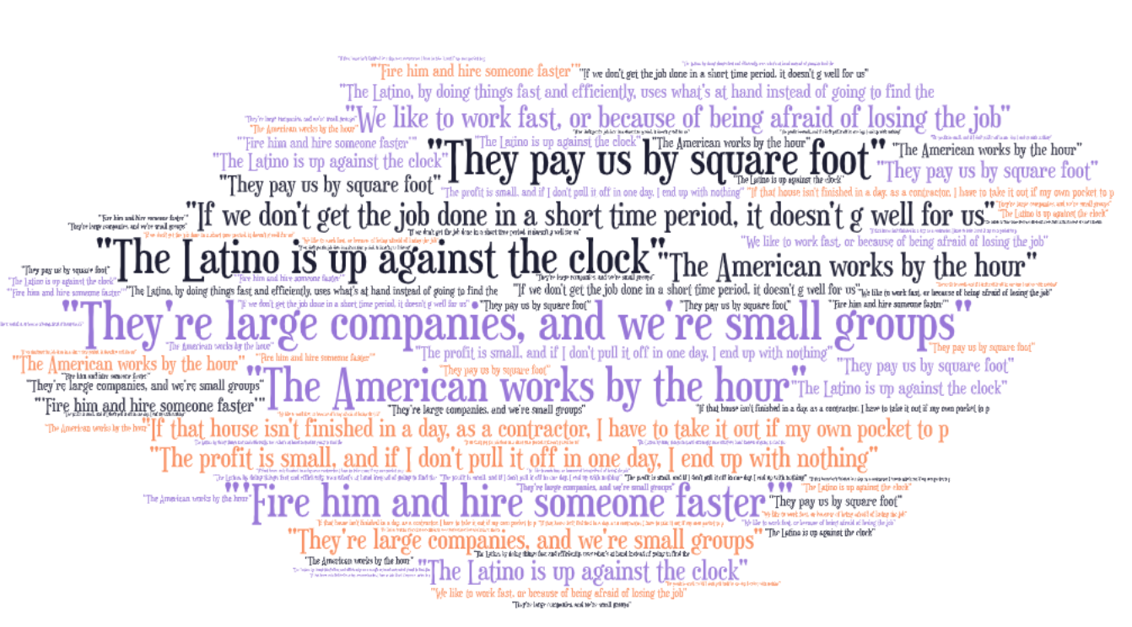
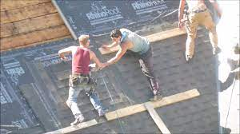
Investigating the Relationship Between Working Fast and the Risk of Injury in Latin American Construction Workers
Belalcazar, S.J., Escalante, S.M., Grzywacz, J.G., Montgomery, S.C.
Introduction
Small-scale Latin American residential construction workers have among the highest rates of injury/ fatality.
Looking at transcripts of conversations with construction workers, and contractors we find that some causes behind these injuries is because of working fast.
The study aims to look at why small-scale Latin American residential construction workers work fast and how they are attributed to increased injury and fatality.
Results
Discussion
Small-scale residential construction companies usually have contractors that hire workers and the amount of money that they receive is based on how much they get done during the day.
Unlike large companies that pay their employees by the hour, small-scale residential construction workers are paid by the amount of square footage completed.
Small-scale residential construction workers have little incentive to take time to put on safety equipment or spending time going to seminars, takes away the time from finishing a job.
Methods
In the Ponte Listo project, qualitative semi-structured interviews were undertaken with n=5 Latino contractors and n=4 Latino construction workers. Interviews were recorded, and transcribed.
Transcripts were coded independently by two UROP students (SJB & SE) as primary and secondary coders which were then discussed upon to find discrepancies and find themes.
References
Shannon Montgomery, Antonio Marin, Elsa Nunez Reyes, Thomas Mills, Michael Merten, Hector Nolasco, Joseph Grzywacz
National Institute for Occupational Safety and Health and American Society for Safety Engineers (2015) ‘Overlapping vulnerabilities: the occupational health and safety of young immigrant workers in small construction firms.’, ((NIOSH) 2015-178), pp. 1–39
Sterud, T. et al. (2018) ‘A systematic review of working conditions and occupational health among immigrants in Europe and Canada’, BMC public health. BioMed Central, 18(1), p. 770. doi: 10.1186/s12889-018-5703-3.
The word cloud above identifies key phrases that have been repeated across several transcripts

