Slide 1
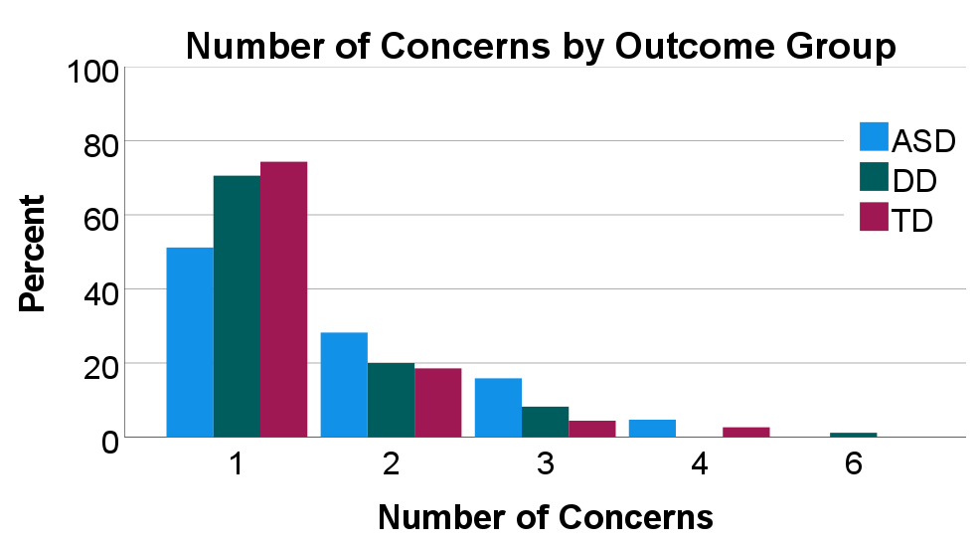
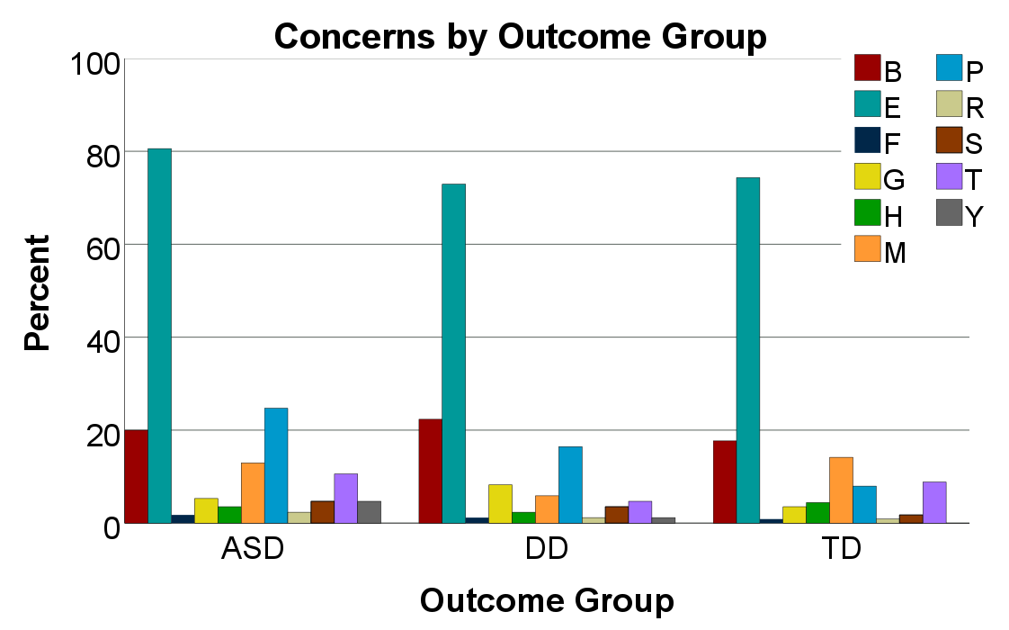
Examining Parent Concern after Autism Screening in Children under 24 Months
Jessica L. Hooker, Ph.D., CCC-SLP, Megan Michaels, Amanda Nunez, Rachel Peters, Danielle Stitzel,
Michelle Martinez, Amy M. Wetherby, Ph.D., CCC-SLP
Undergraduate Research Opportunities Program
Introduction
Parents of young children were invited to participate in this study during a primary care visit for their child. Parents completed the ESAC, a parent-report screener for autism and communication delays. Parents were also asked to report any concerns about their child’s development. As part of the larger screening study, children who received a positive screen or whose parents reported concerns were invited to complete follow-up evaluations.
Primary Outcome:
The primary outcome variable was parent-reported concern about their child’s development. For this study, parent-reported concern was coded for 16 types of concerns by undergraduate research assistant unaware of screening and evaluation results.
The prevalence of children with autism spectrum disorder (ASD) has continued to rise (Maenner et al., 2020; 2021), increasing public awareness of the disorder and its symptoms, screening measures, and availability of early intervention (Hyman et al, 2020). The American Academy of Pediatrics has recommended screening for ASD in primary care at 18 and 24 months since 2007 (Hyman et al, 2020; Johnson & Myers, 2007). However, the US Preventive Services Task Force recently determined that there is not enough evidence to support universal screening for ASD in toddlers and preschool age children without parent or provider concerns of ASD (Sui et al., 2016). Research examining parent reported concerns has indicated that the presence of parent concern significantly influences physicians’ referrals for assessment (Pierce et al., 2021). Research on parent-reported concerns in early development indicates that a large portion of parents report concerns symptoms around or before their child is 24 months old (Chawarska et al., 2007; Guinchat et al., 2012). Overall, most parents report concerns related to communication development, language, and stereotyped or unusual behaviors (Chawarska et al.,2007; Guinchat et al., 2012), but many report broader concerns that aren’t specifically related to ASD, which may contribute to delayed identification (Guinchat et al., 2012). However, the presence of parent concern alone may not be sensitive enough to identify most children at risk for ASD (Hess & Landa, 2012). Examining parent-reported concerns in large community-based samples of children screened for autism and communication delays may provide further insight.
Purpose: This study examined parent-reported concerns in a community-based sample of children with ASD, DD, or TD who were screened for autism and communication delays
Procedures
A majority of parents reported concerns about their child’s expressive communication development. Most parents of children with ASD were concerned about development and reported a higher number of unique concerns, on average, than parents of children with DD or TD. Yet, most parents of children with ASD did not report concerns specific to ASD or its diagnostic features. Results suggest that relying only on parents' concerns specific to ASD, may miss children with early signs of autism.
Discussion
Results
*
Reported Parent Concern by Type (n = 384)
A | autism | 0.5% | N | sleep | 0.5%
B | behavioral | 19.8% | O | other | 0.5%
C | child history | 0.5% | P | social | 17.2%
E | expressive communication | 74.2% | R | receptive language | 1.6%
F | family history | 1.1% | S | feeding- swallowing | 3.4%
G | global/cognitive | 5.7% | T | RRBs | 8.6%
H | health | 3.4% | X | child risk factors | 0.0%
M | motor | 11.7% | Y | play | 2.3%
What types of concerns do parents of children with ASD, developmental delay (DD), or typical development (TD) report during screening for autism and communication delay? Are there differences in parent concerns across diagnostic outcome groups?
Research Questions
Methods
Participants:
This study examined a sub-sample of 549 parents and children with ASD, DD, or TD recruited from a large community-based screening study in Florida. Children in the study were between 12 and 26 months of age when their parents completed a screening for ASD and communication delay with the Early Screening for Autism and Communication Disorders (ESAC).
Screening Characteristics by Outcome Group
 | ASD |  | DD |  | TD
 | M | SD | M | SD | M | SD
ESAC Age | 18.68 | 3.21 | 17.49 | 2.99 | 17.19 | 3.40
 | n | % | n | % | n | %
Positive ESAC | 154 | 77.0 | 91 | 77.1 | 86 | 37.2
 | n | % | n | % | n | %
Parent Concerned
No | 30 | 15.0 | 33 | 28.0 | 118 | 51.1
Yes | 170 | 85.0 | 85 | 72.0 | 113 | 48.9
Chawarska K, Paul R, Klin A, Hannigeb S, Dichtel LE, Volkmar F. Parental recognition of developmental problems in toddlers with autism spectrum disorders. J Autism Dev Disord. 2007;37:62-72.
Guinchat V, Chamak B, Bonniau B, et al. Very early signs of autism reported by parents include many concerns not specific to autism criteria. Research in Autism Spectrum Disorders. 2012; 6: 589-601..
Hyman, S. L., Levy, S. E., Myers, S. M., Kuo, D. Z., Apkon, S., Davidson, L. F., ... & Bridgemohan, C. (2020). Identification, evaluation, and management of children with autism spectrum disorder. Pediatrics, 145(1). Johnson, C. P., & Myers, S. M. (2007). Identification and evaluation of children with autism spectrum disorders. Pediatrics, 120, 1183–1215. http://doi.org/10.1542/peds.2007-2361
Maenner MJ, Shaw KA, Bakian AV, et al. (2021) Prevalence and Characteristics of Autism Spectrum Disorder Among Children Aged 8 Years — Autism and Developmental Disabilities Monitoring Network, 11 Sites, United States, 2018. MMWR Surveill Summ, 70(No. SS-11):1–16.
Pierce, K., Gazestani, V., Bacon, E., Courchesne, E., Cheng, A., Barnes, C. C., ... & Karins, K. (2021). Get SET Early to Identify and Treatment Refer Autism Spectrum Disorder at 1 Year and Discover Factors That Influence Early Diagnosis. The Journal of Pediatrics.
Zuckerman KE, Lindly OJ, Sinche BK. Parental concerns, provider response, and timeliness of autism spectrum disorder diagnosis. J Peds. 2015;166(6): 1431-1439.
Child Characteristics
 | N | %
Sex
Female | 167 | 30.4
Male | 382 | 69.6
Race
Non-white | 169 | 30.8
White | 367 | 66.8
Hispanic | 49 | 8.9
Diagnosis
ASD | 200 | 36.4
DD | 118 | 21.5
TD | 231 | 42.1
References

