Slide 1
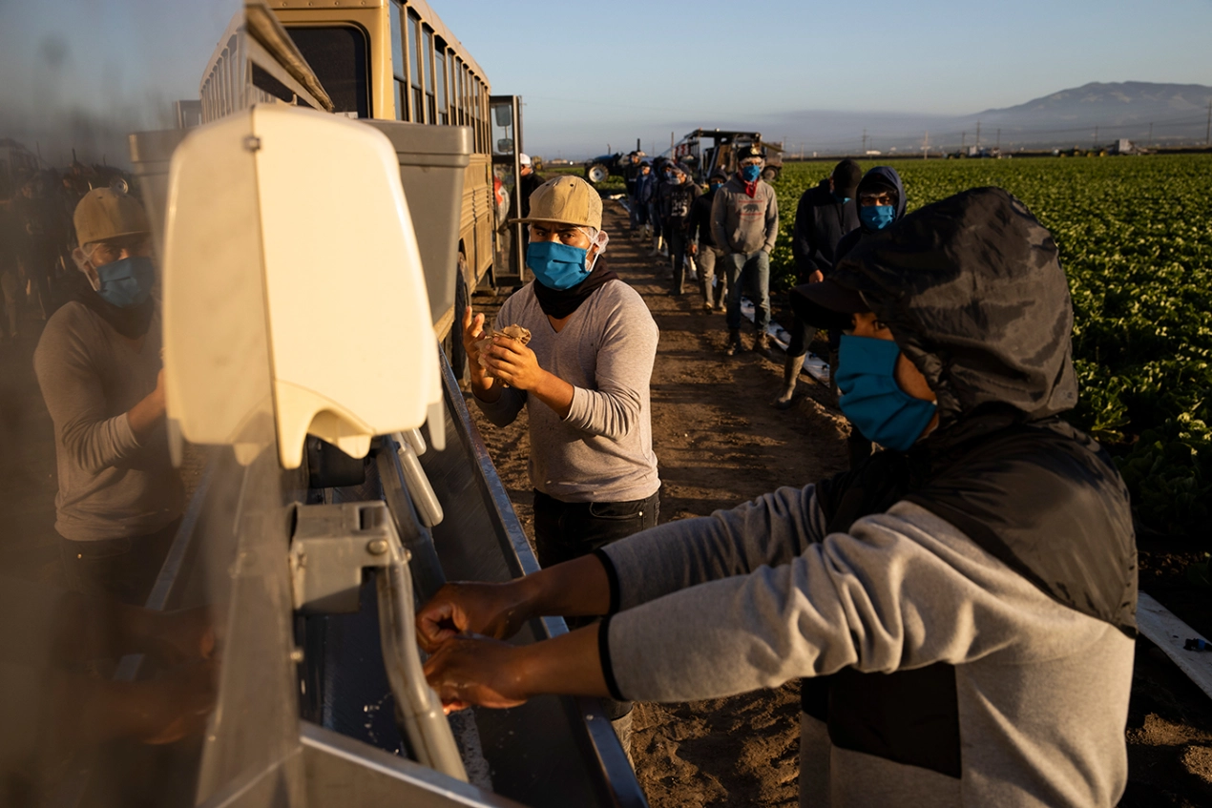
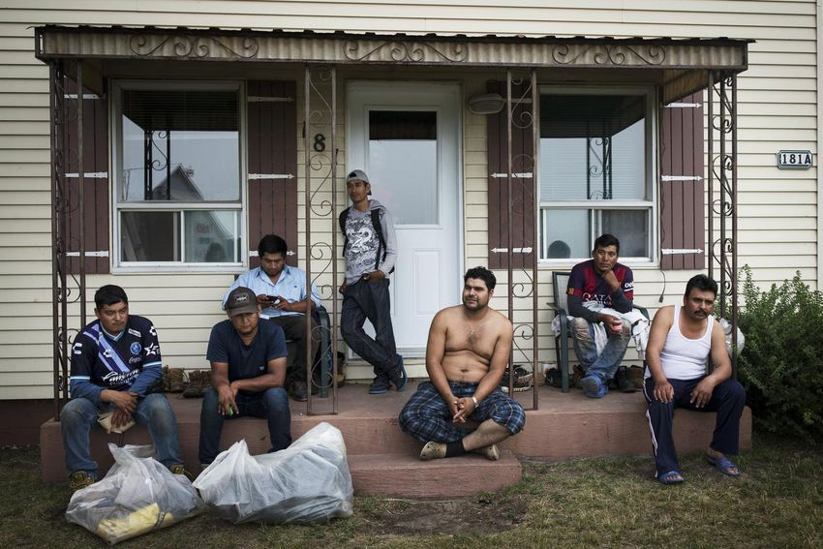
PREPARING FOR THE NEXT PANDEMIC
By: Joseph Grzywacz, Anisa Gonzalez, Alexander Sarmiento, Audrey Brenner, Fiona Giardino and Ellie Giardino
Introduction
This project is in collaboration with the National Center for Farmworker Health and the U.S Centers for Disease Control. The purpose of this project is to help prepare organizations and agencies serving the farmworker community for the next pandemic by creating new policies intended to solve prevalent problems for Community Health Care workers. This project is specifically evaluating the Latino farmworker community in efforts to minimize the spread of disease in the community as well as attempt to decrease the death rate of farmworkers. This project started with a Literature Matrix to gain relevant background information to provide a clear understanding of problems that are occurring in these organizations that are affecting the successes of the Community Health Workers.
Methods
Results
We expect that, through interviews conducted by our research team, a common theme in the farmworker community to be an insufficient amount of provided resources. We expect to find that:
Lack of funding has resulted in the ignorance of health concerns within the farm worker community.
Community Health Workers were not provided with up-to-date information when changes in health guidelines from the Center of Disease Control were implemented elsewhere.
“ lack of resources hindered pandemic response through inaccurate public health information, lack of community resources, no social support or financial support.” (Mayfield-Johnson et al. 2020)
Collect common themes from the articles to create an interview guide
Start to interview organizations and directors to understand the struggles faced
Completion of Literature Matrix consisting of 35 articles
Collect data from Matrix and Interviews to create policies to solve common problems
Future Discussions
In the future we intend to interview leaders within farmworker health organizations.
From the interviews we are seeking to gain insider knowledge about the training, maintenance and organization strategies used to help the Community Health Workers in farming communities.
We intend to pinpoint the specific hardships faced by these organization workers based on their experience and discuss ways to improve these conflicts as well as discuss the lack of attempt to solve these issues.
Background
During the Covid-19 pandemic and years prior to the pandemic, Community Health Workers have been a quiet helping hand to clinics and hospitals. The recent pandemic has highlighted the lack of resources provided to these workers which decrease their effectiveness. Through a rapid evidence synthesis, the authors concluded, “Lack of funding for drug and equipment supplies was common.”( Bhaumik et al.,2020). Community Health Workers are expected to aid their community but are not provided the proper funding to perform to the best of their abilities
.
Recommendations
Create a yearly course that Community Health Workers must attend/ pass to make sure that their training is still up to date
Creating mandatory inspections of farmworkers living conditions in addition to working conditions.
Provide more funding to the organizations working with Community Health Workers so they have increased medical and communicative resources.
Educate illegal immigrants about their human rights.
References
Bhaumik S;Moola S;Tyagi J;Nambiar D;Kakoti M; (2020). Community Health Workers for Pandemic Response: A Rapid Evidence Synthesis. BMJ global health. Retrieved November 7,2021
Mayfield-Johnson S;Smith DO;Crosby SA;Haywood CG;Castillo J;Bryant-Williams D;Jay K;Seguinot M;Smith T;Moore N;Wennerstrom A; (2020). Insights on COVID-19 from Community Health Worker State leaders. The Journal of ambulatory care management. Retrieved January 27, 2022
Renwick , M. (2020). A study urged better standards for migrant workers’ housing. Nothing was done. Now COVID-19 has struck. Toronto Star File Photo. Retrieved from https://www.thestar.com/business/2020/05/11/a-study-urged-better-standards-for-migrant-workers-housing-nothing-was-done-now-covid-19-has-struck.html.
Stirton, B. (2020). Farmworkers in Greenfield . Without Federal Protections, Farm Workers Risk Coronavirus Infection to Harvest Crops . Getty Images . Retrieved from https://khn.org/news/as-crisis-grows-farms-try-to-balance-health-of-field-workers-and-food-supply/.

