Slide 1
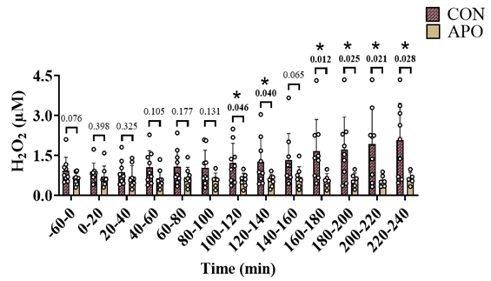
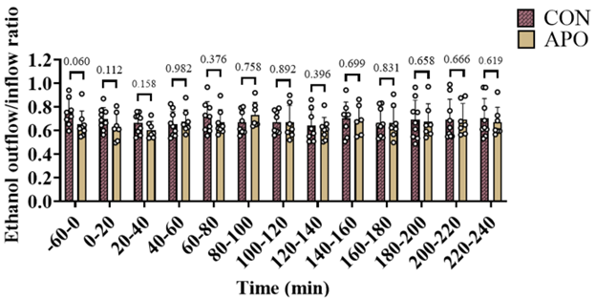
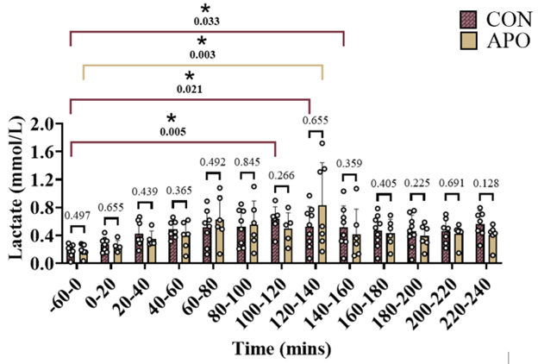
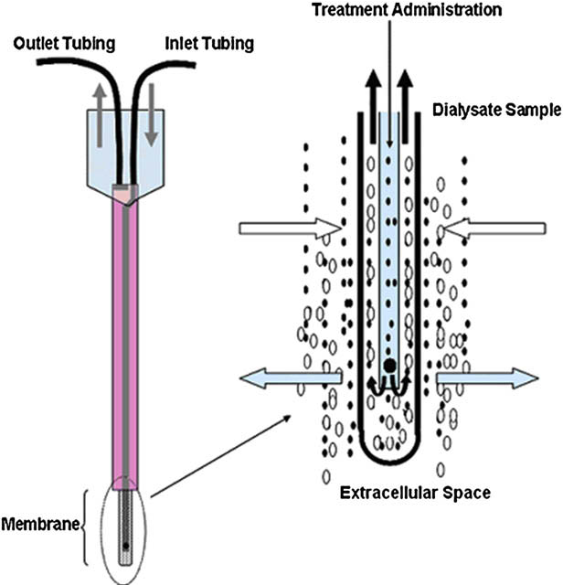
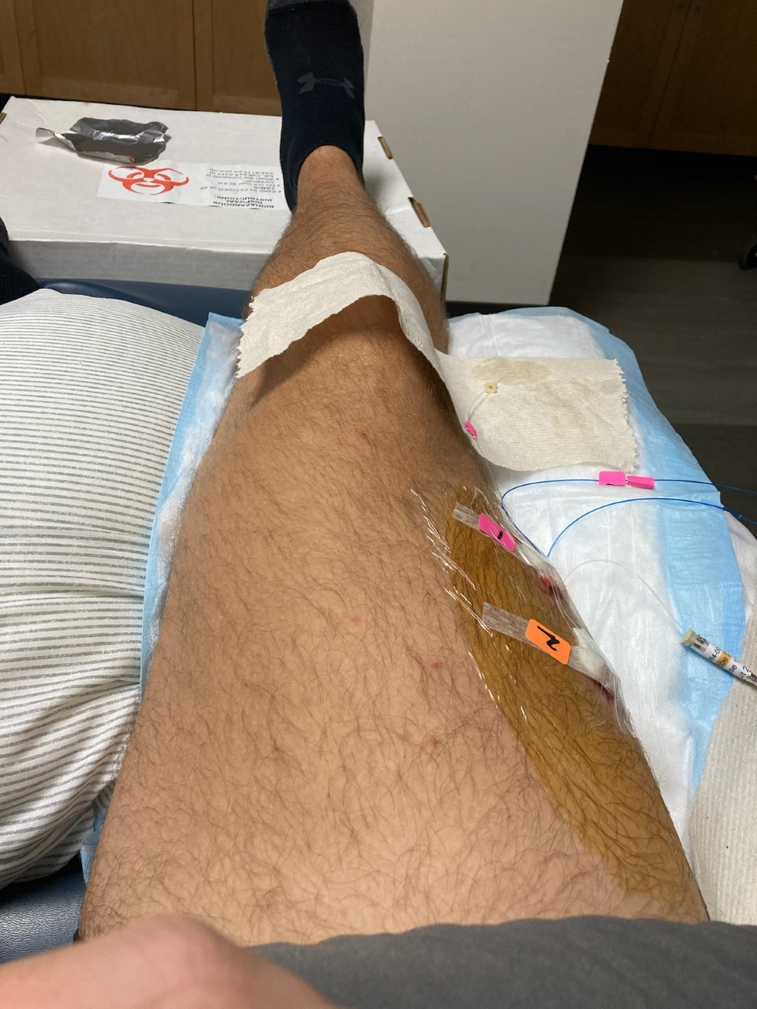
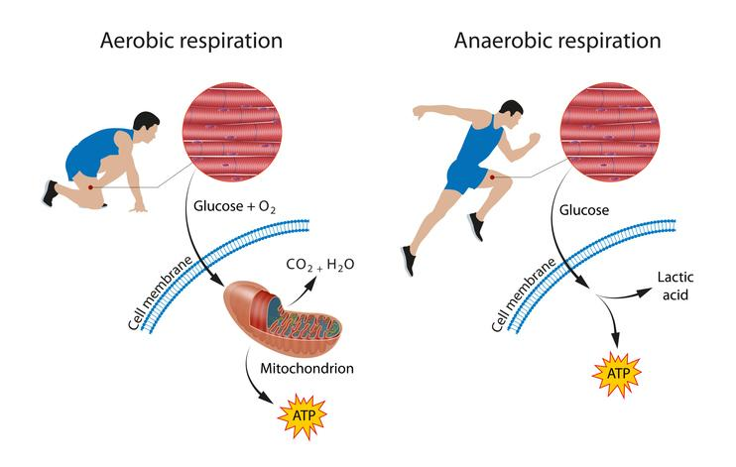
NADPH Oxidase Effects on Skeletal Muscle Blood Flow and Lactate Following the Administration of a High Carbohydrate Meal in Older Individuals with Overweight/Obesity
John C. Decaro, Sequoia D. Ernst, Connor J. Krassel,
Paul A. Baker Ph.D, Riley K. Hart, Robert C. Hickner Ph.D
Department of Health, Nutrition, & Food Sciences, College of Education, Health & Human Sciences, Florida State University, Tallahassee, FL 32306
Background
Methods Continued
Results
ROS
Reactive oxygen species (ROS) are highly reactive molecules produced by cellular metabolism.
Chronically elevated levels of ROS have been shown to increase risk for cardiovascular disease.
Consumption of high-carbohydrate (HC) or high-fat (HF) meals are known to increase concentrations of ROS.
Microdialysis Probes
2A
2B
Muscle probes:
Probe One: Control
_{NADPH Oxidase}
Equilibrium period
Hour 1
Hour 2
Hour 3
Hour 4
Hour 5
Hour 6
Probe Two: Apocynin
NADPH Oxidase (NOX) is a protein in the human vasculature that prior research has shown to be a potent producer of ROS. A drug called apocynin can eliminate ROS produced by NOX in a small area.
07:00
07:10
08:10
09:10
09:30
10:30
11:30
12:30
13:30
_{Lactate}
Bodyweight
Height
High Carb Meal
Microdialysis
2C
Lactate is a byproduct of normal metabolism that may be harmful in high concentrations.
Image shows the testing visit in which microdialysis probes were inserted. Microdialysis and cardiovascular measures were taken at rest and continued for four hours after consuming a high-carbohydrate meal..
Purpose
a.) To determine if NOX-derived ROS impairs skeletal muscle microvascular blood flow at rest and in response to a HC meal.
Figure 2A: Dialysate H₂O₂ concentrations from APO compared to CON probe following a high carbohydrate meal. *Significance marked as a P-value ≤ 0.05.
b.) To determine if NOX-derived ROS affects lactate concentrations in the skeletal muscle.
Figure 2B: Ethanol outflow/inflow ratio from APO compared to CON probe following a high carbohydrate meal. *Significance marked as a P-value ≤ 0.05.
Methods
Figure 2C: Dialysate lactate concentrations from APO compared to CON probe following a high carbohydrate meal. *Significance marked as a P-value ≤ 0.05.
Study Design
Double blind crossover study design.
Conclusions
Participants
Nine participants (6 females, 3 males, 67 ± 6 years, 30.9 ± 2.9 kg/m², 39 ± 7 % body fat percentage).
Apocynin is a potent NOX-inhibitor, consistent with literature.
Following HC meal consumption, there was no significant change in SMBF between CON and APO groups.
Thus, SMBF may not be as negatively affected by NOX-produced ROS as previously thought.
However, there was a strong positive correlation between NOX-produced H₂O₂ (ROS) and increases in lactate following HC meal consumption suggesting a link between the two molecules may exist.
Microdialysis Procedures
Microdialysis was used to monitor in-vivo ROS production, lactate concentration, and microvascular blood flow within skeletal muscle.
Images show a schematic illustration of the microdialysis technique (left) and microdialysis probes inserted into skeletal muscle (right).
ROS measurements (Hydrogen Peroxide (H₂O₂) and Superoxide (O₂)
The control and apocynin microdialysis probes were perfused with Amplex UltraRed, horseradish peroxidase, and superoxide dismutase to determine levels of ROS. The apocynin probe was additionally perfused with apocynin.
Because SOD converts H₂O₂ into O₂, ROS was analyzed as the combination of H₂O₂ and O₂ concentrations.
References
La Favor, J. D., Dubis, G. S., Yan, H., White, J. D., Nelson, M. A., Anderson, E. J., & Hickner, R. C. (2016). Microvascular endothelial dysfunction in sedentary, obese humans is mediated by NADPH oxidase: influence of exercise training. Arteriosclerosis, thrombosis, and vascular biology, 36(12), 2412-2420.
Hickner, R. C., Rosdahl, H., Borg, I., Ungerstedt, U., Jorfeldt, L., & Henriksson, J. (1992). The ethanol technique of monitoring local blood flow changes in rat skeletal muscle: implications for microdialysis. Acta physiologica scandinavica, 146(1), 87-97.
Kerckhoffs DAJM, Arner P, Bolinder J. Lipolysis and Lactate Production in Human Skeletal Muscle and Adipose Tissue following Glucose Ingestion. Clin Sci. 1998 Jan 1;94(1):71–7.
Huang YF, Wang G, Ding L, Bai ZR, Leng Y, Tian JW, et al. Lactate-upregulated NADPH-dependent NOX4 expression via HCAR1/PI3K pathway contributes to ROS-induced osteoarthritis chondrocyte damage. Redox Biol. 2023 Nov 1;67:102867.
Bedard K, Krause KH. The NOX Family of ROS-Generating NADPH Oxidases: Physiology and Pathophysiology. Physiol Rev. 2007 Jan;87(1):245–313.
Skeletal muscle microvascular blood flow
Microvascular blood flow was assessed by perfusing both microdialysis probes with ethanol. The ethanol outflow-to-inflow ratio is inversely related to blood flow.
Skeletal Muscle Lactate
Skeletal muscle lactate concentrations were measured using the CMA 600 Microdialysis Analyzer.

