Slide 1
Global Scholars
2022 Info Session

Slide 2
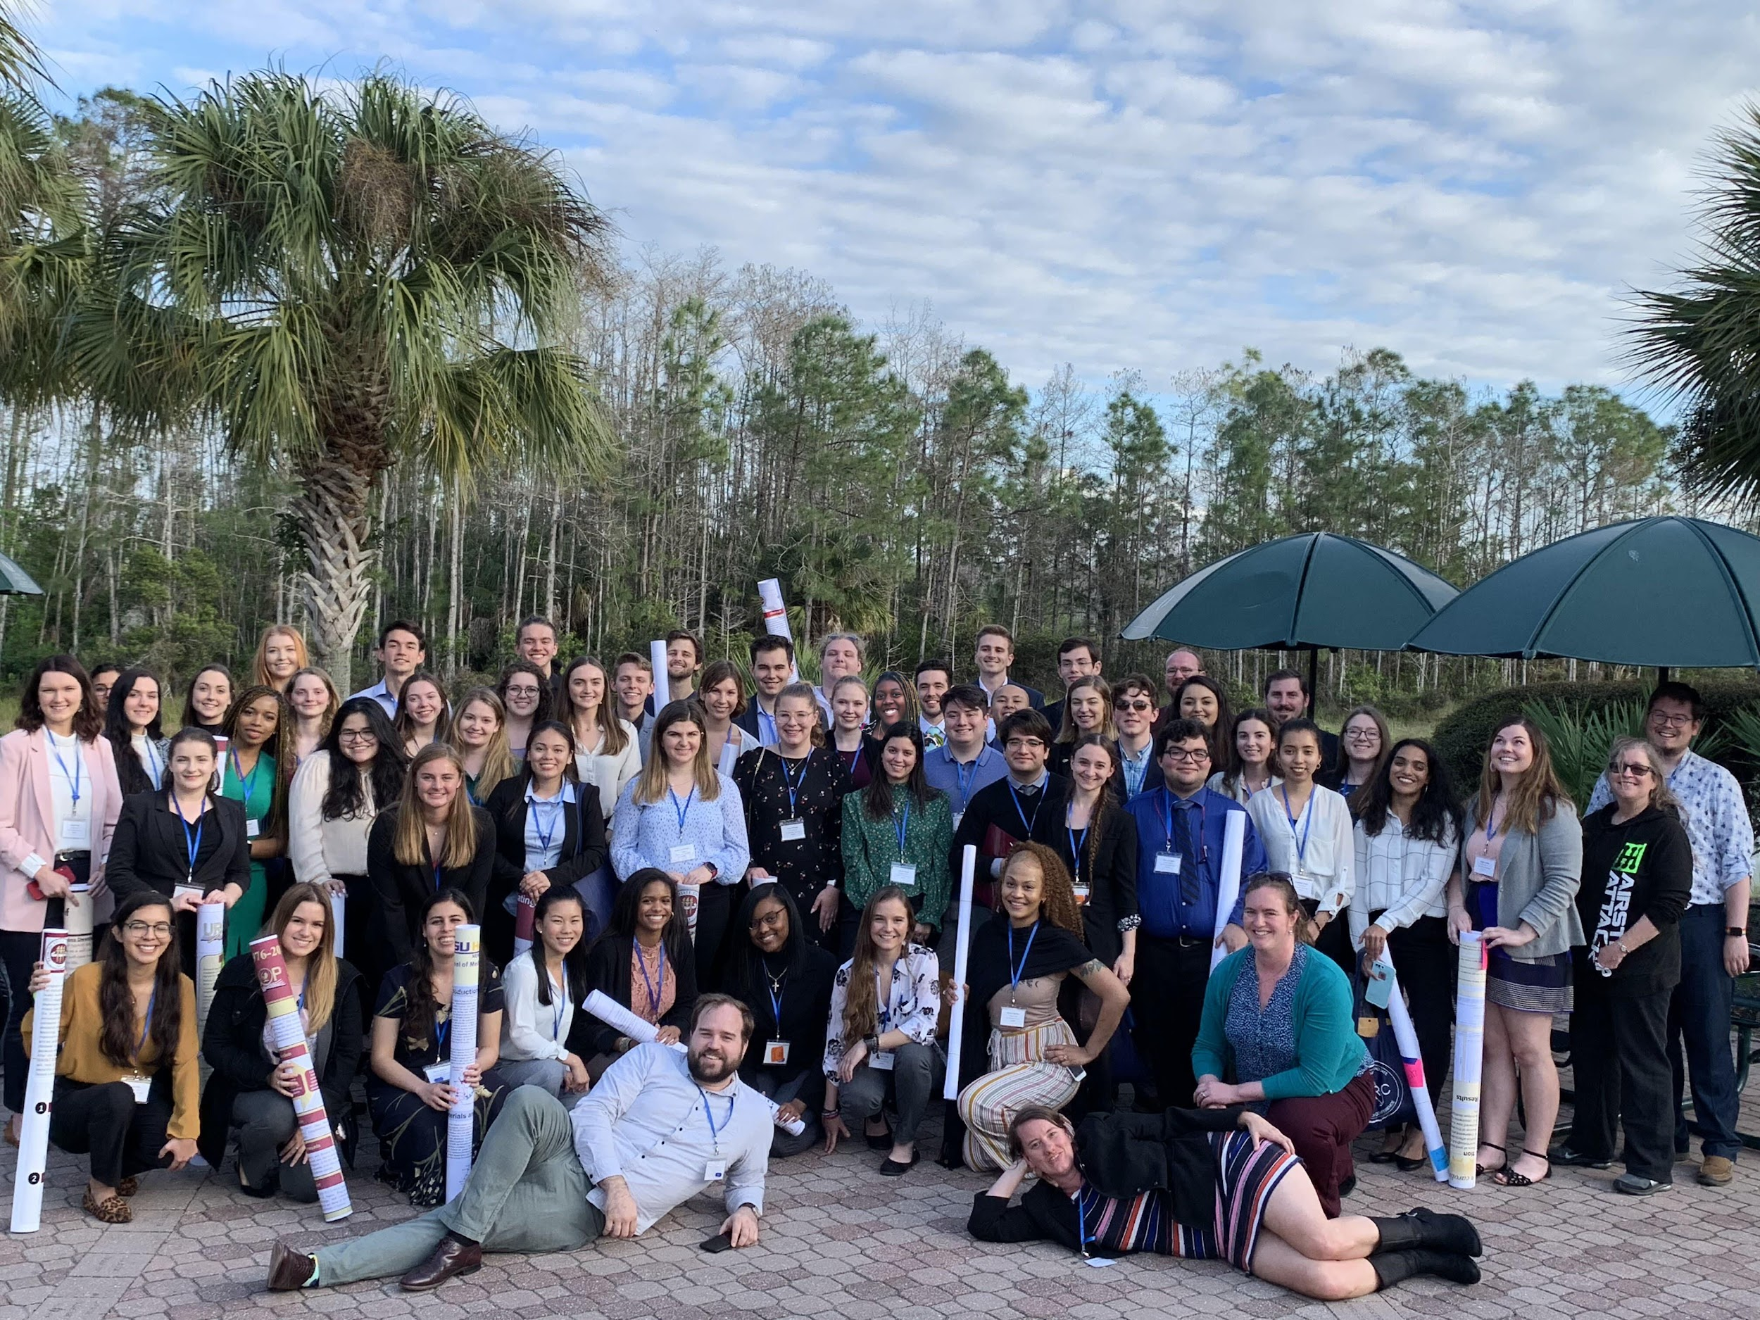
Center for Undergraduate Research & Academic Engagement (CRE)
Latika Young, Director
Alicia Batailles, Senior Associate Director (UROP and FGLSAMP)
David Montez, Associate Director (Entrepreneurship/Innovation, IDEA Grants, and Tech Fellows)
Warren Oliver, Associate Director (Gap Years and Global Scholars)
David Advent, Assistant Director
Yanira Campos (Graduate Assistant)

Slide 3
Global Scholars Program
Offers students and opportunity to engage with critical questions about:
Social Impact
Social Justice
Social Change
Program includes cohort-based learning combined with experience (i.e. independent research, an internship, and/or service-learning experiences)

Slide 4
Quick Question
Global Scholars is centered on introducing students to Social Impact Work and exploring its impacts
Question:
So what is Social Impact Work?
Can you give an example and some skills you might need to develop to do this?

Slide 5
Program Objectives
Explore the ethical and political complexities of attempting to ‘do good’ or ‘help others’ while crossing significant differences of culture and power
Introduce students to qualitative, community-based research
Provides space to reflect on larger questions about power, privilege, inequality, and diversity
Figuring out how to put these ideas into practice

Slide 6
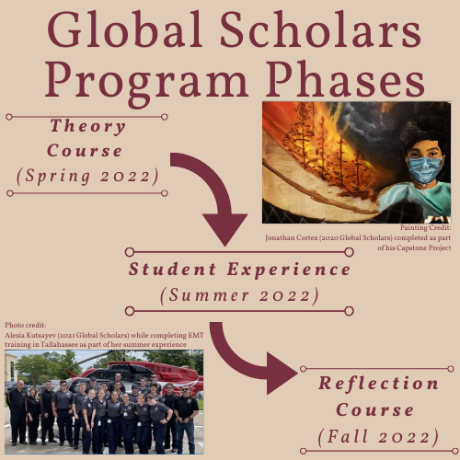
Program Outline
3 Phases:
Theory Course to learn:
Theory/ethics of community based projects
How to use qualitative research to help understand community impacts
How to develop/get FSU approval for an experience
Student Experience
Reflection Course
Reflect on your experience
Plan your next step

Slide 7
Theory Course
Spring 2022 (Thursdays, 3:05pm-4:20pm)
Goals: What do I need to know beforehand?
Describe the ethical/political complexities of individual and institutional efforts to promote positive social change
Develop introductory qualitative research skills
Discuss impacts/nuances of social impact and social change work within communities
Examine interests/roles for engaging in social change/social impact work
Develop a plan for intended experience

Slide 8
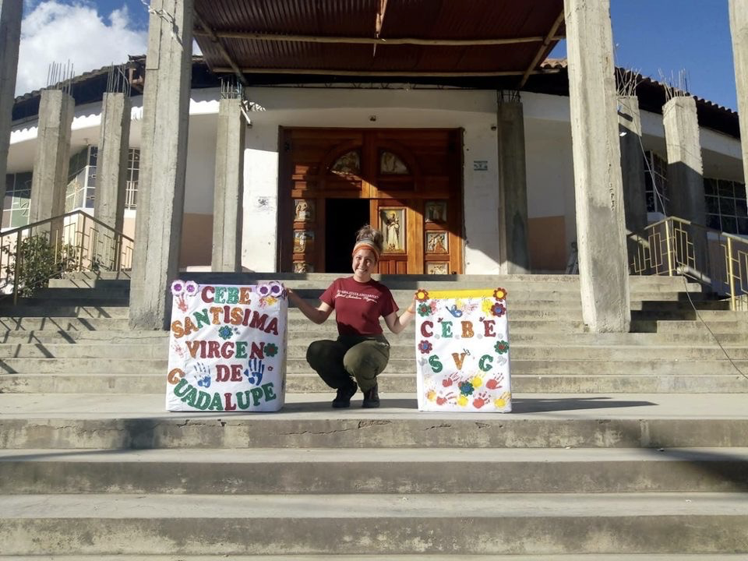
Student Experience
Summer 2022 (specifics TBD by student)
Goal: Apply Lessons from Spring in Summer Environment
Keep a Blog of Experience
Complete a Capstone Project (Digital Portfolio)
Students encouraged to do Experience Recognition Program (ERP) to gain Formative Experience
International, Domestic, and Remote Opportunities
Student-Developed (as approved by FSU travel policy)
Independent Experience developed during Spring
Pre-planned RSO work/Campus Program

Slide 9
Quick Question
Does anyone have an interest in what they might want to do for their experience?
(for example work with a specific group, complete a project with an RSO, or complete a specific fellowship or internship)

Slide 10
Developing Your Experience
Part of the Theory Course (don’t worry if you do not know now)
Should be relevant to your
Interests
Abilities/Skills
Budget

Slide 11
Examples of Experiences
A project with one of FSU’s RSOs focused on social impact work
Opportunities provided through FSU’s International Programs (such as study abroad opportunities or independent internships) which have been given explicit approval for Summer 2022
Volunteering at Intercultural/Global FSU programing (such as International Cafe, English Conversation Clubs, or English Conversation Partners)
Opportunities found through the Center for Leadership and Social Change
Americorps
Student Conservation Association

Slide 12
Examples of Experiences (cont.)
Independent projects (such as those granted by Summer Research, IDEA Grants, or those found through FSU’s Office of National Fellowships) which have been given explicit approval for Summer 2021
An organic farming experience through WWOOF (domestic opportunities only for Summer 2021)
Relevant professional training (such as FSU-CIES TEFL Program, HSC Physician Assistantship Certificate, TCC2Work EMT Certificate, or those found through FSU’s Career Center)
Other opportunities offered through FSU’s Career Center
Opportunities offered through the Student Opportunity Network

Slide 13
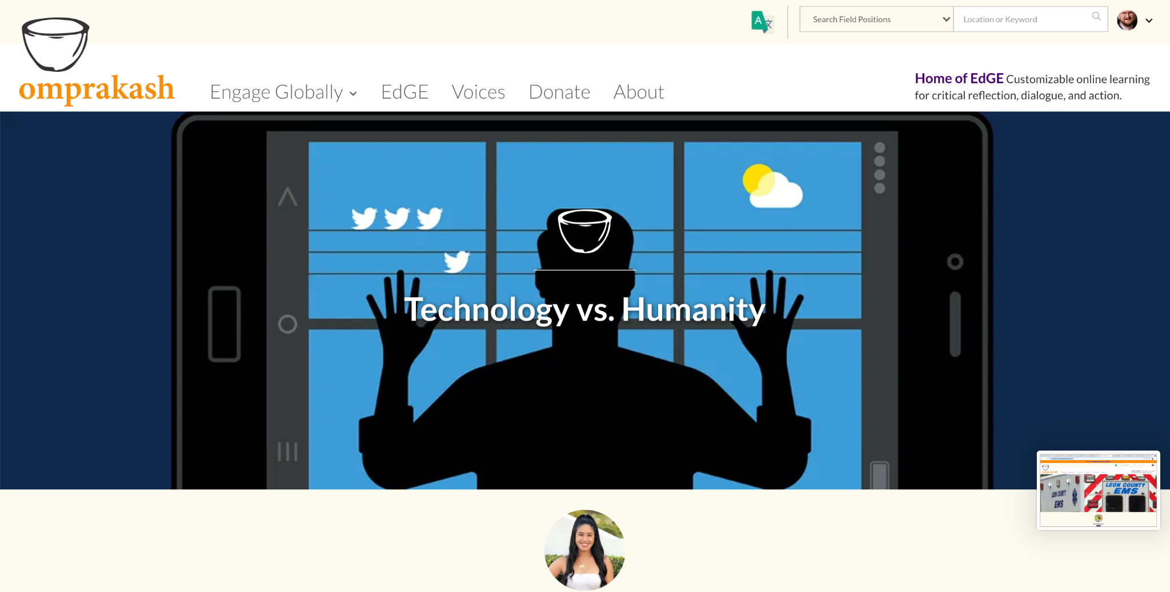
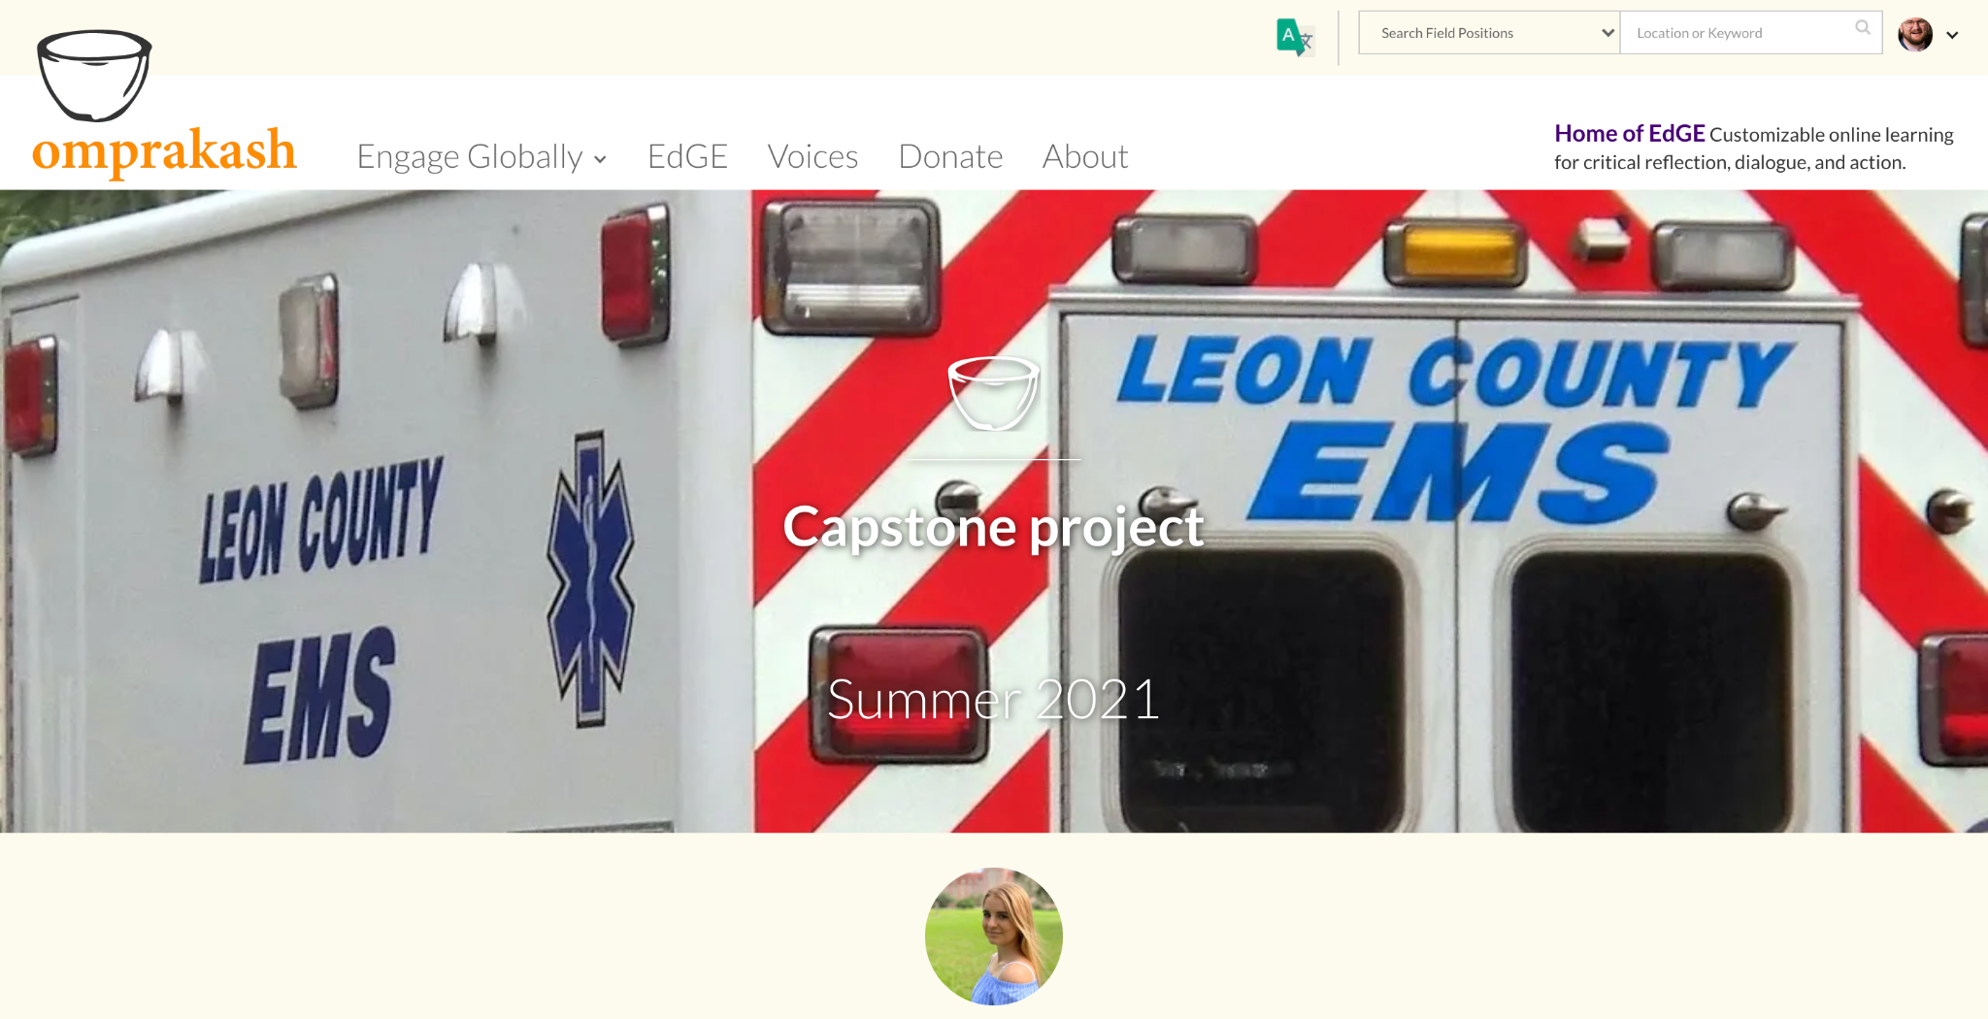
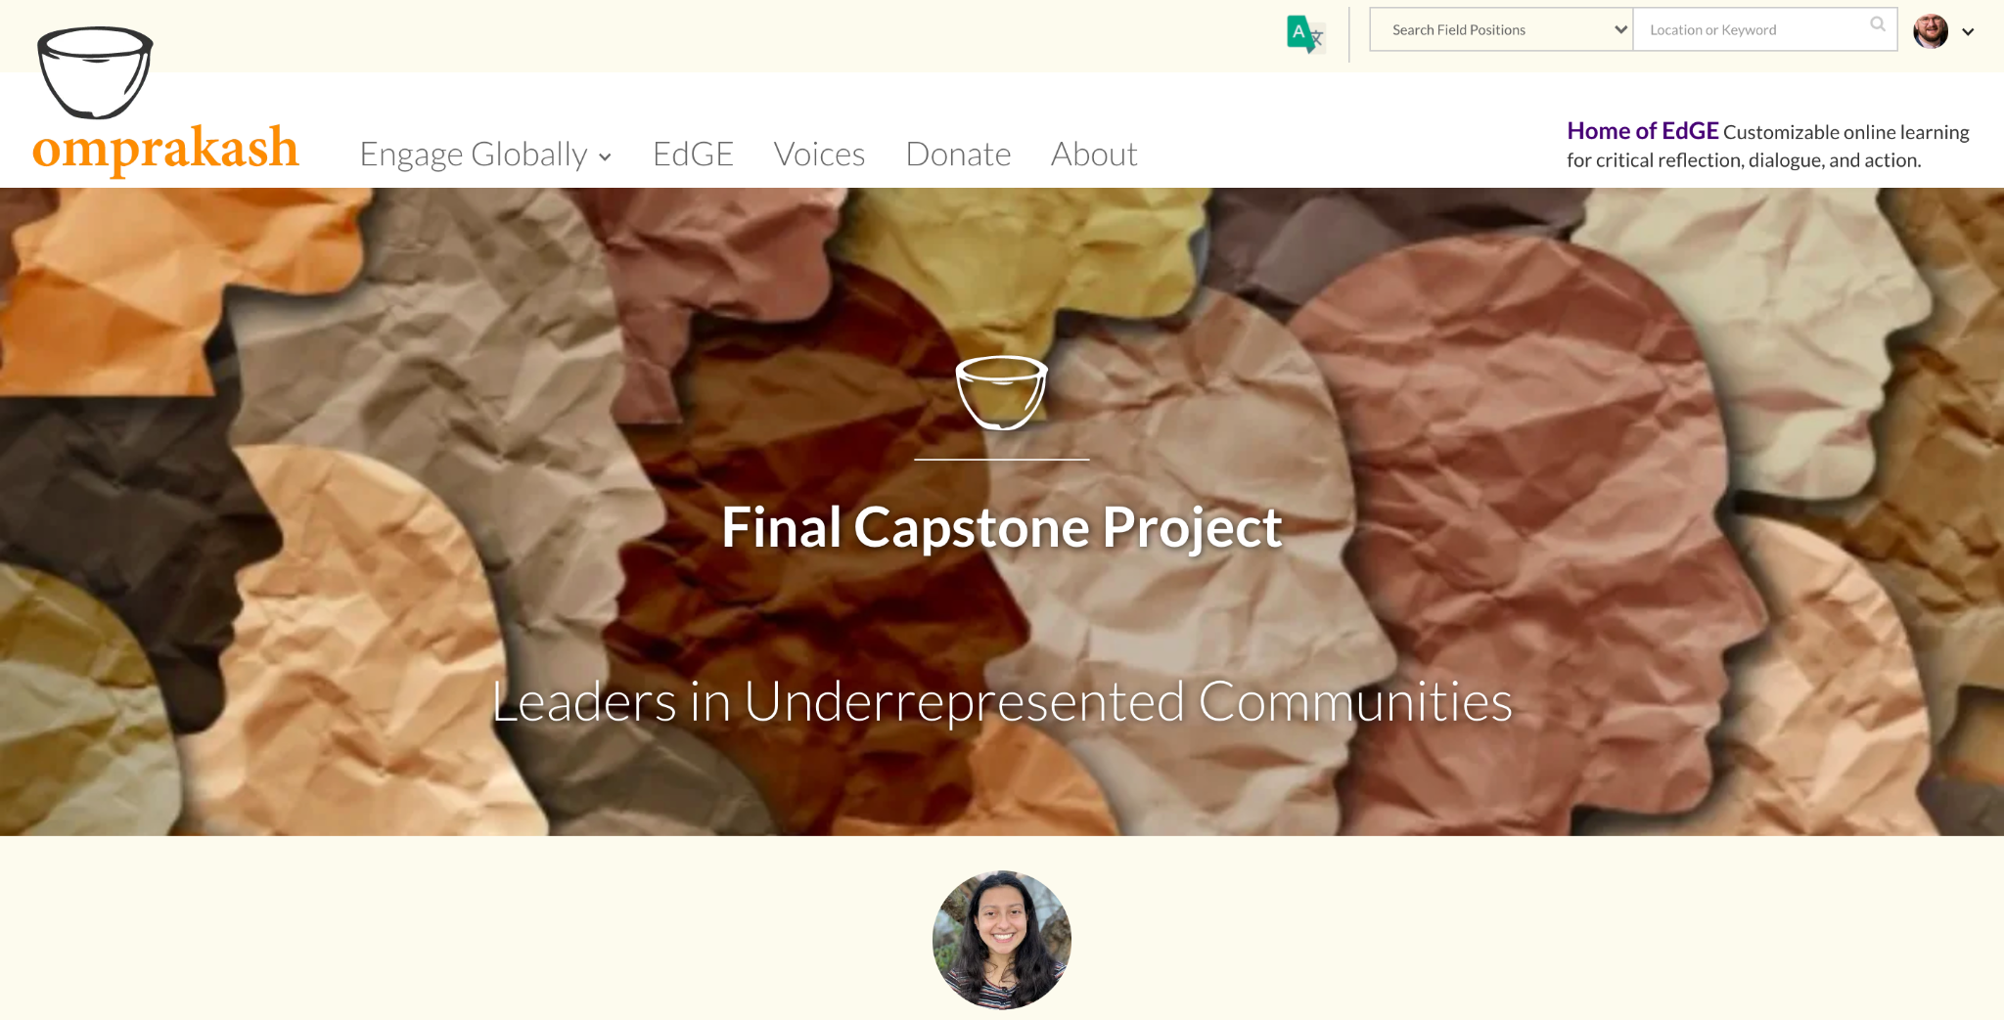
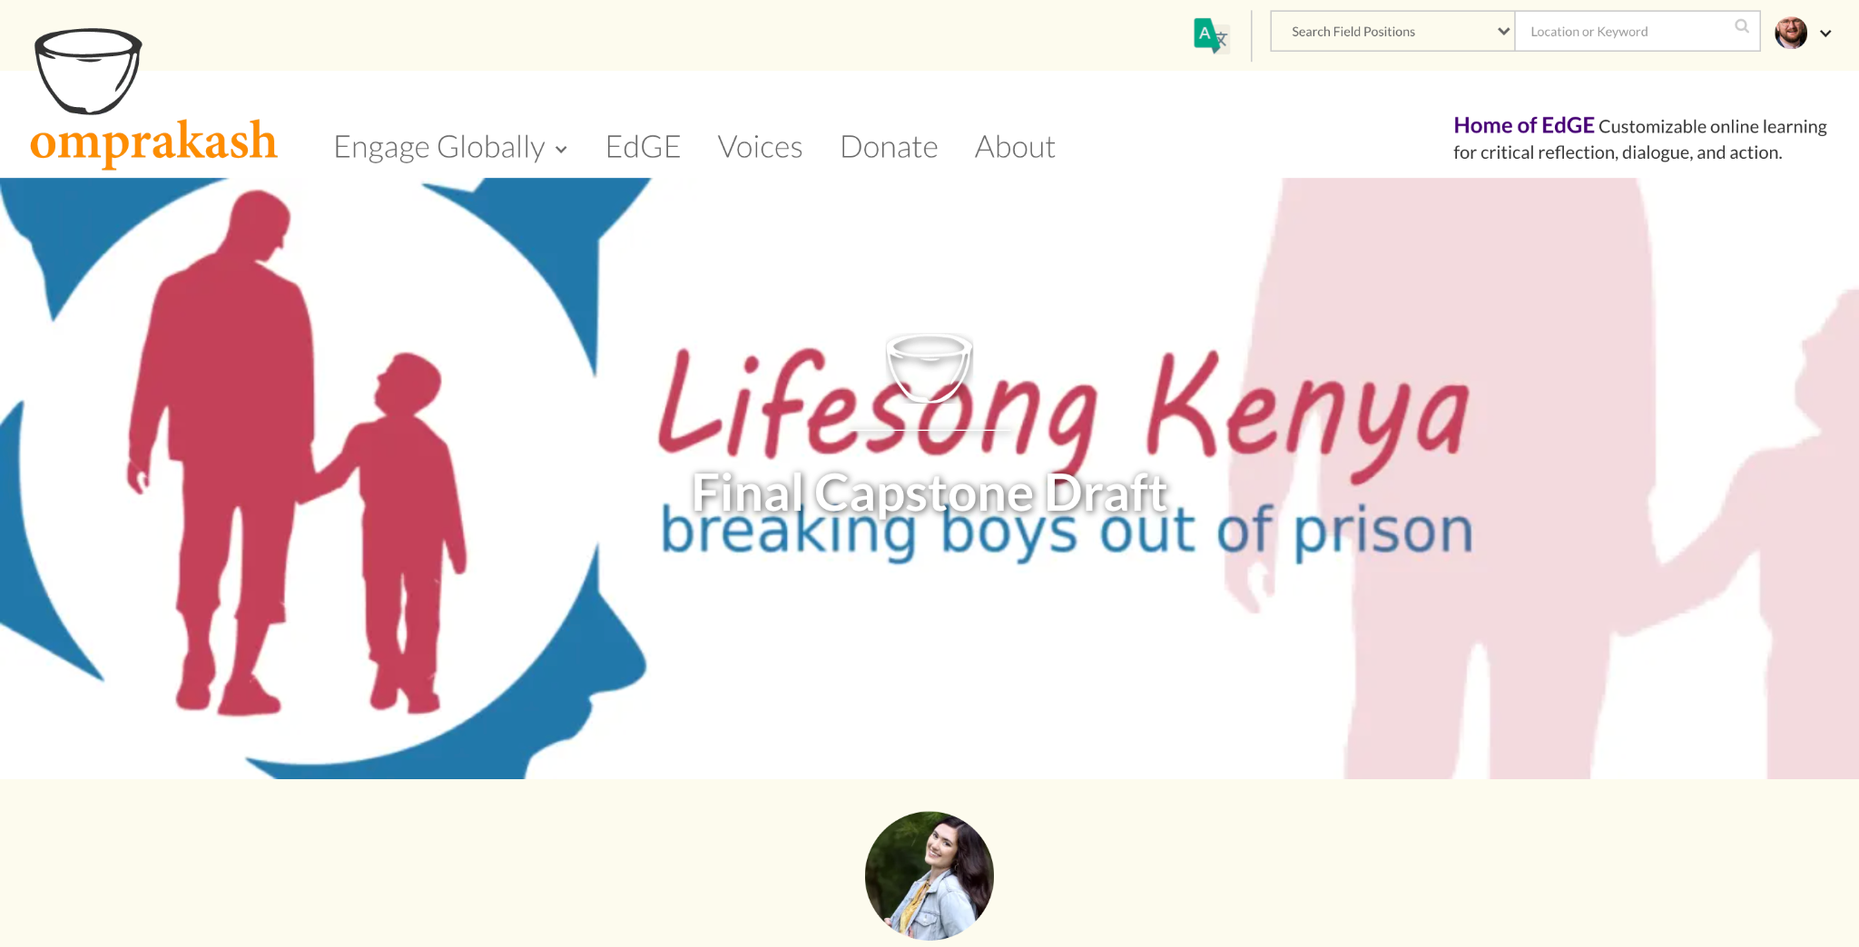
Capstone/Digital Portfolio
Student-derived (Program Approved)
This is a summative project to talk about your summer experience. Could be (but not limited to):
Research
Art (written, performative, drawn, digital, etc)
Media Project
Should
be centered on your experience and interests
Relate to one of the concentrations covered within the theory course

Slide 14
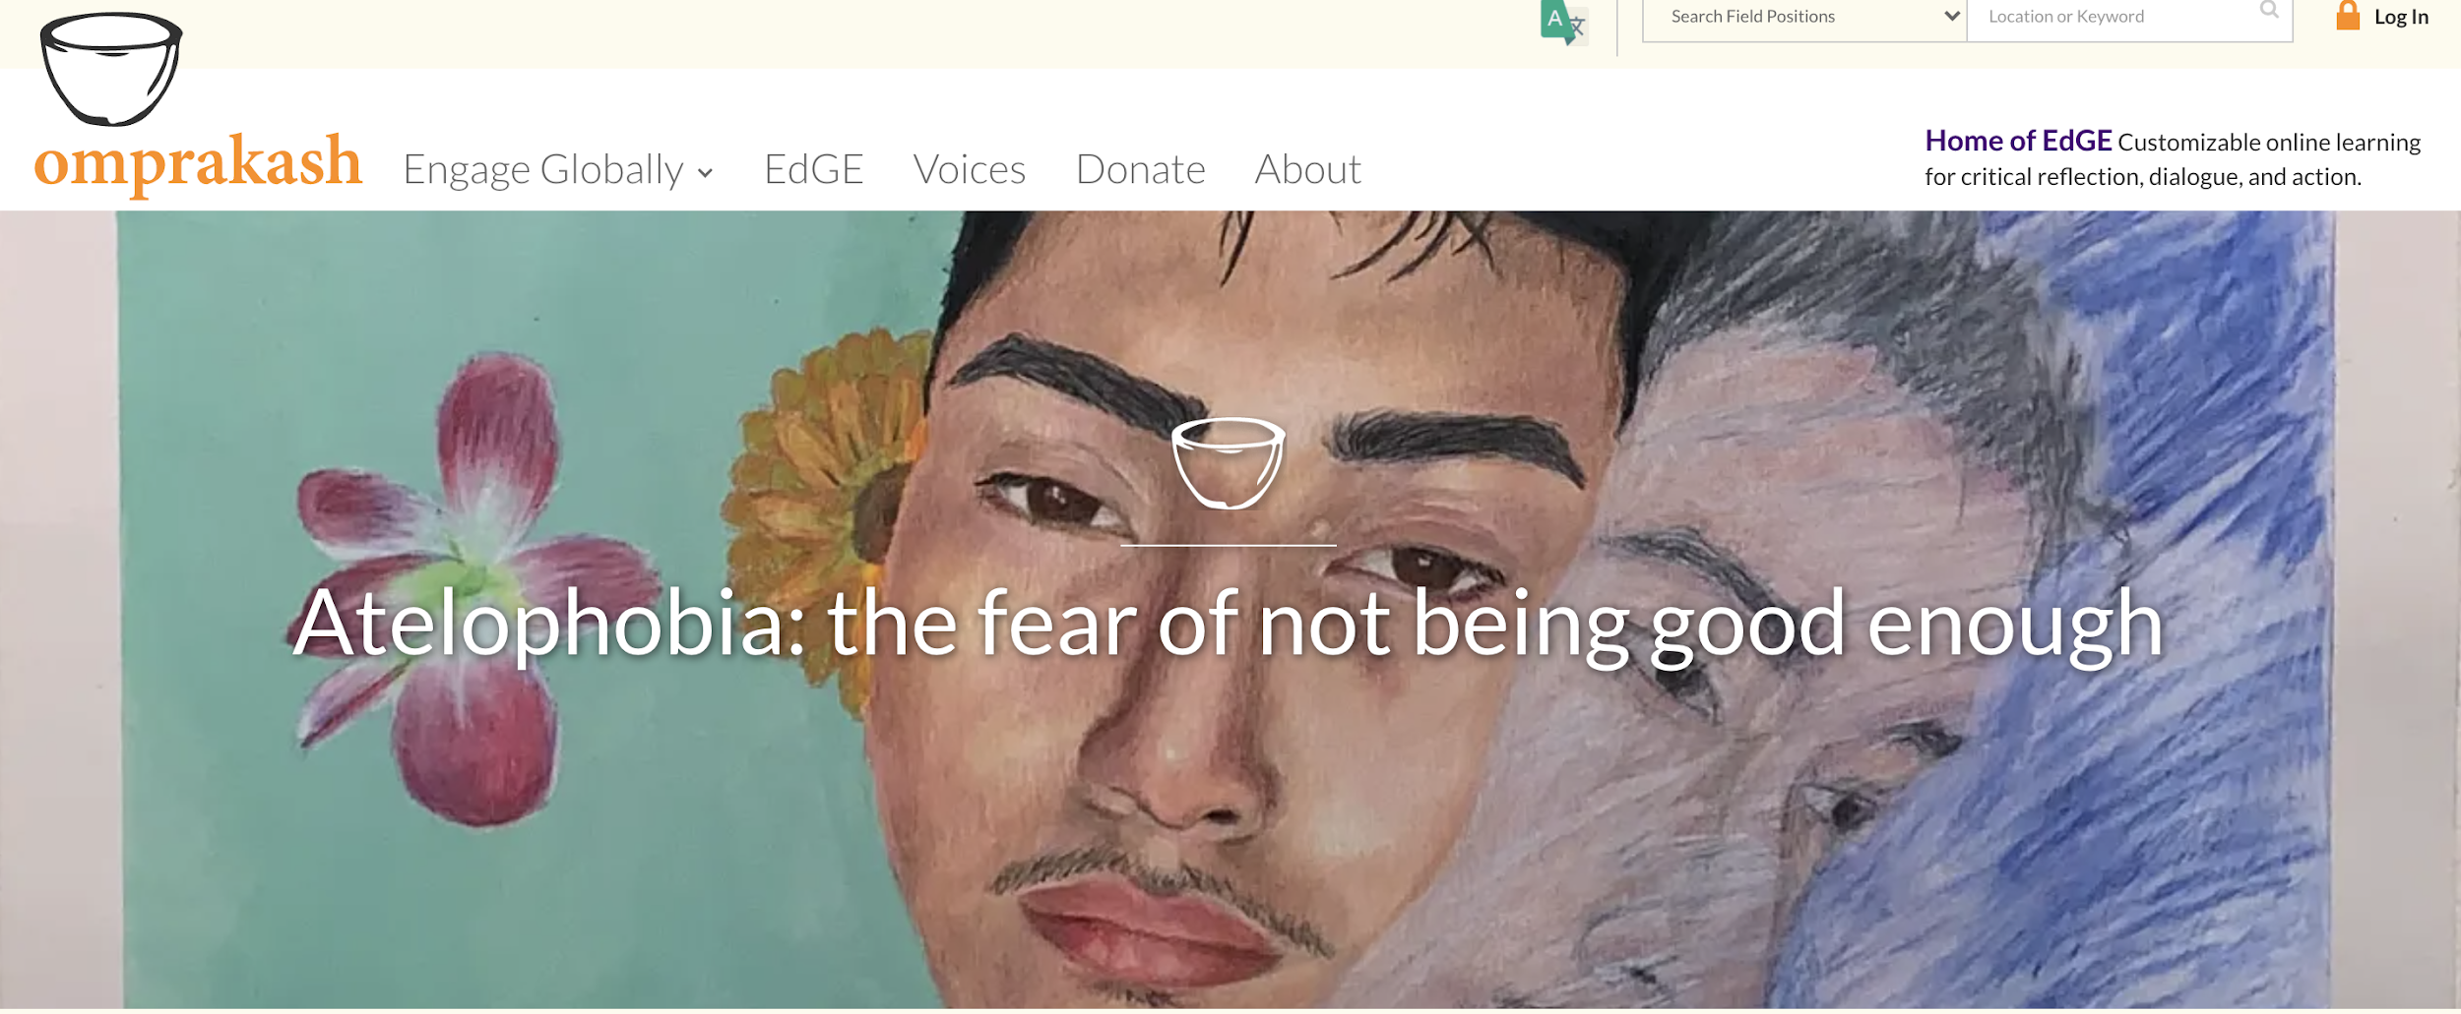
What’s it like to do a Capstone?
Let’s hear from a 2021 Global Scholar about their Capstones!
Examples:
Thalia (remote, innovation-centered domestic internship)
Alesia (face-to-face, domestic, public health/professional development experience)
Sarah (face-to-face, domestic, social-impact volunteering)
Annie (remote, international, social justice-related experience)

Slide 15
Reflection Course
Fall 2022 (periodic Fridays afternoons)
Goal: How to follow up on THAT?
Reflect on summer experiences
Formalize and complete students’ digital portfolios into presentable media to be shared at relevant university and scholarly events
Plan for future engagement (at FSU and beyond) based upon reflections and observations

Slide 16
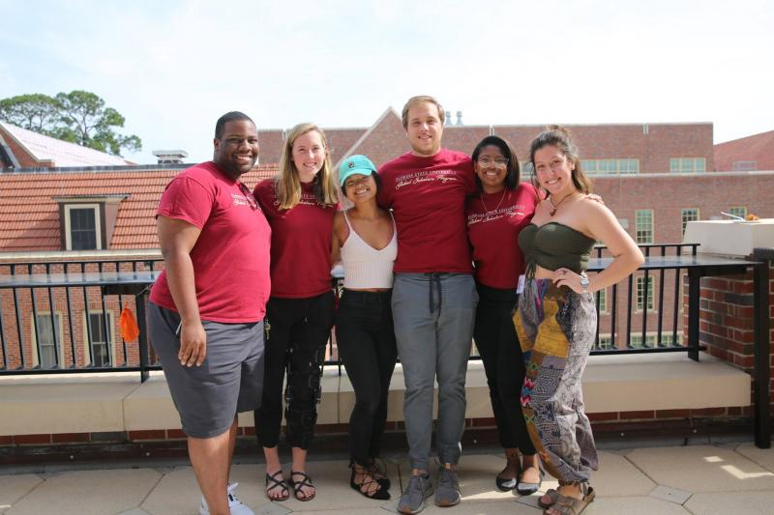
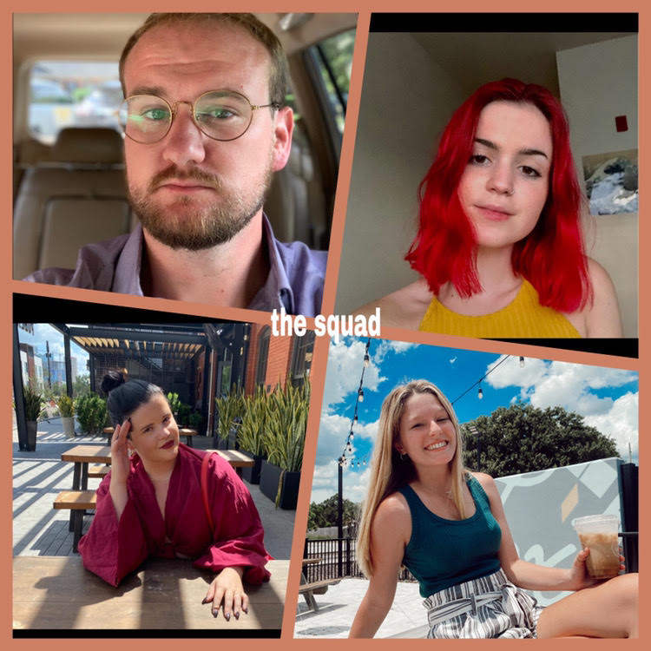
Mentorship
Global Scholar Ambassadors:
Former Global Scholars
Gives insight during Theory and Reflection Course
Instructor check-ins to make sure that you can complete phases
2019 GSAs outside the Great Hall
2021 GSAs in Digital Collage

Slide 17
Application Process
All done online: https://fsu-cre.smapply.us/prog/global_scholars_2022
Questions will ask about:
You (fill in the blanks: name, major, etc)
Your interest in Global Scholars (1 matching, 4 short essays about your experience and interests)
How you heard about the Global Scholars Program
All applications are due November 7th at 11:59PM

Slide 18
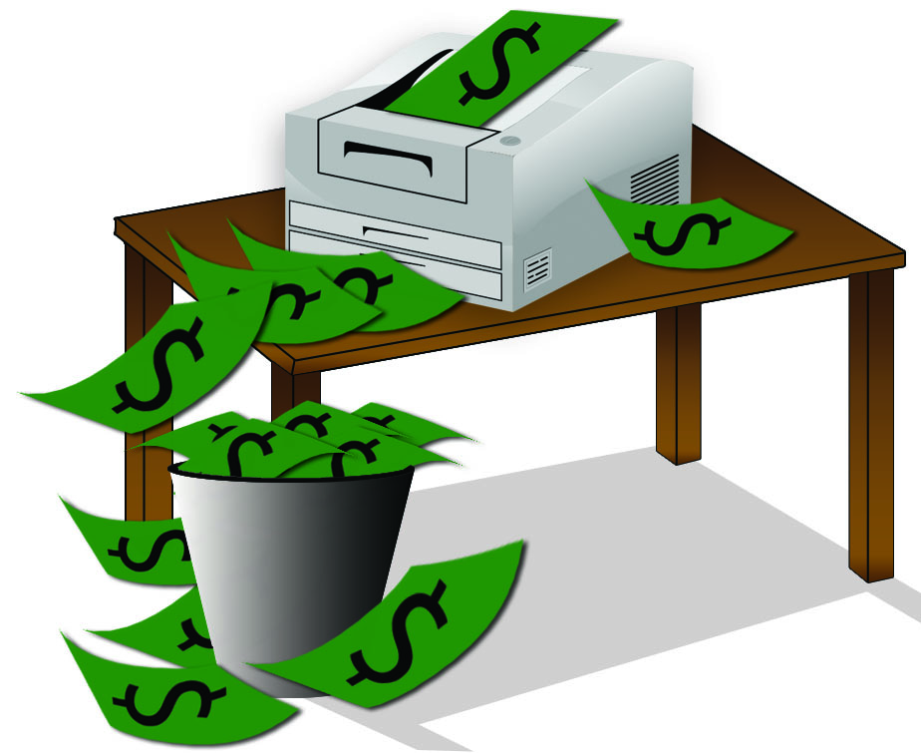
Funding
From CRE:
Up to $1000 offered in needs-based funding for Experience
Application to be completed during the Spring Course
Additional Partial Project Funding:
Office of National Fellowships (especially Gillman)
Moellership Program
IDEA Grants
Internship Fund
If qualified, can take up to 6 credits during summer experience to qualify for FASFA loans and Bright Futures (if applicable)

Slide 19
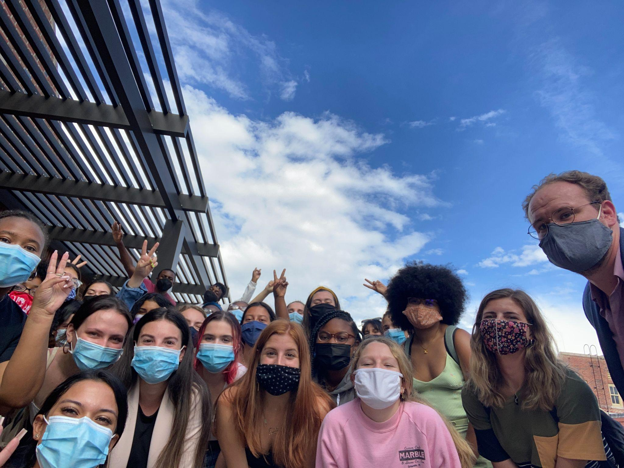
What’s it like to go through the program?!
Let’s hear what the program is like from one of the members of the 2021 cohort!
Audience questions?
2021 Global Scholars’ first day of the Reflection Course, during Fall 2021 in the HSF Great Hall

Slide 20
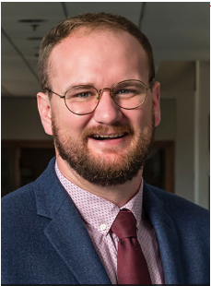
Contact Warren Oliver
Set up a meeting with Campus Connect
Email: boliver@fsu.edu
Phone: (850) 644-7420
Online: https://cre.fsu.edu/global/globalscholars

Slide 21
Florida State University
Contact the CRE Office
cre@fsu.edu
@CREFSU
(850) 645-9630
@CRE_FSU
www.cre.fsu.edu
@FSU_CRE
Notes:
21

